Slide 1
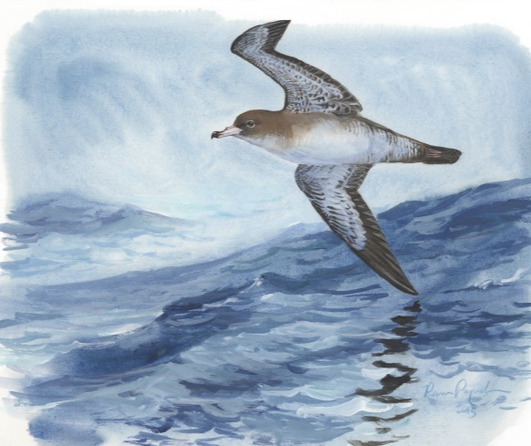
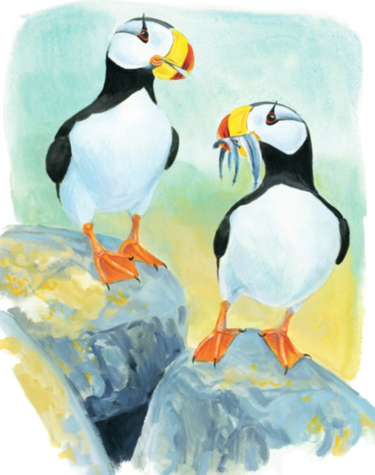
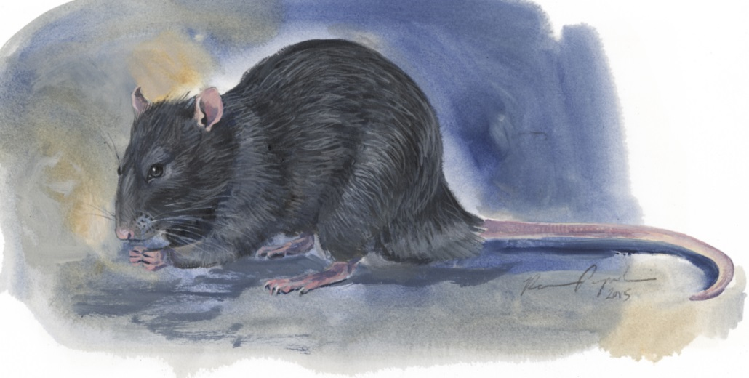
INVASIVE SPECIES AND SEABIRDS
Lesson: 3
Consequences
©Ram Papish

Slide 2
Key Concepts
Consequences of invasive species
Cost of invasive species
Scope of the problem
Rats and Islands

Slide 3
Invasive Species and Ecosystems
Invasive species affect native species and ecosystems in a number of ways:
Competition for food, water, space, and other resources
Predation through overconsumption of native species
Habitat alteration may cause severe reductions in native populations
Disease by acting as hosts for invasive viruses or pathogens
Parasitism by invasive species feeding on one or more native species, either killing or weakening them
Hybridization occurs when the invasive species reproduces with a closely related native species resulting in loss of diversity or extinction of the native species

Slide 4
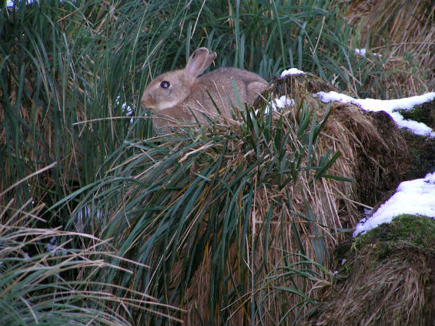
Consequences of Invasions
Competition: Invasive species may out-compete native species for food, water, and habitat.
European Rabbits, introduced as human food source, compete with seabirds for nesting burrows
Notes:
Image Source: Mental Floss, Messing with Mother Nature: The Macquarie Islands Ecosystem
http://mentalfloss.com/article/30307/messing-mother-nature-macquarie-island-ecosystem
European rabbits also overgraze vegetation, thus altering breeding habitat for seabirds, increase erosion rates, and can spread the seeds of invasive plant species.

Slide 5
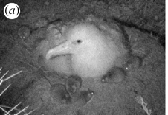
Consequences of Invasions
Predation – many native species did not evolve to respond to predators
Seabirds – ground or burrow nesting seabird eggs and chicks vulnerable to rats and mice
Image of a mice attacking Tristian Albatross chick, Gough Island, South Atlantic.
Notes:
Image Source: The Royal Society, Biology Letters, Can Predation by invasive mice drive seabird extinctions?
http://rsbl.royalsocietypublishing.org/content/3/3/241
Biodiversity: variety of life
Threats to biodiversity:
1. Habitat loss
2. Invasive species
Predators – invasive species may consume native species and their eggs or juveniles often preventing the native species from reproducing successfully and potentially causing extinction of the native species
e.g., brown tree snake introduced on the island of Guam , almost all vertebrates have disappeared from the island including birds, lizards, and bats

Slide 6
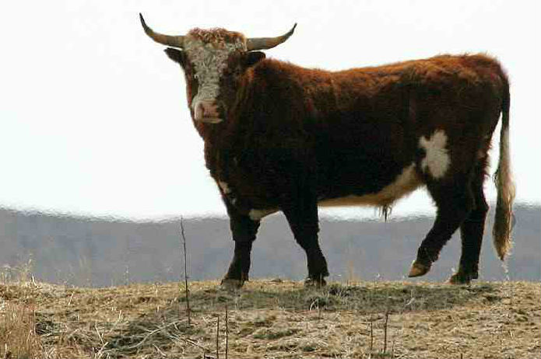
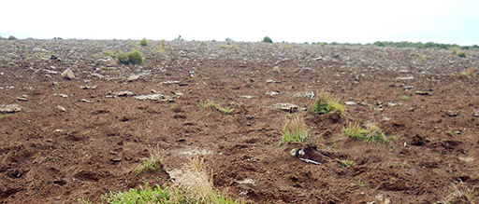
Consequences of Invasions
Habitat alteration – herbivores may change the structure and composition of a habitat and make it unsuitable for native species.
Cows on islands in Alaska
©Steve Ebbert/USFWS
©Steve Ebbert/USFWS
Adverse impact caused by grazing has caused heavy erosion along coastal areas. Chirikof Island, Alaska.
Notes:
Herbivores(e.g., cows and goats) alter the ecosystem in many ways not just through removing vegetation. Removal of vegetation reduces the biodiversity by removing habitat for small mammals, insects, and birds.
Image Source: U.S. Fish & Wildlife Service,
http://www.fws.gov/refuge/alaska_maritime/grazing.html
Both Wosnesenski and Chirikof islands, located in remote Southwest Alaska, are uninhabited and part of the Alaska Maritime National Wildlife Refuge. The Refuge was established in 1980 to conserve marine mammals, seabirds and other migratory birds, and the marine resources upon which they rely. Wosnesenski and Chirikof islands have sustained severe impacts to wildlife habitat, native vegetation, and archaeological sites from grazing by unauthorized cattle left behind when ranchers left the islands years ago.
Another Example:
Wild boar (USGS National Wetlands Research Center)
Habitat alteration– Feral hogs/pigs (Sus Scrofa) are invasive animals first introduced in the continental United States during the 1500s by European sailors. The animals are a problem across the Southeastern and the Western United States. Large numbers exist on Federal lands, including National Wildlife Refuges and National Parks, as a result of illegal releases and high reproductive rates. They are known to be the most prolific large mammal in North America. With adequate nutrition, breeding occurs throughout the year. Females often breed at less than a year old and can produce two litters in a year with an average of four to eight piglets per litter. Large predators of swine, such as wolves and mountain lions, have been extirpated from most of the area where feral swine range, leaving few natural controls. Feral swine are known to spread more than 30 diseases and 37 parasites, including swine brucellosis and pseudorabies, which can have devastating effects on livestock and wildlife.
Their impact can change entire ecological systems. Feral swine compete directly with many native animals such as deer, squirrels, ducks, turkeys, and bears for food and destroy habitat for many other wildlife species. They are omnivorous with a diet that includes ground-nesting birds, reptiles, and amphibians. Feral swine dig for food (rooting) and create wallows, thereby destroying vegetation and ruining water holes used by other wildlife. Rooting activities in marsh and other wetland habitats leads to increased erosion, displacement of native wildlife, loss of habitat value and quality, and destruction of sensitive vegetation. Damage is often severe and in some cases may be nearly irreversible. Rooting activities in forested habitats impact forest regeneration and vegetation structure and may lead to increases in invasive plants, including Chinese tallow tree and cogon grass. Severe rooting and damage has occurred on hurricane protection levees and other water control structures.

Slide 7
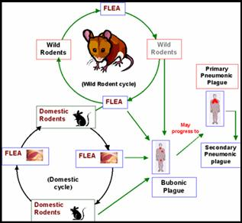
Consequences of Invasions
Disease carriers/introducers
Bubonic plague (Yersinia pestis) – bacterial infection transmitted by fleas usually carried by rats or rodents
Black plague – 14th century, 34 million human deaths in Asia and Middle East
Great plague – 17th Century (1655-66), London 65-100,000 human deaths, spread by Dutch trading ships
Notes:
Image Source: Columbia Edu, Introduced Species Summary Project, Bubonic Plague (Yersinia pestis),
http://www.columbia.edu/itc/cerc/danoff-burg/invasion_bio/inv_spp_summ/Yersinia_pestis.htm
Disease carriers/introducers – Pathogens and parasites may be invasive species or may be introduced by them (invasive vestors).
e.g., Bubonic plague – spread by non-native black rats carrying infected fleas.
The plague is typically spread from one rodent to another by fleas. When the flea loses its natural host it will find a new host within the existing environment.

Slide 8
Consequences of Invasions
Hybridization – invasive species mate with native species creating hybrids
Mallard ducks introduced around the world have hybridized and reduced the populations of the New Zealand gray duck, the Hawaiian duck, and the Florida mottled duck.
©K. Uyehara
The greatest threat to the future of the Koloa maoli as a unique species is cross-breeding with the introduced Mallard duck (A. platyrhynchos). This photograph shows feral Mallards, including “barnyard ducks,” at Wailoa River State Park on Hawai‘i.
Notes:
Image Source: USGS/UC Davis, K. Uyehara, http://pubs.usgs.gov/fs/2007/3047/
Example: Hawaiian Ducks and wild Mallard Ducks
USGS & University of California Davis: Hawaiian Duck’ Future Threatened by Feral Mallards
dlnr.hawaii.gov/wildlife/files/2014/01/USGS-Koloa-Factsheet.pdf
The Federally endangered Hawaiian Duck (Anas wyvilliana) ("Koloa maoli” or simply "Koloa" in Hawaiian), is an endemic species (found nowhere else on Earth) of the Hawaiian Islands. The greatest current threat to the future of the Koloa is cross-breeding or "hybridization" with the introduced Mallard (A platyrlzync!ws). The Mallard was brought to Hawai 'i for farming, sport hunting, and pond beautification,
but it escaped into the wild and became "feral.“
The Greatest Threats-Introduced Species and Hybridization
Introductions of nonnative species can bring species together that were previously geographically isolated and had separate gene pools. This is particularly a problem when "aggressive" introduced species, such as feral Mallards, come in contact with rare native species. Studies in other parts of the world have shown that feral Mallards are dominant ducks, adapted to survive and reproduce in habitats with human introduced predators. They also are well adapted to using habitats degraded by human activity. These factors may give feral Mallards a competitive edge over native ducks, such as the Koloa. When a Mallard and Koloa mate, they produce fertile, hybrid offspring. Because of this, interbreeding among hybrids, Mallards, and Koloa can over generations lead to loss of the Koloa as a unique island species.

Slide 9
Cost of Invasions
Invasive species cost the United States an estimated $120 billion/year.
Annually, black and Norway rats consume stored grains and destroy other property valued over $19 billion.
Annually, nonnative species (zebra mussels and quagga mussels) carried in the ballast or hulls of ships cost the Great Lakes Region $200 million to control.
U.S. agriculture loses $13 billion annually in crops from invasive insects, such as vine mealybugs.
If zebra and quagga mussels invade the Columbia River in Washington State, they could cost hydroelectric facilities alone up to $250-300 million annually.
Notes:
Information Source: U.S. Fish and Wildlife Service, The Cost of Invasive Species
http://www.fws.gov/home/feature/2012/pdfs/CostofInvasivesFactSheet.pdf
For more information see: Zebra Mussel FAQs, USGS
http://fl.biology.usgs.gov/Nonindigenous_Species/Zebra_mussel_FAQs/zebra_mussel_faqs.html
Zebra mussels (Dreissena polymorpha) and quagga mussels are in invasive species from Eurasia. Zebra mussels were first discovered in the Lake St. Clair (east of Detroit, Michigan) in 1988, they have since spread, mostly by ballast water in ships and barges, to the large rivers of the Mississippi River drainage, from the headwaters in Minnesota to the mouth at the Gulf of Mexico. Quagga mussels (Dreissena bugensis) , a close relative of zebra mussels, were first detected in Lake Mead on the Colorado River and have since spread to Arizona and Nevada.
Planktonic zebra and quagga mussels enter hydroelectric equipment through water intakes. The mussels attach and quickly grow to maturity clogging pipes. A female zebra mussel can lay over one million eggs in a single spawning season. Once attached to a hard surface they are extremely hard to remove, an unusual trait for fresh water mussels.
Cleaning hydroelectric pipes contaminated with zebra mussels costs millions of dollars.

Slide 10
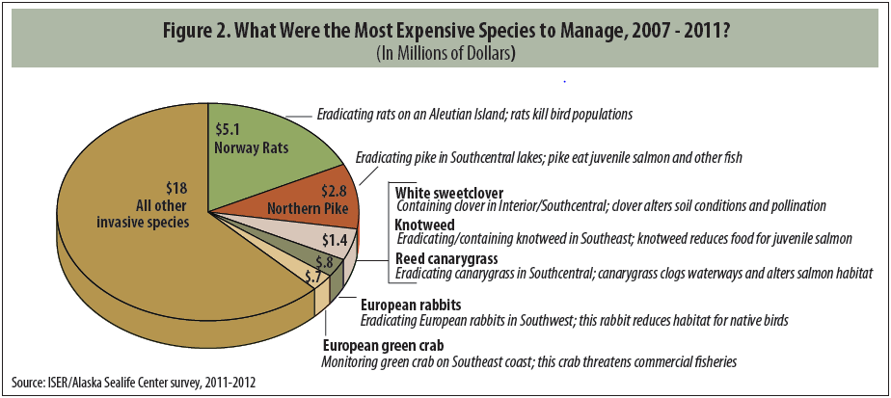
Cost of Invasions
Cost of invasive species in Alaska
Notes:
Image Source: Managing Invasive Species: How Much Do We Spend?, Tobias Schworer (ISER), Rebekka Federer and Howard Ferren (Alaska SeaLife Center)
ISER=Institute of Social and Economic Research, University of Alaska Anchorage

Slide 11
Scope of the problem
42% of threatened or endangered species are at risk because of invasive species
43% of the world’s critically endangered animals breed on islands
75% of threatened birds on oceanic islands are experiencing population declines due to invasive species
80% of species extinctions have occurred on islands
92% of island breeding threatened seabirds face threats from invasive species
Notes:
Source: USFWS Cost of Invasives Fact Sheet

Slide 12
Scope of the problem
One of the most significant threats to biodiversity.
Global map showing the number of harmful alien species by coastal ecoregions. The darker red shades indicate a greater number of species with a high impact on the local ecology. The blue color indicates ecoregions with alien species that have been described as less harmful. Source: Molnar et al. 2008
Notes:
Source: Molnar et al. 2008
According to the International Union for Conservation of Nature the most significant threats to biodiversity are listed below.
Habitat loss and degradation
Invasive Alien Species
Over-exploitation of natural resources
Pollution and disease
Human induced climate change
For more information see the IUCN webpage on biodiversity.
http://www.iucn.org/what/biodiversity/about/

Slide 13
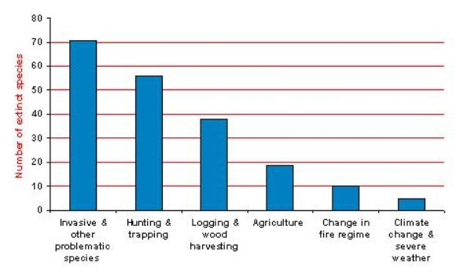
Scope of the problem
Invasive alien species implicated in nearly 50% of recent bird extinctions
Number of extinct species
Invasives & other problematic species
Hunting & trapping
Logging & wood harvesting
Agriculture
Change in fire regime
Climate change & severe weather
The major threats contributing to bird extinctions since 1500 (Bird Life International).
Notes:
Image Source BirdLife International, http://www.birdlife.org/datazone/sowb/casestudy/127
Analysis of data held in BirdLife’s World Bird Database (2008).

Slide 14
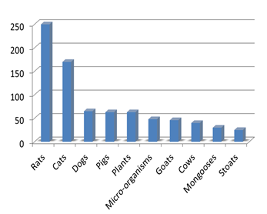
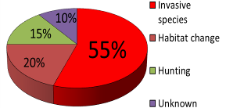
Scope of the problem
Island habitats are of particular concern:
75% of bird species found on islands are threatened by invasive species
80% of documented extinctions occurred on islands
Causes of recent bird extinctions on Islands (Bird Life International)
Number of globally threatened bird species affected by different types of invasive species. (Adapted from BirdLife's World Bird Database, 2008).
Notes:
Figure Source: Pacific Invasive Species Initiative, Benefits of Eradication
http://rce.pacificinvasivesinitiative.org/intro/Benefits_of_Eradication-Threat.html

Slide 15
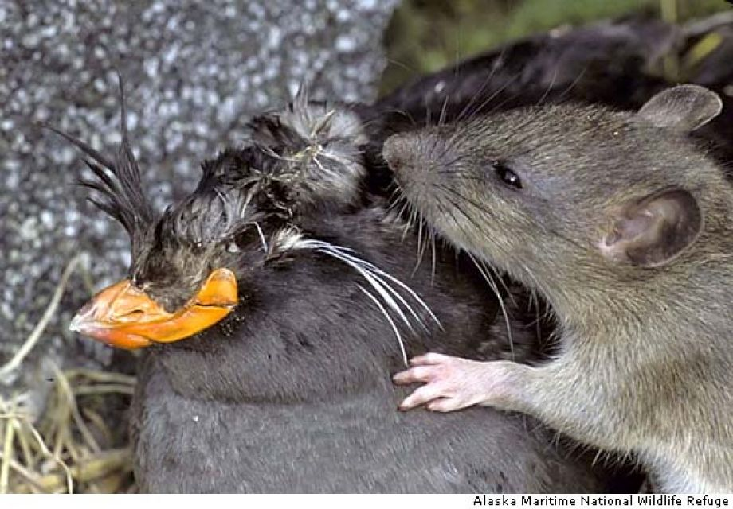
Rats
Rats have characteristics needed to be a successful invasive species including:
Generalist, eating a wide variety of foods
Adapt well to a wide variety of habitats
Mature and reproduce quickly
Migrate, spread, and colonize quickly
Aggressive and efficient predators
Image of a rat predating a Parakeet Auklet.
Notes:
Image source: Alaska Maritime National Wildlife Refuge

Slide 16
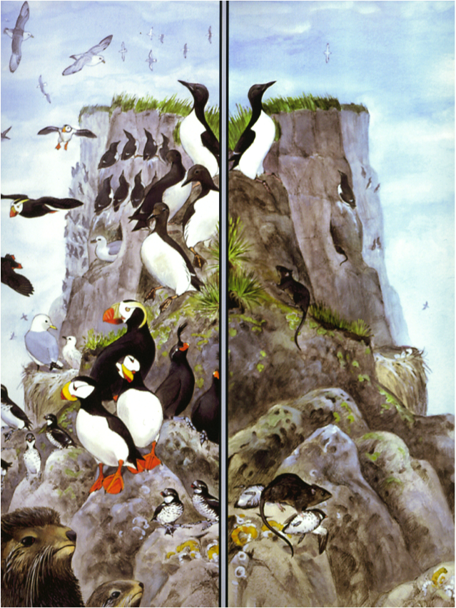
Rats and Islands
Impacts of rats on an island ecosystem
Predation on seabirds, seabird eggs, and chicks cause severe population declines
No Rats
Rats
©Ram Papish
Notes:
Illustration: ©Ram Papish
Rats have reached 80% of the worlds islands.
Rats in islands with seabirds prey mainly on seabird eggs and chicks causing the population to decline.

Slide 17
Rats and Islands
Impacts of rats on an island ecosystem
Eat plants and other native species that can change the vegetation community.
Affect the productivity of the island indirectly by interrupting the flow of nutrients from ocean to land that is normally in the form of seabird guano.
Carry parasites and pathogens that can affect other species including humans.
Effective dispersers of seeds of invasive plant species.
Notes:
Seabird guano: the excrement of seabirds

Slide 18
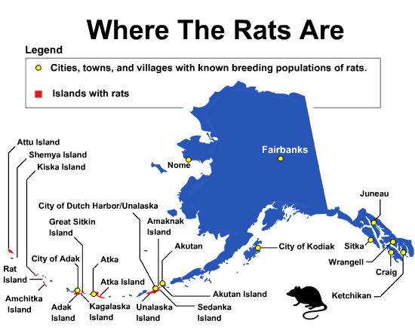
Rats and Islands of Alaska
1780: Norway rats accidently introduced to Hawadax (formerly Rat Island), Alaska, from a Japanese shipwreck.
Distribution of rats in Alaska by Alaska Department of Fish and Game.
Notes:
Image Source: ADF&G, http://www.adfg.alaska.gov/index.cfm?adfg=invasiveprofiles.norwayrat_distribution
U.S. Fish and Wildlife Service (http://www.fws.gov/refuge/alaska_maritime/what_we_do/partnership/rat_island.html)
“Though Rat Island is a remote island in the Aleutian chain about 1,300 miles west of Anchorage, invasive Norway rats arrived via a 1780's shipwreck preying on native birds and altering the native vegetation during the ensuing 220 years. The Rat Island restoration is the most recent project in a long campaign to restore otherwise healthy seabird habitat in the Aleutians.”
ADF&G
In Alaska, rats are responsible for significant losses of ground-nesting seabirds. For example, hundreds of dead auklets have been found in rat dens on formerly rat-free Kiska Island in the western Aleutians.

Slide 19
Summary
Worldwide, invasive species cost an estimated $143 billion/year. Invasions impact habitats, industries, jobs, and human health.
Invasive species impact an ecosystem in a variety of ways including through: competition, predation, habitat alteration, disease, parasitism, and hybridization.
Invasive species are especially harmful to island habitats, with 75% of island bird species now threatened.
18

Slide 20
Resources & References
Alaska Maritime National Wildlife Refuge
www.fws.gov/refuge/alaska_maritime/
Alaska Department of Fish and Game
www.adfg.alaska.gov/
Island Conservation
www.islandconservation.org/
International Union for Conservation of Nature
www.iucn.org/
Coastal Conservation
www.coastalconservation.org
Oikonos
http://oikonos.org/
19
Notes:
If your computer is connected to the Internet, you can use the Hyperlinks (purple text) to connect directly to the associated website.
Hyperlinks to websites
Place the cursor anywhere in the purple text
Right click
Select Hyperlink
Select Open Hyperlink

