Slide 1
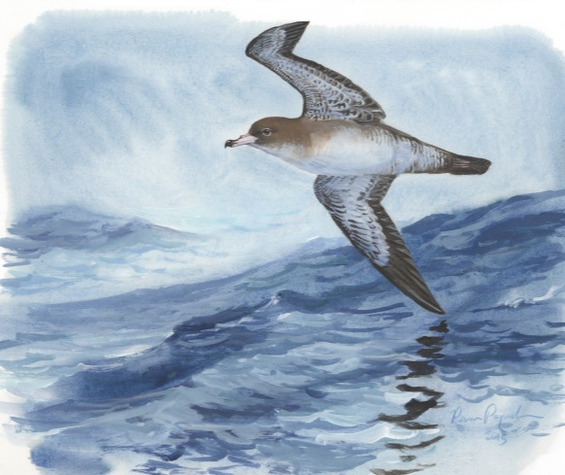
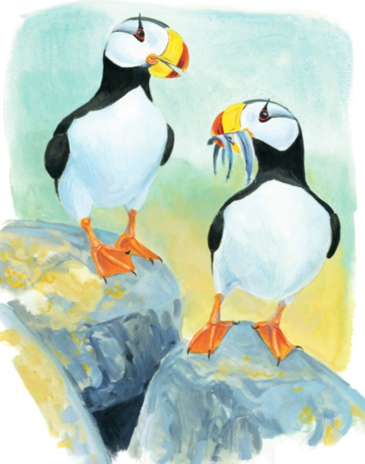
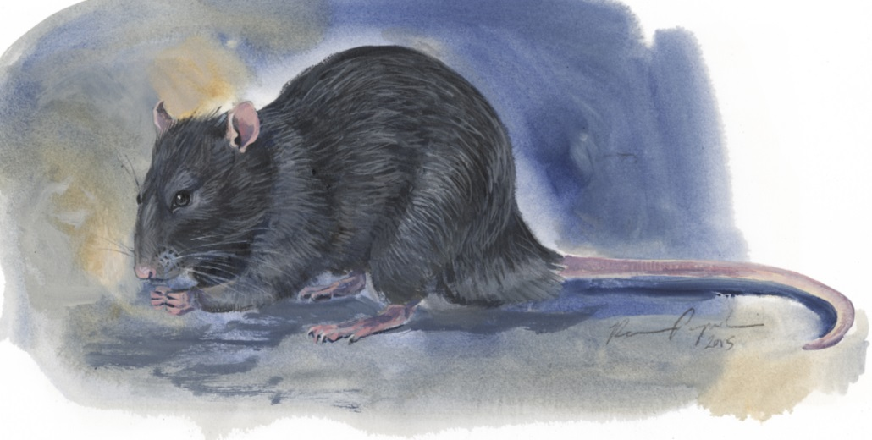
INVASIVE SPECIES AND SEABIRDS
Lesson:4
Stewardship and
Biosecurity
©Ram Papish

Slide 2
Key Concepts
Environmental stewardship
Protecting the environment
Learning about threats to a healthy ecosystem, e.g. invasive species
How to achieve biosecurity
Formulating an invasive species prevention plan
Implementing the plan
Detecting invasive species so action can be taken
Examples of biosecurity plans
Lesson 4: Stewardship and biosecurity
Notes:
1
Lesson 2: Consequences

Slide 3
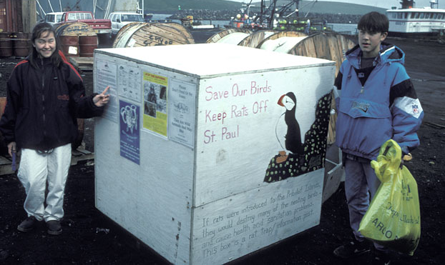
Environmental Stewardship
What is environmental stewardship?
Historically: People caring for the region in which they lived by sustainably harvesting food and resources
Current: Sustainable living, protecting the environment, and learning about potential threats to native ecosystems such as invasive species
St. Paul Island Students educating the public about rats.
Lesson 4: Stewardship and biosecurity
Notes:
Photo: St. Paul Island students educating the public about rats and seabirds.
2
Lesson 2: Consequences

Slide 4
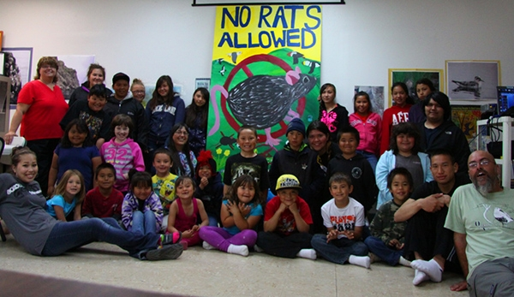
Environmental Stewardship
Protecting against invasive species requires campaigns that include entire communities
Governmental agencies
General public
Tourists
Lesson 4: Stewardship and biosecurity
Notes:
Photos:
Puffin - https://pixabay.com/en/puffins-alcids-birds-fratercula-263157/
Classroom campaign - www.seabirdyouthnetwork.org. St. Paul seabird camp
3
Lesson 2: Consequences

Slide 5
Biosecurity
Biosecurity: actions designed to deal with invasive species within a particular area
Biosecurity Plan: provides guidance to the public and land managers
Key components
Prevention
Detection
Response
Lesson 4: Stewardship and biosecurity
Notes:
Image source: ©Pam Goddard, St. Paul Island Harbor
4
Lesson 2: Consequences

Slide 6
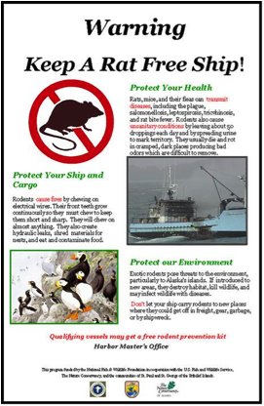
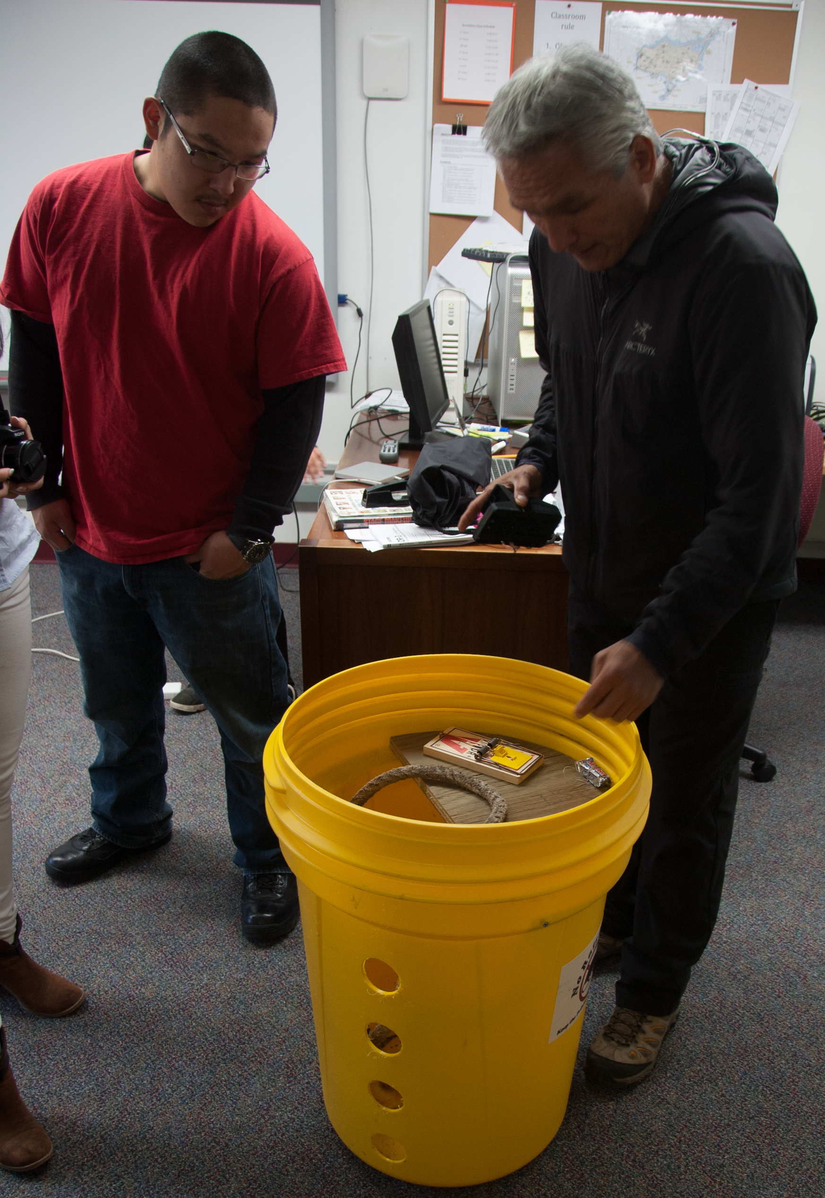
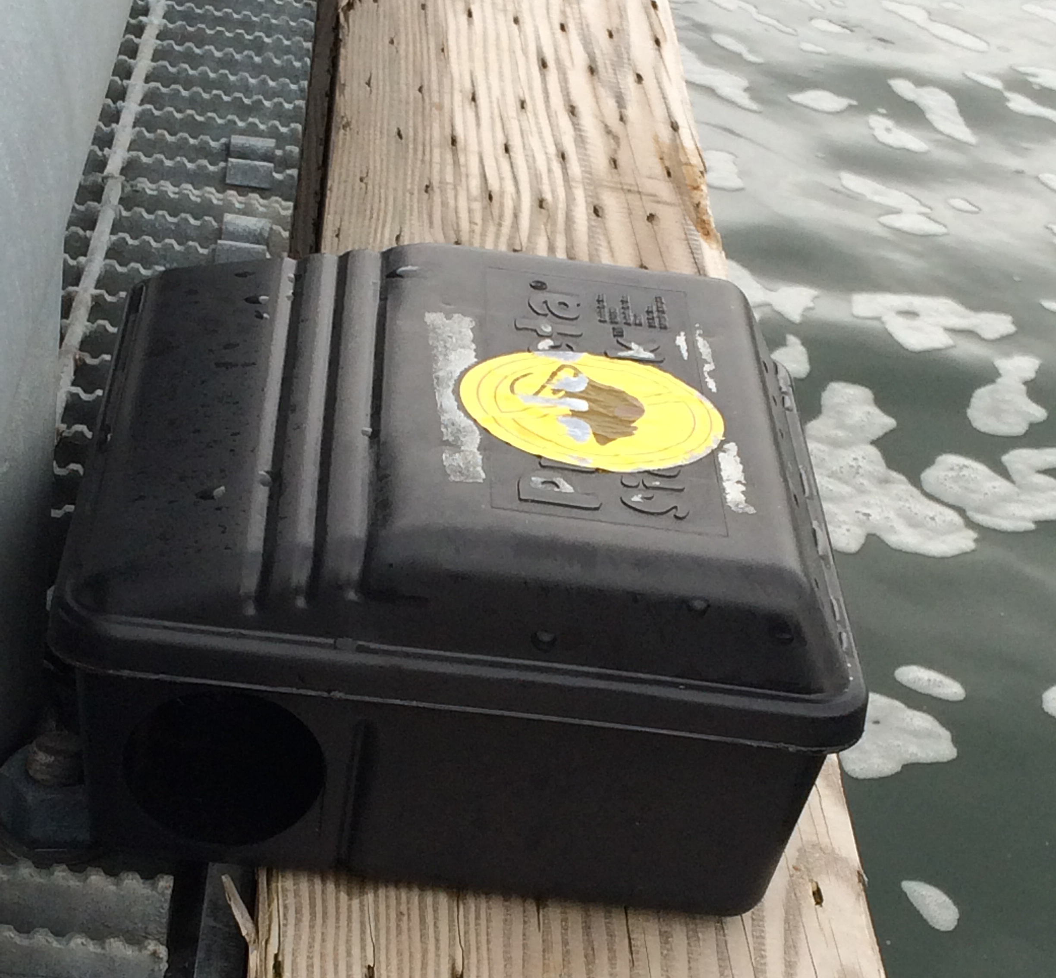
Biosecurity - Prevention
Prevention includes:
Education (signs, ads, personal contact)
Rules for visitors
Surveillance (traps)
Government policies and legislation
St. Paul Island school invasive species prevention training.
Rat traps, St. Paul Island harbor
Lesson 4: Stewardship and biosecurity
Notes:
Images: ©Pam Goddard, Thalassa, St. Paul Island, Bering Sea Days 2015
St. Paul Island Ecosystem Conservation Office, Pribilof Islands Aleut Community of St. Paul Island
New harbor construction and industrialization in the Pribilof Islands in the 1990's seemed to make rat introductions a certainty unless a preventive measures were taken. In 1993, in cooperation with the local communities of St. Paul and St. George, we initiated a preventive program. The main components include harbor defenses and outreach. Over the years, nine Norway rats have been found dead on St. Paul, 4 in snap traps, 1 poisoned, 1 drowned at the harbor, 2 taken by fox, and 1 dead on a boat.
5
Lesson 2: Consequences

Slide 7
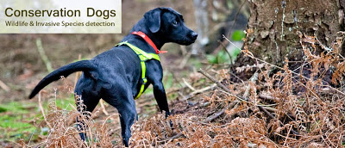
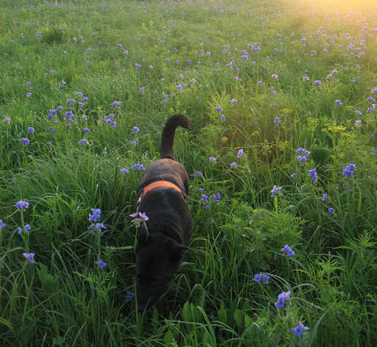
Biosecurity: Detection
Arrival of a single or small number of individuals of an invasive species is called an incursion.
Detection tools:
Tracking methods
Remotely operated cameras
Detection dogs
Bait stations
Traps
Working Dogs for Conservation
Lesson 4: Stewardship and biosecurity
Notes:
Photo: Conservation Dogs, http://www.conservationdogs.com/
Photo: Working Dogs for Conservations, http://wd4c.org/
6
Lesson 2: Consequences

Slide 8
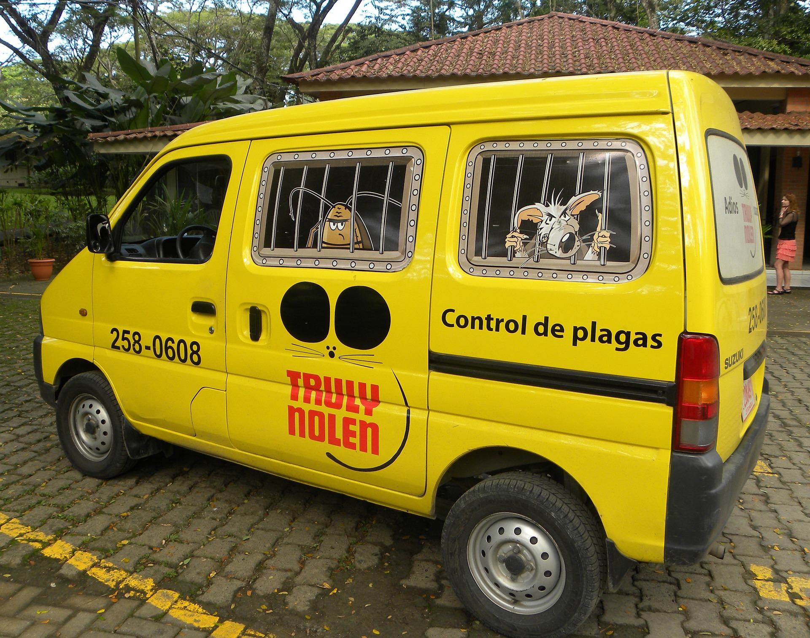
Biosecurity: Response
Following detection, rapid response is critical!
The biosecurity plan will outline actions to be taken.
Goal: completely rid the area of the invader before it has time to establish.
Lesson 4: Stewardship and biosecurity
Notes:
Example: Following a rat incursion on a seabird island, steps will include details on how to:
Eliminate the invader
Monitor progress
Photo: Pest control company van - https://pixabay.com/en/pest-control-mosquitoes-insect-rat-802231/
7
Lesson 2: Consequences

Slide 9
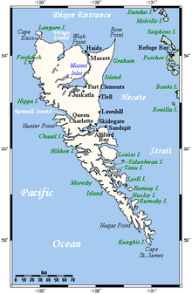
Biosecurity : Example 1
Bird areas of Haida Gwaii, B.C.
An estimated 1.5 million seabirds from 13 species nest on more than 200 offshore islands, islets, and rocks.
The accidental introduction of rats to several of the islands has resulted in seabird declines.
Government agencies and environmental groups have initiated both eradication programs and biosecurity plans.
Lesson 4: Stewardship and biosecurity
Notes:
- 19 seabird areas have a special designation for being globally important.
Image:
https://en.wikipedia.org/wiki/Haida_Gwaii
Lesson 2: Consequences
8

Slide 10
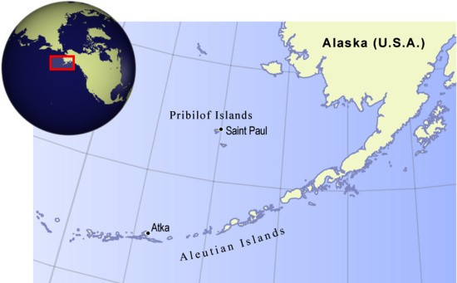
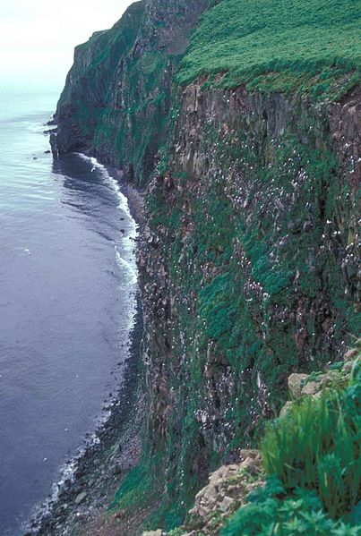
Biosecurity: Example 2
Pribilof Islands, Alaska
Home to large populations of breeding seabirds and unique non-bird species.
80% of the world’s population of Red-legged Kittiwakes nest there.
©GRID-Arendal
Lesson 4: Stewardship and biosecurity
Notes:
Image: Seabirds nesting on St. George Island. Photo by Vernon Byrd, US Fish and Wildlife. http://digitalmedia.fws.gov/cdm/singleitem/collection/natdiglib/id/5483/rec/4
Lesson 2: Consequences
9

Slide 11
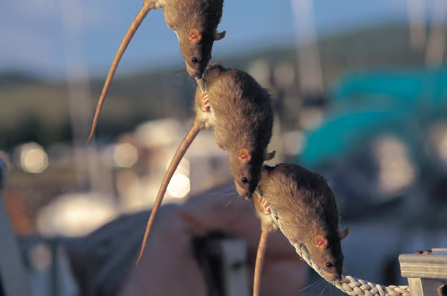
Biosecurity: Example 2
Pribilof Islands, Alaska
Rats are biggest threat due to ship traffic.
A rodent invasion prevention program was initiated in 1993. Islands remain rat free.
Community has made it harder for rats to find food and shelter.
St. Paul Island Rat trap
Lesson 4: Stewardship and biosecurity
Notes:
Images: From presentation posted by Alaska Seagrant - https://seagrant.uaf.edu/map/conservation/rats/rattalkharbormaster-web.pdf
Lesson 2: Consequences
10

Slide 12
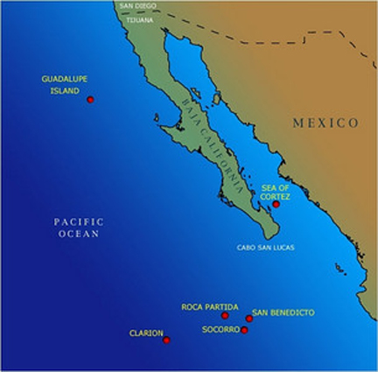
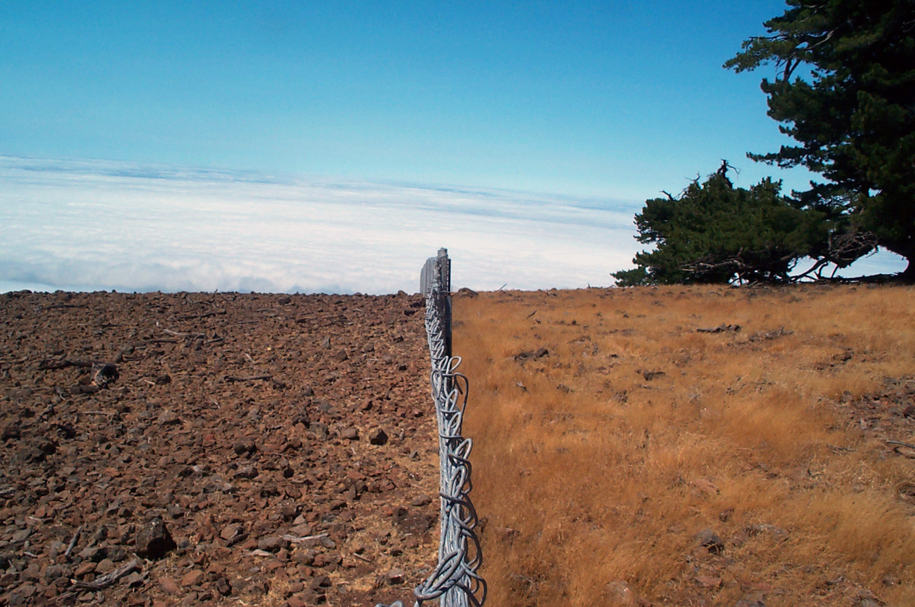
Biosecurity: Example 3
Guadalupe Island, Mexico
Goats introduced by sailors over 100 years ago ate all of the local plants.
Goat population grew to over 10,000 animals.
Goats were removed from the island by 2007.
Within a year native plants started growing again.
Goats No Goats
Lesson 4: Stewardship and biosecurity
Notes:
Image source: Island Conservation
Lesson 2: Consequences
11

Slide 13
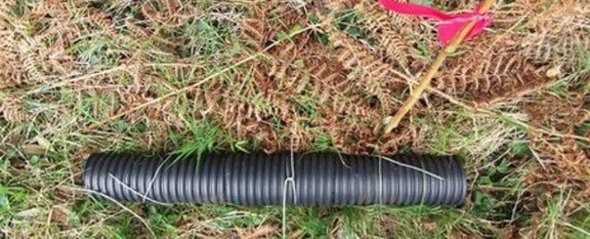
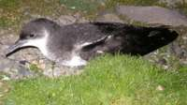
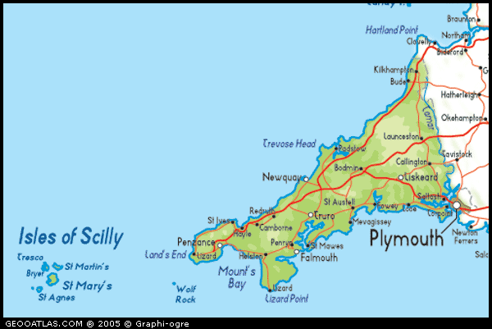
Biosecurity: Example 4
Isles of Scilly, Great Britain
Rats were the biggest threat.
A rodent eradication program was initiated in 2013.
The largest community-supported island restoration project in the world.
Biosecurity plan includes educating community members and schools on importance of prevention.
Rat trap
Manx Shearwater (Puffinus puffinus)
Lesson 4: Stewardship and biosecurity
Notes:
Image Source: http://www.bbc.com/news/uk-england-cornwall-24583514
More information on rat removal can be found on the PelGar International web page. https://www.pelgar.co.uk/news/rats-ahoy
Lesson 2: Consequences
12

Slide 14
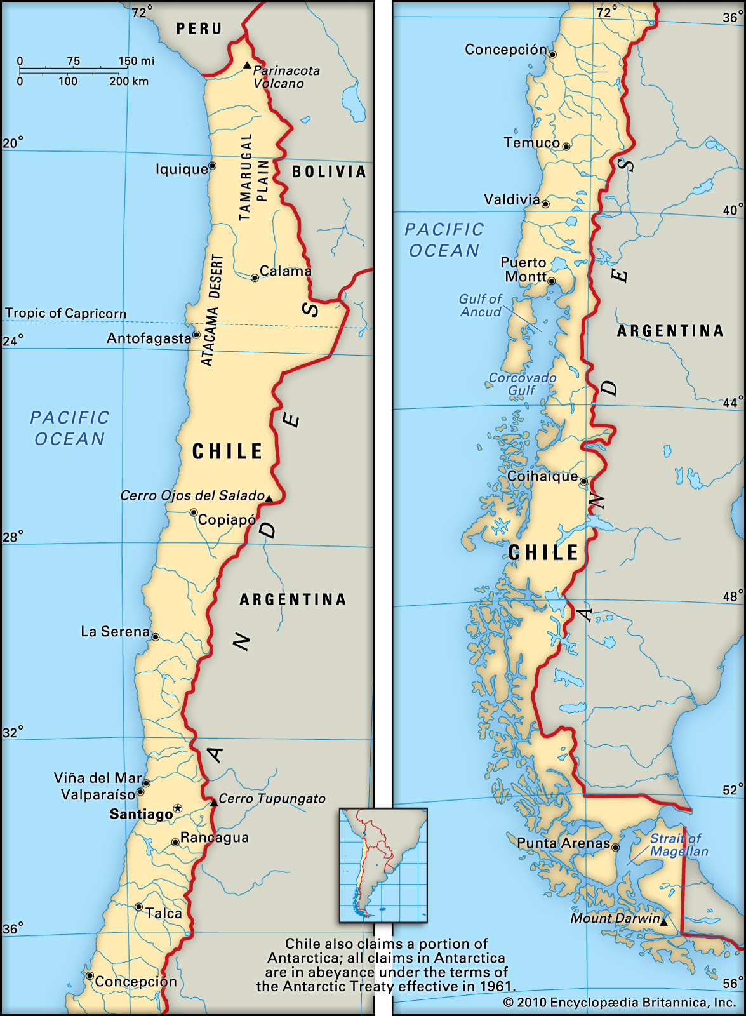
Southeast Pacific: Juan Fernández
Juan Fernández Islands, Chile
One of the most ecologically vulnerable ecosystems in the world
Volcanic archipelago and national park
15 bird species live there, six of which are globally threatened
Biosecurity plan includes community and government partners
Goal of full eradication by 2020
Lesson 4: Stewardship and biosecurity
Notes:
Image Source: Encyclopedia Britannica
Lesson 2: Consequences
13

Slide 15
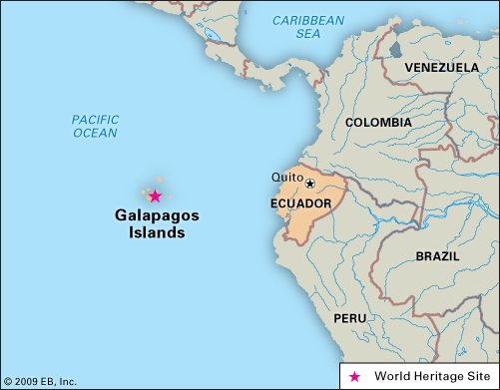
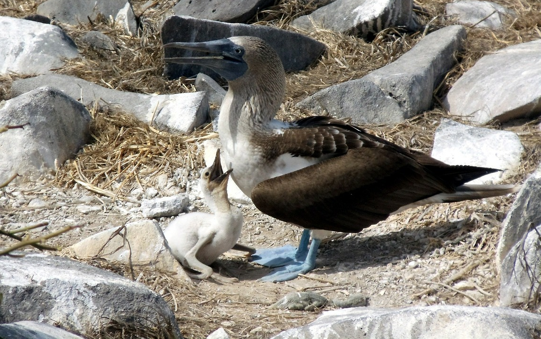
Biosecurity: Example 6
Galapagos Islands, Ecuador
Many visitors increase the threat for the introduction of invasive species.
Biosecurity plan includes three components: inspection and quarantine, control and eradication, and outreach to awareness.
Students participate in projects to monitor invasive species.
Blue-footed booby (Sula nebouxii), Galápagos Islands, Ecuador
Lesson 4: Stewardship and biosecurity
Notes:
Image source: Galapagos birds - https://pixabay.com/en/blue-footed-boobie-bird-baby-163755/
Image source: Galapagos Islands map, Kids Encyclopedia Britannica (http://kids.britannica.com/elementary/art-138983/Galapagos-Islands-Ecuador-designated-a-World-Heritage-site-in-1978)
Lesson 2: Consequences
14

Slide 16
Summary
Environmental stewardship: sustainable living, caring for the environment, threat awareness.
Biosecurity plans: communities can address the threat of invasive species through prevention, detection and response.
Biosecurity plans: proven effective at fighting invasive species threats, especially on islands.
©Pam Goddard, Thalassa
St. Paul Island Students learn about rat prevention.
Lesson 4: Stewardship and biosecurity
Notes:
Image: ©Pam Goddard, Thalassa, Bering Sea Days 2015, St. Paul Island, Alaska
Lesson 2: Consequences
15

Slide 17
Resources & References
Alaska Sea Grant
https://seagrant.uaf.edu/map/conservation/rats/rattalkharbormaster-web.pdf
Galapagos Conservancy
http://www.galapagos.org/conservation/biosecurity/
Island Conservation
http://www.islandconservation.org/
Ecosystem Conservation Office, Pribilof Islands Aleut Community of St. Paul Island
https://www.facebook.com/St.PaulIsland
Lesson 4: Stewardship and biosecurity
Notes:
If your computer is connected to the Internet, you can use the Hyperlinks (purple text) to connect directly to the associated website.
Hyperlinks to websites
Place the cursor anywhere in the purple text
Right click
Select Hyperlink
Select Open Hyperlink
16
Lesson 2: Consequences

Slide 18
Resources & References
PelGar International, Isles of Scilly
https://www.pelgar.co.uk/news/rats-ahoy
BBC, Isles of Scilly rat eradication
http://www.bbc.com/news/uk-england-cornwall-24583514
Global Invasive Species Database, goats
http://www.issg.org/database/species/ecology.asp?si=40&fr=1&sts=sss&lang=EN
Lesson 4: Stewardship and biosecurity
Notes:
If your computer is connected to the Internet, you can use the Hyperlinks (purple text) to connect directly to the associated website.
Hyperlinks to websites
Place the cursor anywhere in the purple text
Right click
Select Hyperlink
Select Open Hyperlink
17
Lesson 2: Consequences

