Slide 1
Lesson 1: Seabird Basics
SEABIRDS
Ann Harding¹ and Tonia Kushin²
Ram Papish
Notes:
¹Ann Harding, Auk Ecological Consulting: a.m.a.harding@gmail.com
²Tonia Kushin, Pribilof School District: toniakushin@gmail.com

Slide 2
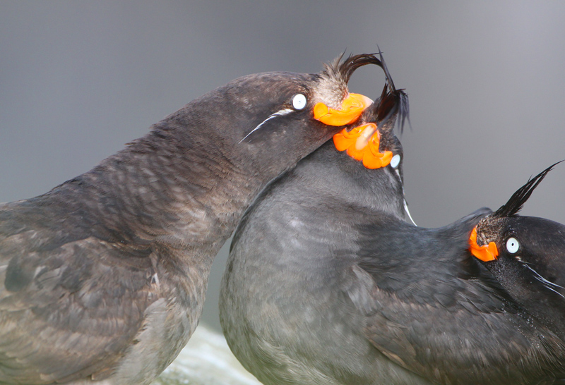
What makes a bird a seabird?
Seabirds spend most of their life at sea
They find their food out at sea
But, they all need to come to land to breed
crested auklet © Ram Papish
Notes:
A seabird is a bird that spends most of its life at sea. Although all seabirds breed on land, they find their food out at sea, and some even sleep on the water.

Slide 3
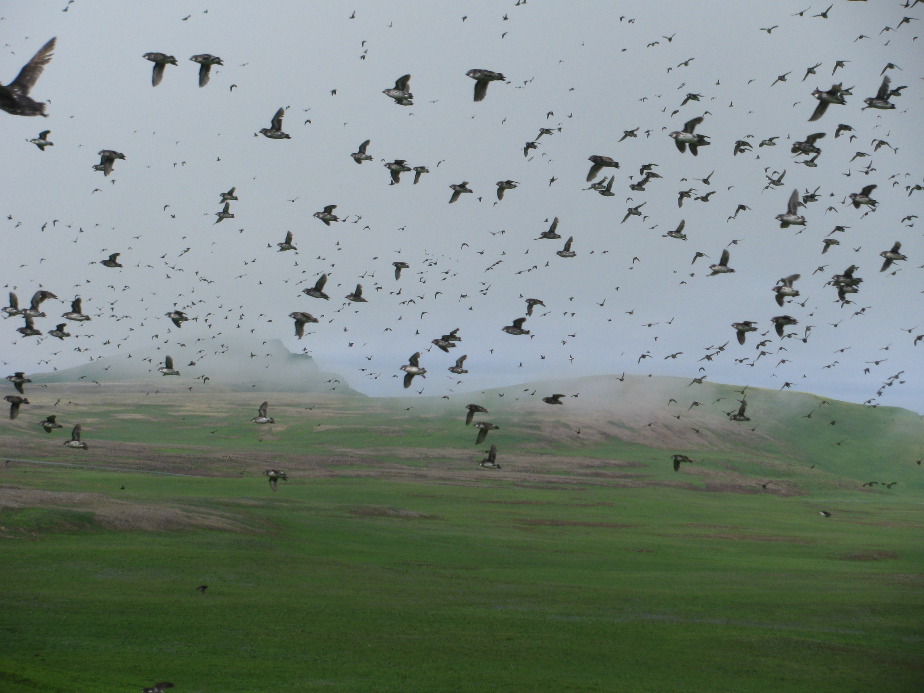
Despite huge variation among different species, they all share similar characteristics
THEY ALL HAVE ADAPTATIONS FOR LIFE AT SEA

Slide 4
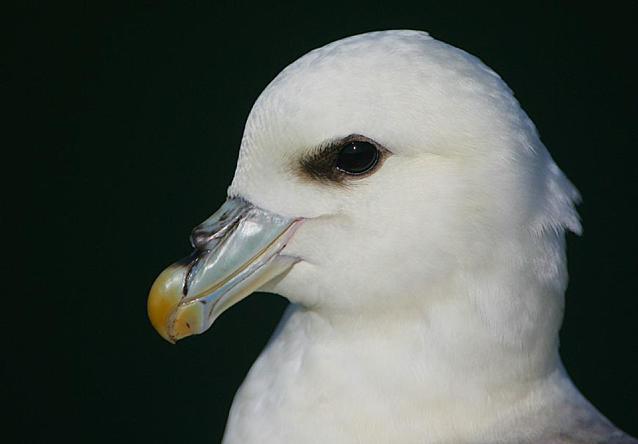
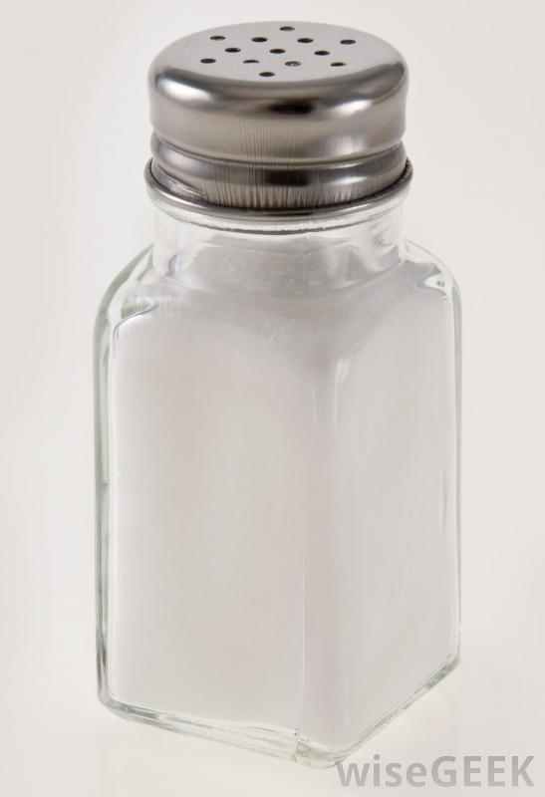
PHYSICAL ADAPTATIONS
SALT GLANDS
Imagine drinking only sea-water!
Salt glands (Uropygial glands) on their head concentrate the salt
When lots of salt has built up, it either flows out of the gland (out the nostril), or the bird “sneezes” it out!
© Steve Garvie
northern fulmars: nostrils on top of bill

Slide 5
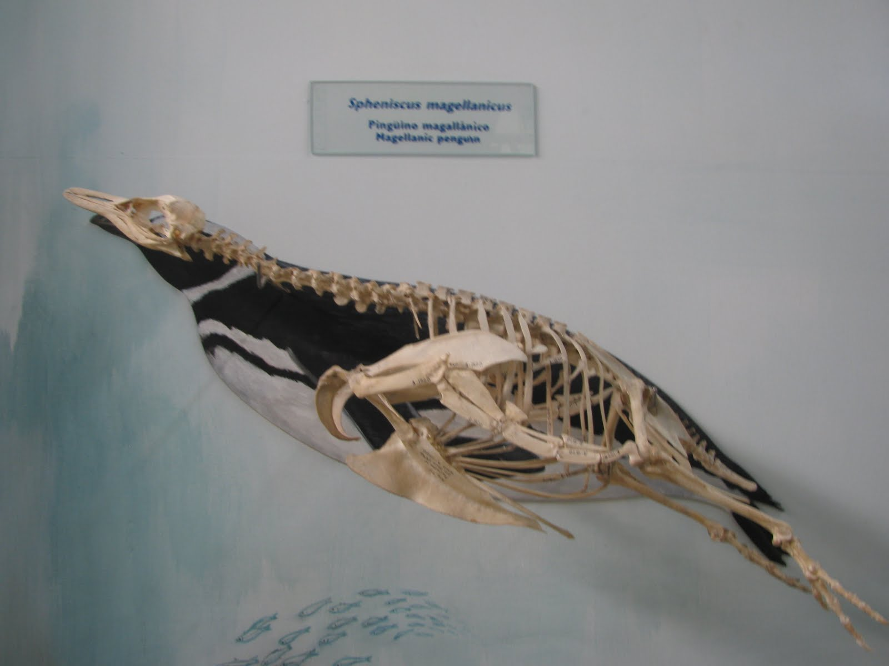
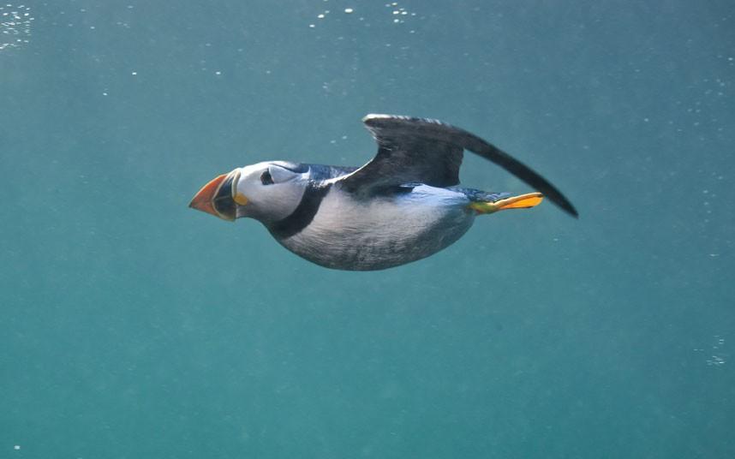
DENSE BONES
Many diving seabirds (like penguins) have dense bones to reduce buoyancy when they dive deep for food
© Alex Mustard
Atlantic puffin swimming underwater

Slide 6
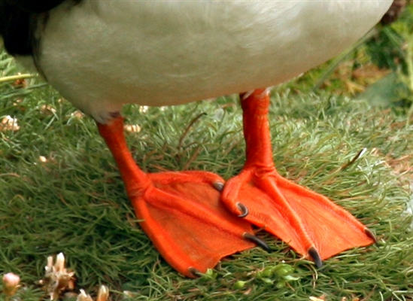
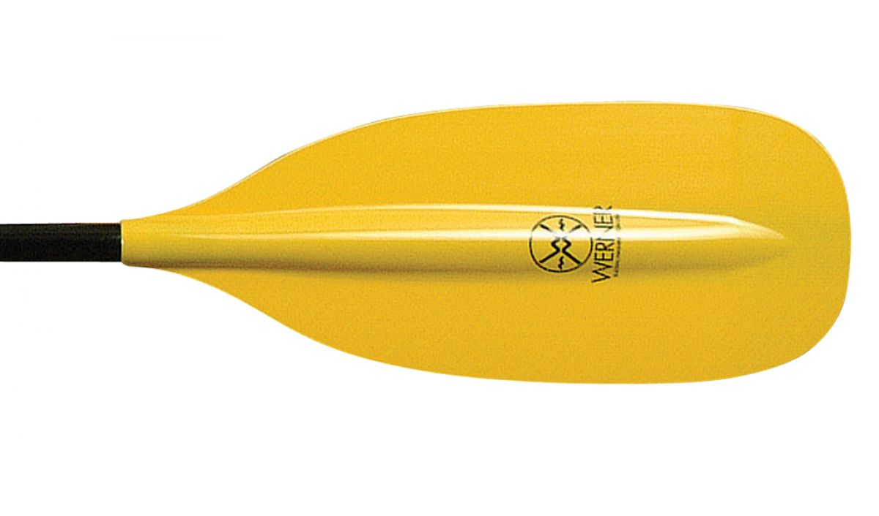
FEET AND LEGS
Shape and size of feet and legs can tell us a lot about a seabird
Species that spend a lot of time on the ocean (like puffins) usually have short, strong legs and webbed feet that act as paddles.
Atlantic puffin feet

Slide 7
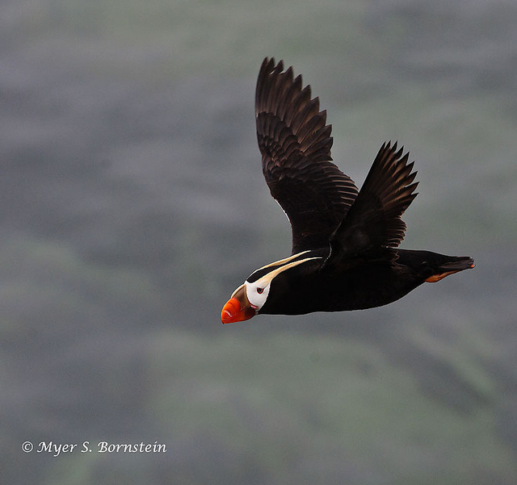
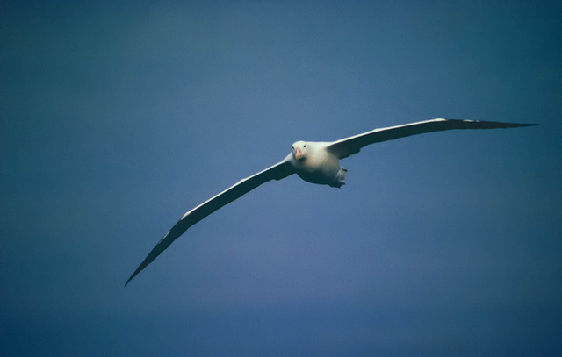
WINGS
Wing shape can tell us a lot about a seabird’s feeding behavior
Diving species (like puffins) have short strong wings that act as paddles
Penguins can’t fly at all!
Species that fly great distances have long slender wings
Wandering albatross have a wingspan (wing tip to wing tip) of over 11 foot!
© Mario QU, via Creative Commons.
tufted puffin
wandering albatross

Slide 8
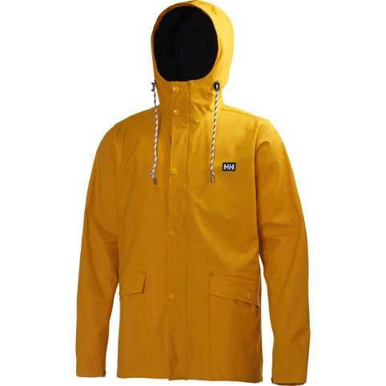
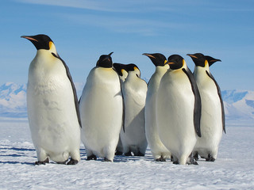
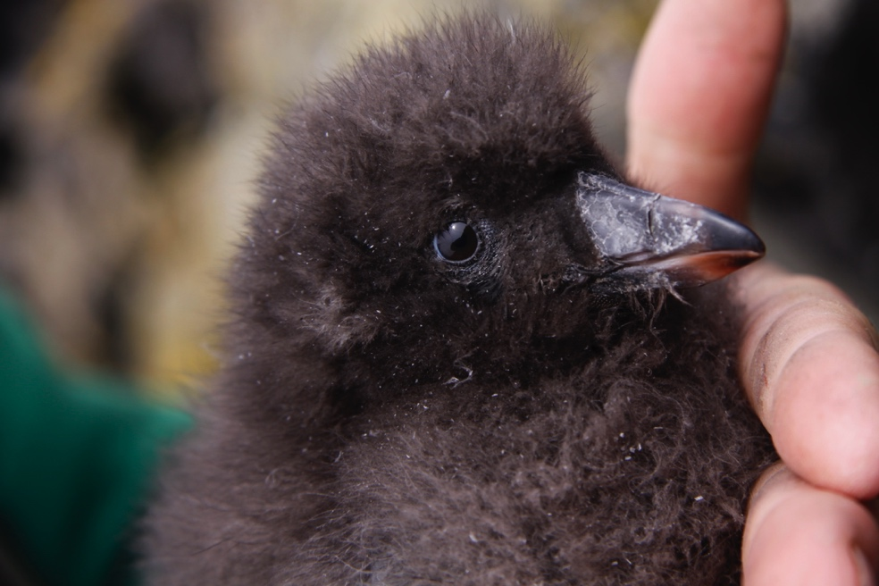
WATERPROOF COAT
Many seabirds spend most of their life in very cold water
Thick layers of down and feathers keep them warm and dry
A special gland releases oil to keep feathers waterproof
© Sandwichgirl
© Ram Papish
emperor penguin
tufted puffin chick

Slide 9
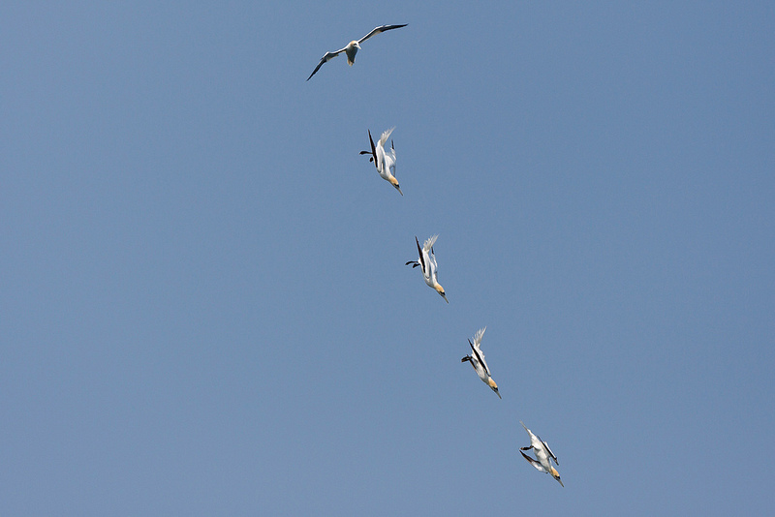
HEAD STUCTURE
Some species have specialized adaptations to their head for high impact diving.
Gannets dive into the ocean from heights up to 130 feet!
Reach speeds of 60-90 mph when they hit the water
Gulp in air as they descend
Fill up air sacks around the neck and shoulder to protect them when they hit the water.
© Keith Marshall, via Creative Commons
gannets diving for food
Notes:
Check out this video of gannets feeding
https://www.youtube.com/watch?v=D8vaFl6J87s

Slide 10
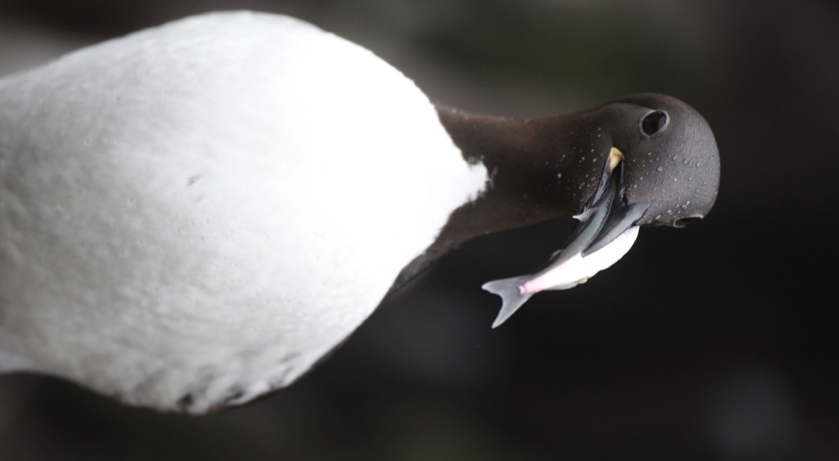
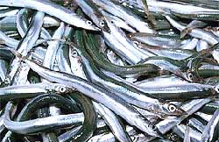
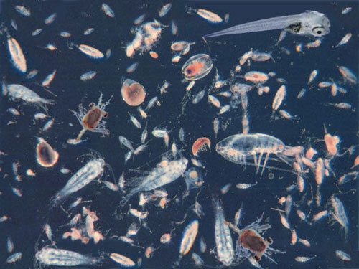
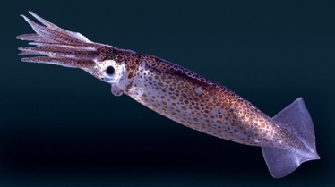
BEHAVIORAL ADAPTATIONS
Seabirds have specialized behavior to help them live and feed in the marine environment
DIET
Seabirds eat mostly fish, squid, and zooplankton
© Ram Papish
common murre with fish for chick

Slide 11

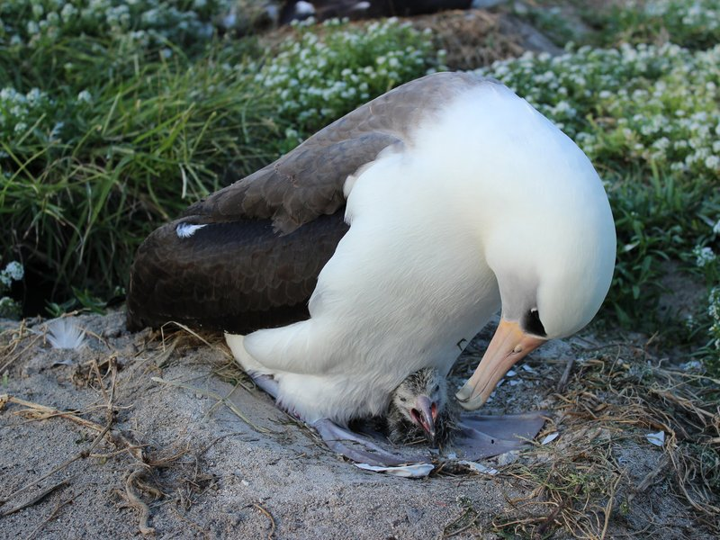
LONG-LIVED
Most seabirds live a long time (between 20-60 years!)
© USFWS/Anna Bell
Wisdom the albatross (the world’s oldest known wild bird) is over 65 years old (born in 1951), and she just had another chick!

Slide 12
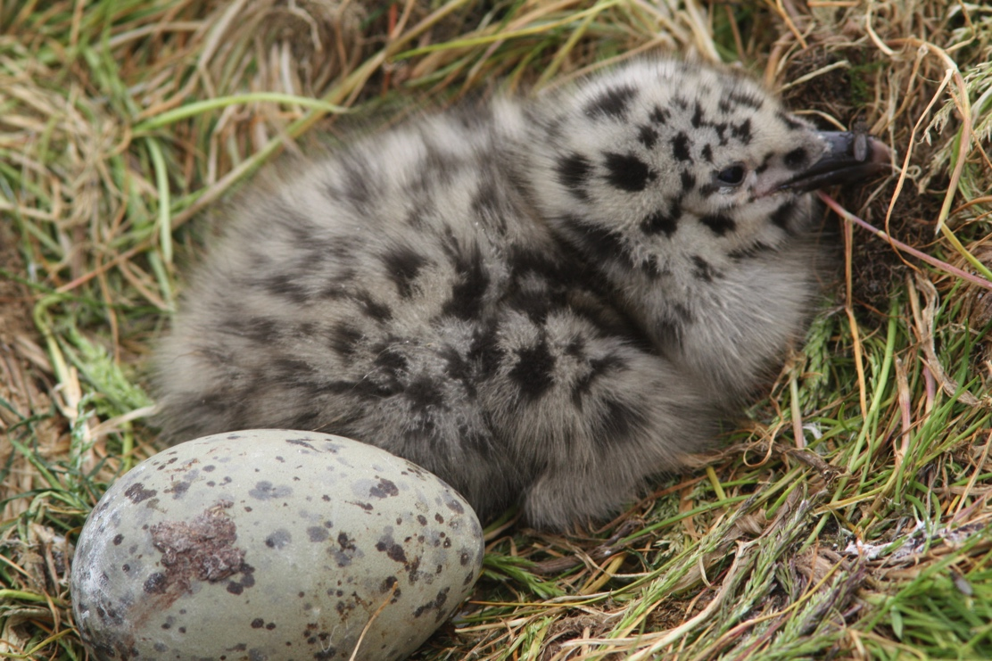
FEW CHICKS
Seabirds generally have few chicks (1-3), and often do not start breeding until later on in life (2-10 years old).
© Chris Barger
glaucous-winged gull chick
Notes:
These traits likely evolved because of unpredictable marine conditions, challenges of finding food at sea, and the relative lack of predation compared to land-birds

Slide 13

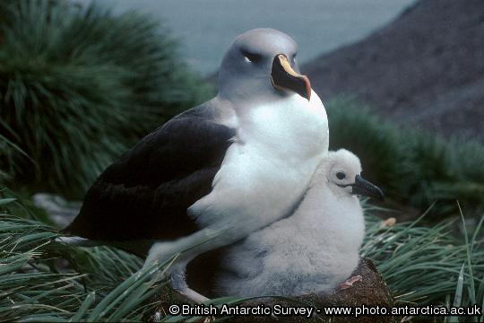
HARD-WORKING PARENTS
Parent seabirds spend a lot of time and effort rearing their chick
Parents of some of the larger albatross species feed their chick at the colony until they are 10 months old

Slide 14
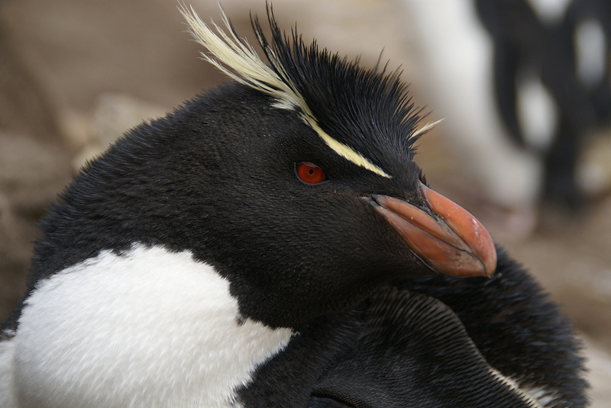
MAIN GROUPS OF SEABIRDS
PENGUINS
All are highly adapted to underwater travel, but cannot fly
Except for the Galapagos penguin, they all live in the Southern Hemisphere
Not all live where it is very cold
Mark “Clancy”, via Creative Commons
rock-hopper penguin

Slide 15
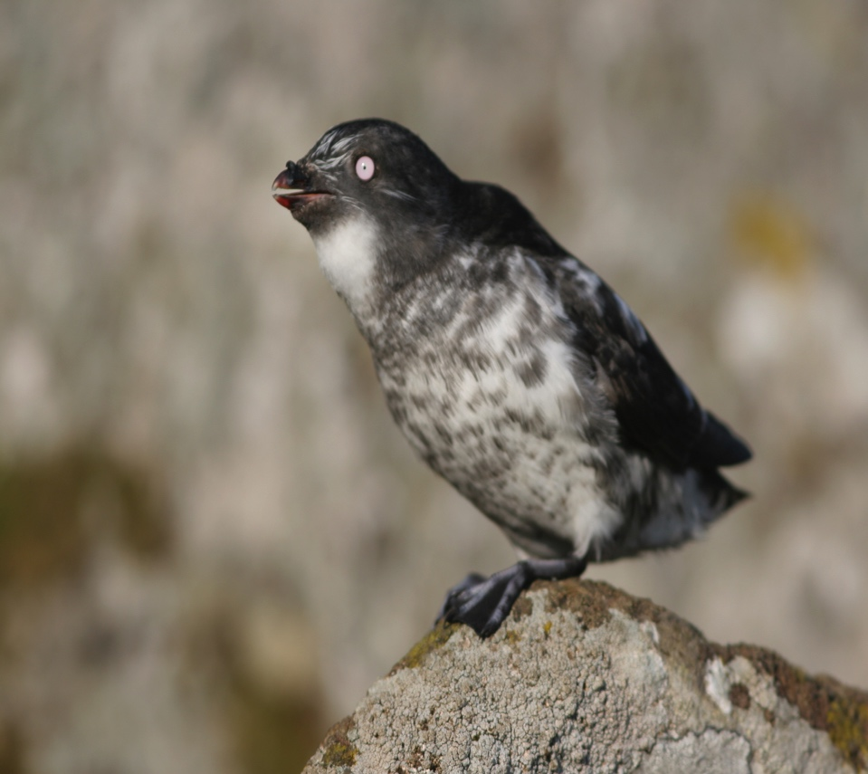
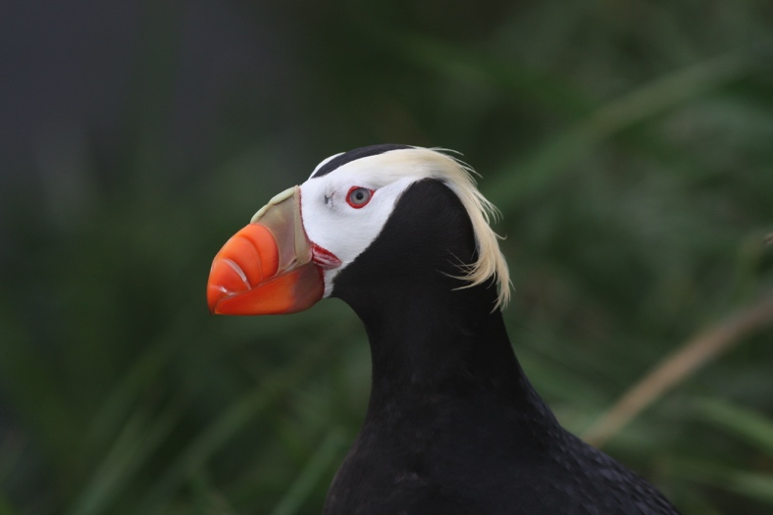
ALCIDS (Auks)
This group of species (the Auk or Alcid family) use their wings to both fly and swim
They live only in the Northern Hemisphere
Species of alcid include the puffins, murres, and auklets
The great auk is now extinct
Ram Papish
least auklet
Chris Barger
tufted puffin

Slide 16
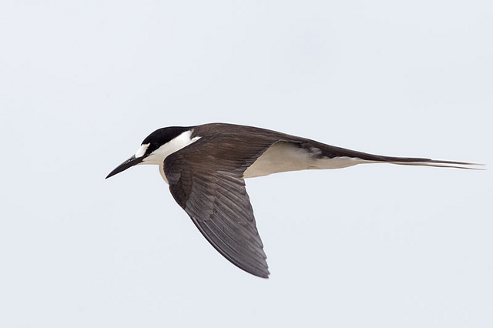
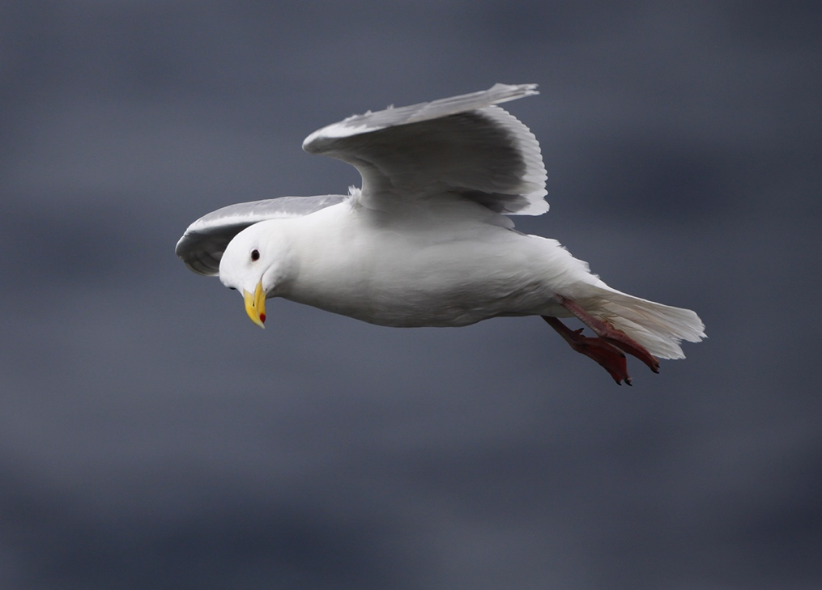
GULL-LIKE BIRDS
The skuas, jaegers, gulls, kittiwakes and terns (family Laridae)
Arthurgrosset, via Creative Commons
sooty tern
Ram Papish
glaucous-winged gull

Slide 17
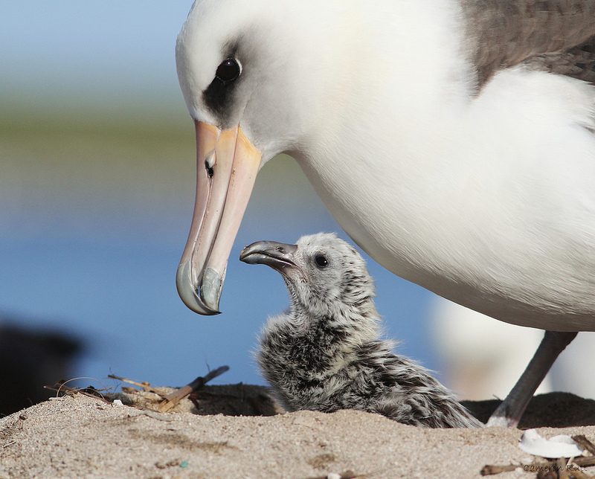
TUBENOSES
All tubenose species (Order Procellariformes) have their nostrils enclosed in tubes
They include the albatross, fulmar, petrels, shearwaters and prions
Chrysoptera, via Creative Commons.
laysan albatross

Slide 18
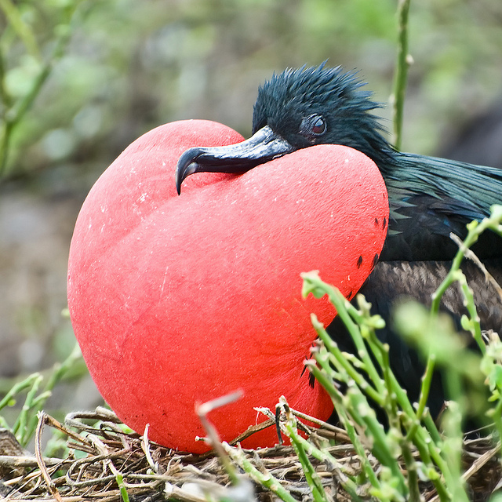
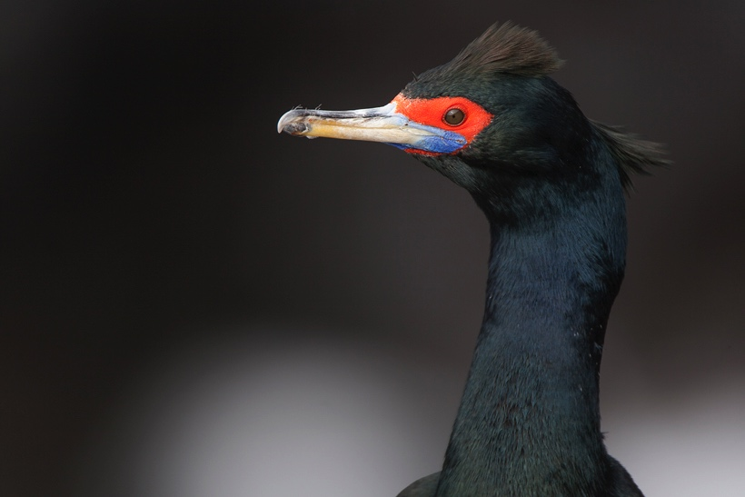
D200-Paul, via Creative Commons
OTHER SEABIRDS
This order (Pelecaniformes) includes the gannets, pelicans, boobies, tropic birds, cormorant, and frigate birds
D200-Paul, via Creative Commons
frigate bird
© Ram Papish
red-faced cormorant

Slide 19
Review
Seabirds have 6 physiological adaptations to life at sea:
1. Salt Glands
2. Dense bones
3. Special Shape feet and legs
4. Specialized wings
5. Waterproof coat
6. Unique head structure
5 Main Groups of Seabirds:
1. Penguins
2. Alcids
3. Tubenoses
4. Gull-like birds
5. Other Seabirds
4 Specialized Behaviors:
1. Diet
2. Long-lived
3. Few Chicks
4. Hard-working Parents
Notes:
A review slide for consideration. Could be used as an assessment if necessary (whole class, group, individual) by taking a screen shot of the blank slide (prior to filling in) and then passing that out.

Slide 20
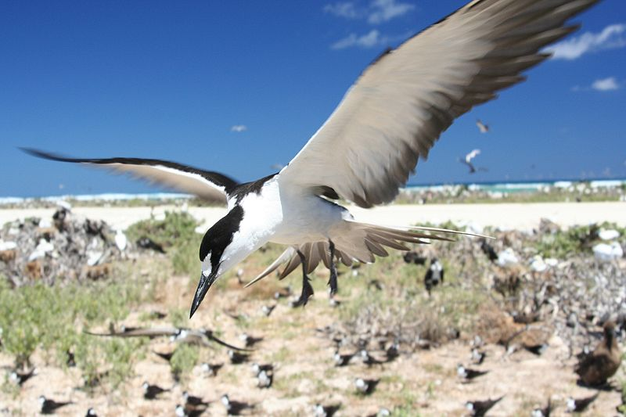
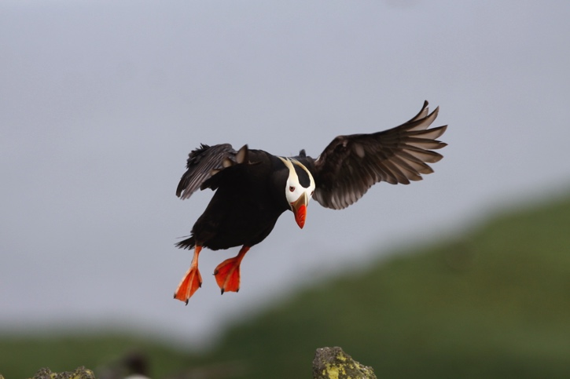
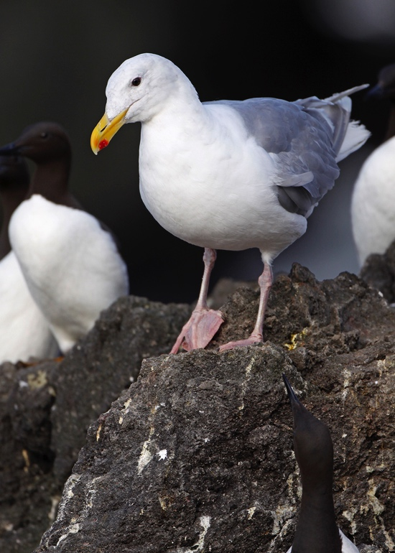
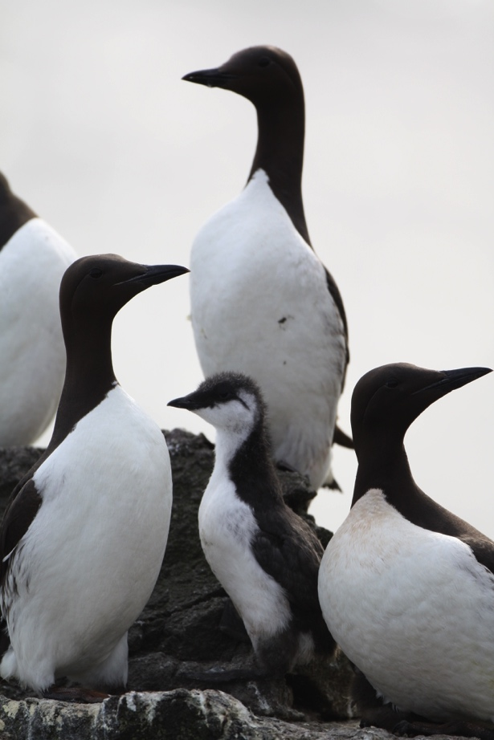
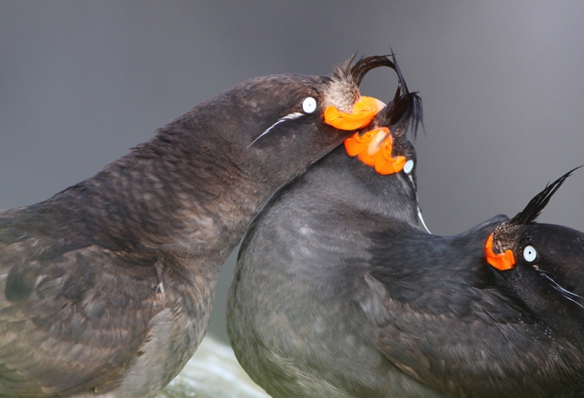
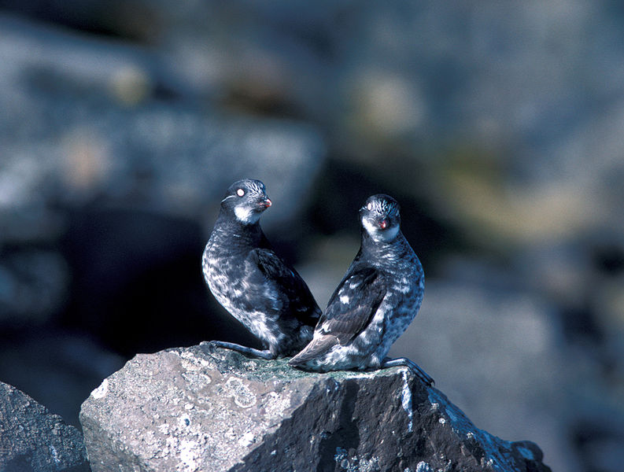
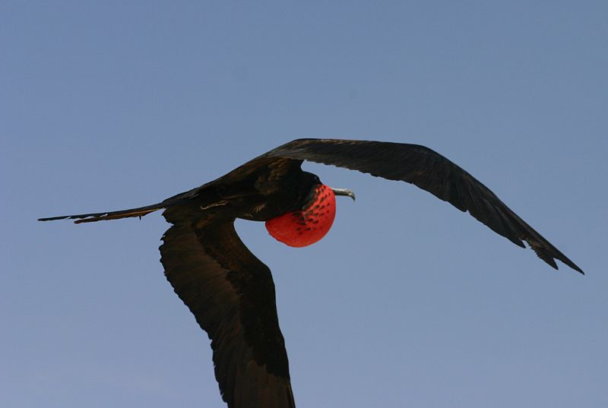
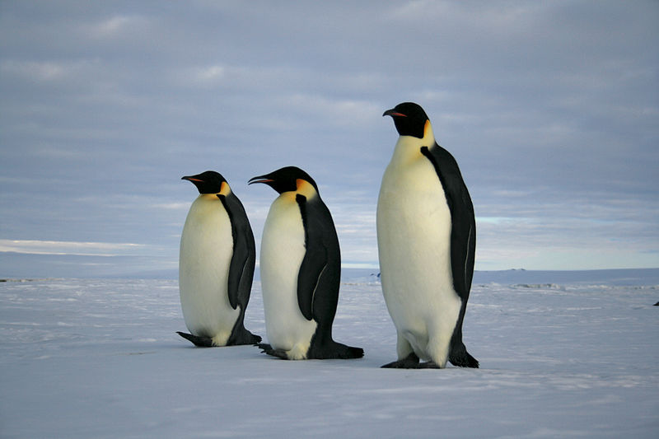
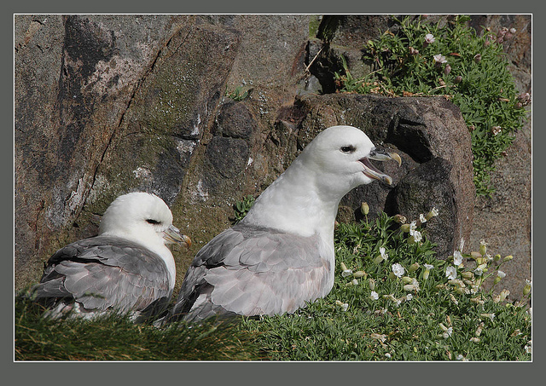
All these species were in the presentation: NAME THEM
Duncan Wright, USFWS
TUFTED PUFFIN
COMMON MURRE
SOOTY TERN
GLAUCOUS-WINGED GULL
Ram Papish
LEAST AUKLET
Ram Papish
Ram Papish
CRESTED AUKLET
Ram Papish
FRIGATE BIRD
Robert Angell, USFWS
NORTHERN FULMAR
Charlesjsharp, via Creative Commons
EMPEROR PENGUIN
lin padgham, via Creative Commons
Raiinbirder

