Slide 1
Lesson 1: Seabirds of the Pribilof Islands, Alaska
SEABIRDS
Ann Harding¹ and Ram Papish²
Ram Papish
Notes:
¹Auk Ecological Consulting: a.m.a.harding@gmail.com
²Ram Papish: rampapish@yahoo.com

Slide 2
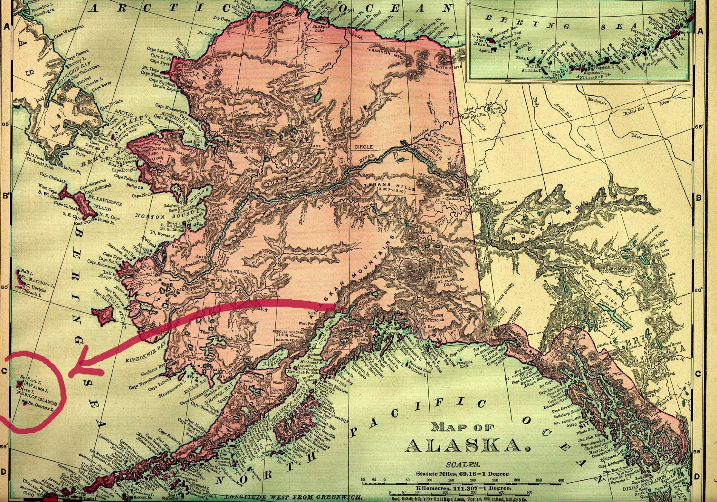
Where are the Pribilof Islands?
Notes:
World Map: The World Factbook 2013-14. Washington, DC: Central Intelligence Agency, 2013.
https://www.cia.gov/library/publications/the-world-factbook/index.html
The Pribilof Islands are located North of the Aleutian Islands, in the Bering Sea. They are part of Alaska (USA)

Slide 3
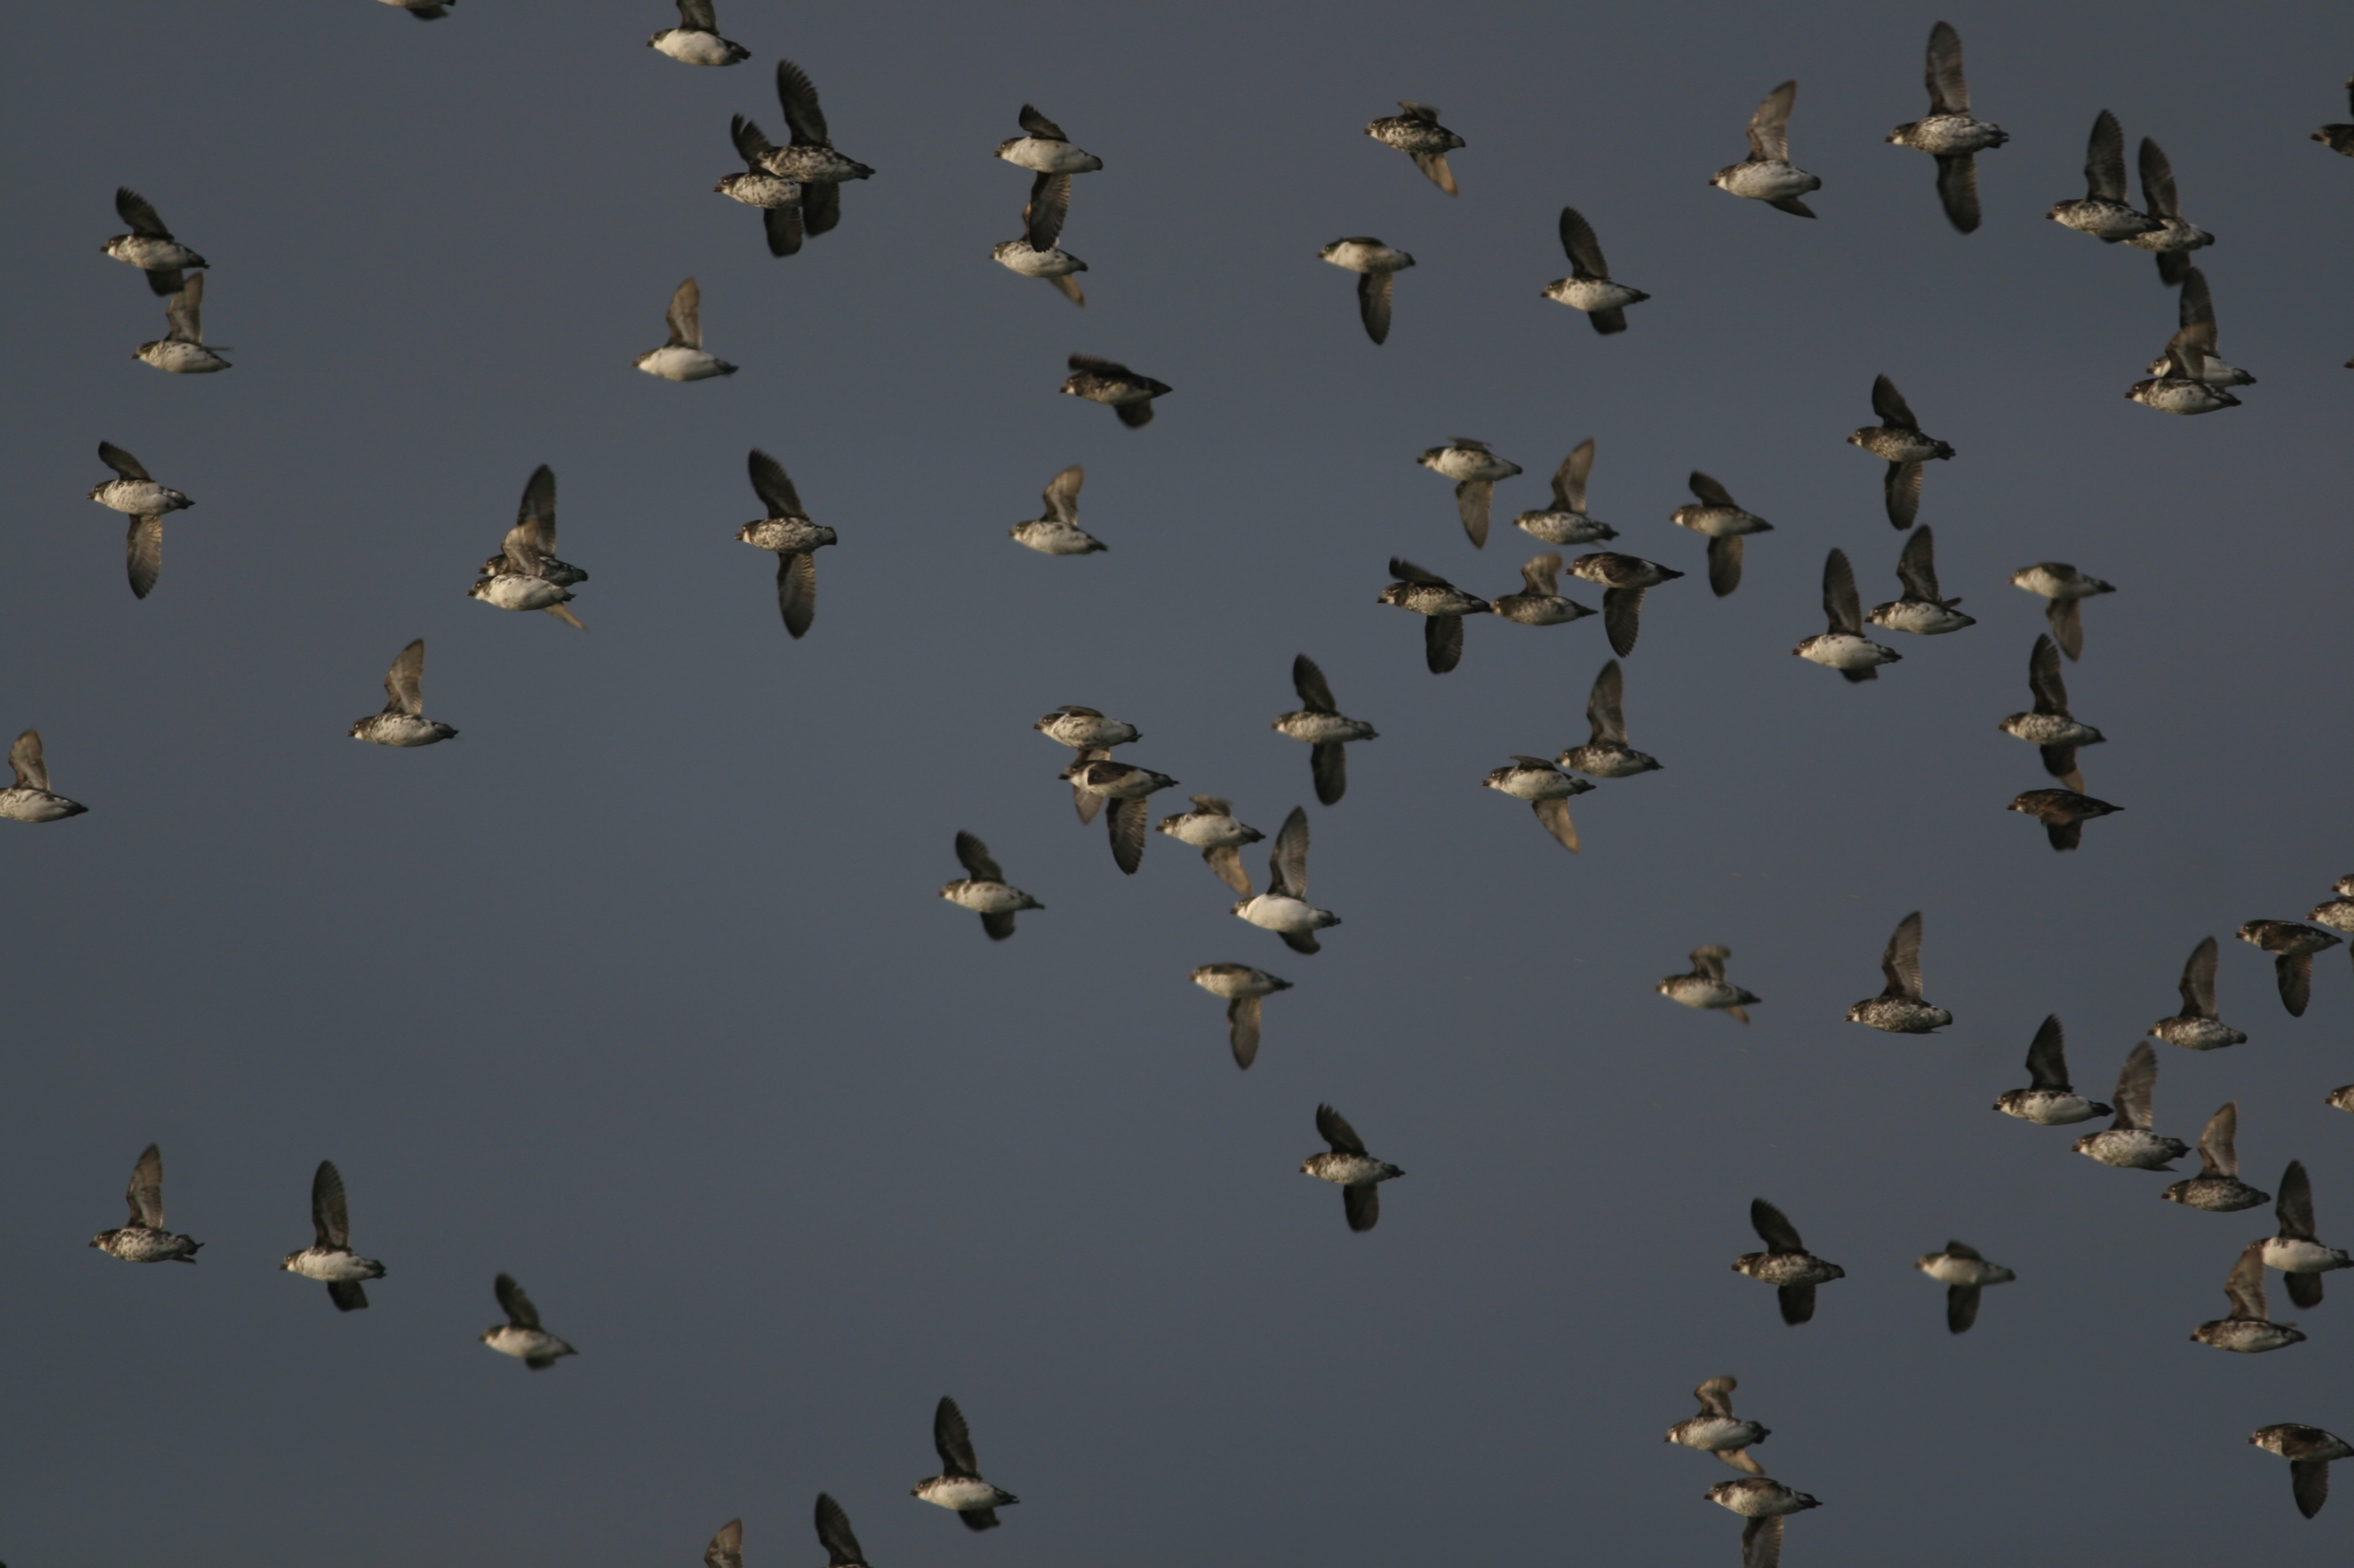
Globally important site for breeding seabirds
Estimated 2.8 million seabirds
Pribilof Islands were incorporated into the Alaska Maritime National Wildlife Refuge in the 1980s
© Ram Papish

Slide 4
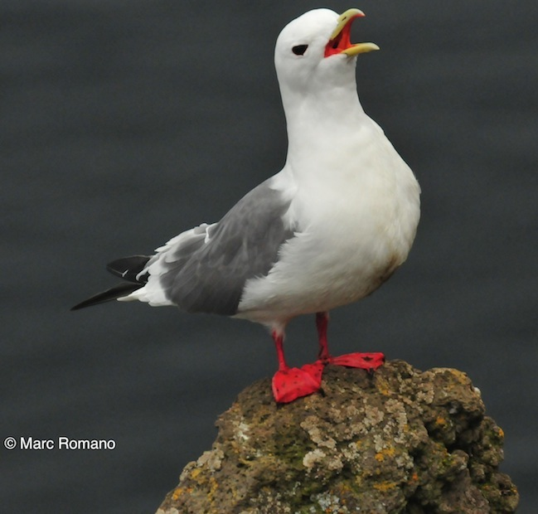
Red-legged kittiwakes
80% of world population breeds on the Pribilof Islands
Plunges into the water or dips head underwater to catch fish and invertebrates.
Feeds mostly on myctophids (lantern fish)
Lays one egg

Slide 5
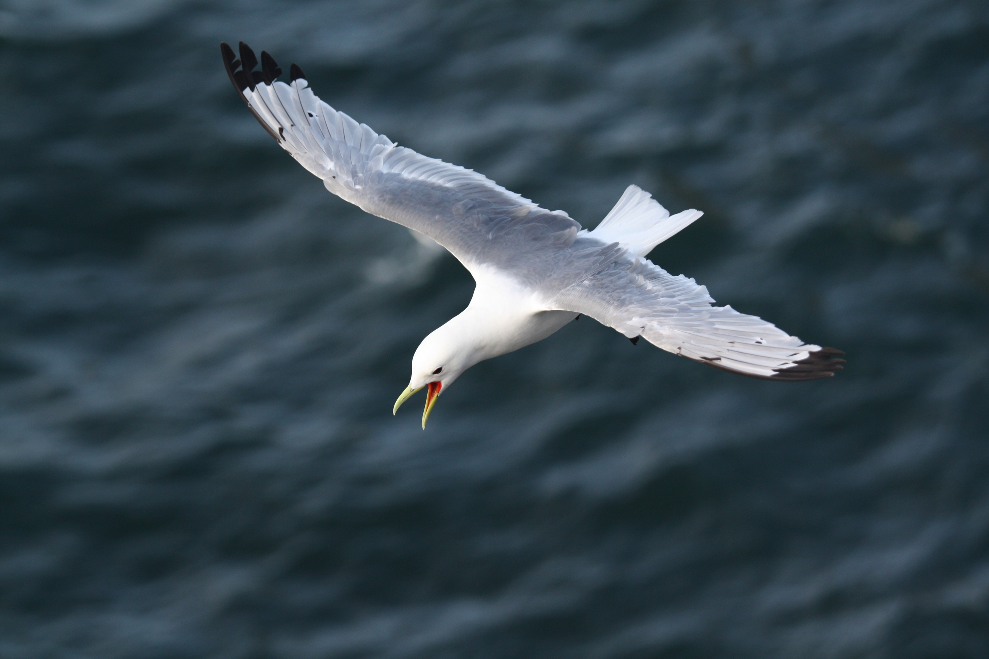
Black-legged kittiwakes
Circumpolar breeding distribution
Lays one to three eggs
Larger body size, but
smaller eyes than the
red-legged kittiwake
Generalist feeder
© Chris Barger

Slide 6
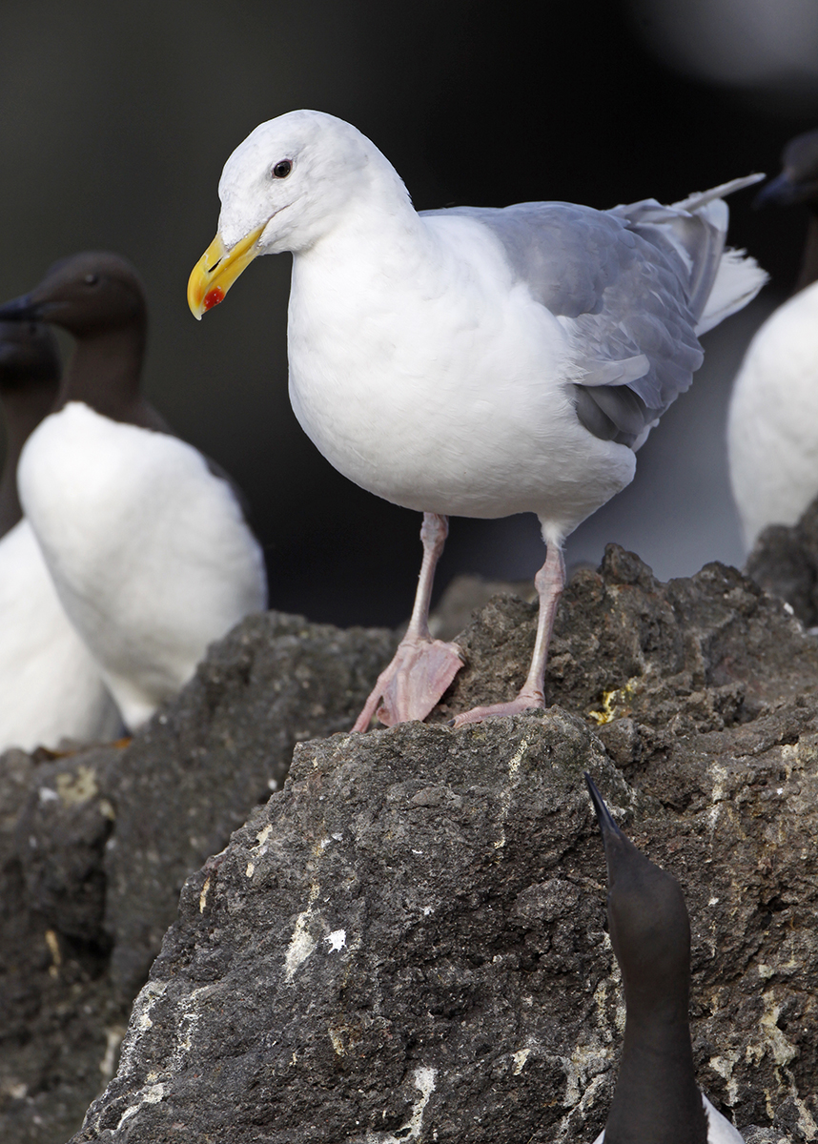
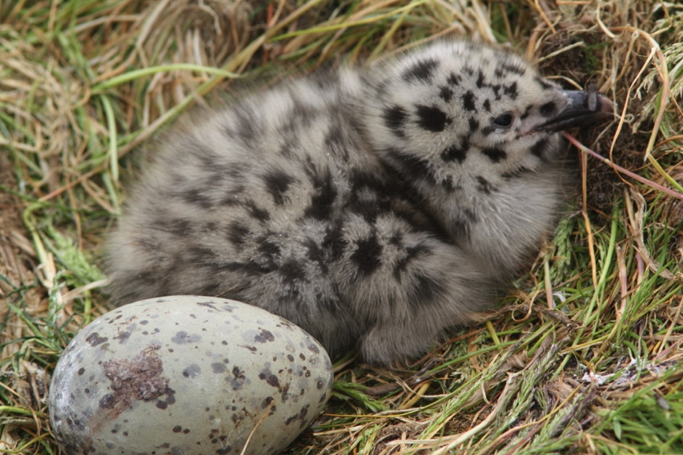
Glaucous-winged gull
Non-Breeders on Pribilofs
Glaucous comes from the latin glaucus, meaning “bluish-grey or green”
from the
Lays 2-3 eggs in a nest on cliffs, flat ground, and even roof-tops
Eats marine invertebrates and fishes. Eggs and chicks of seabirds. Scavenges carrion and refuse
© Chris Barger
© Ram Papish

Slide 7
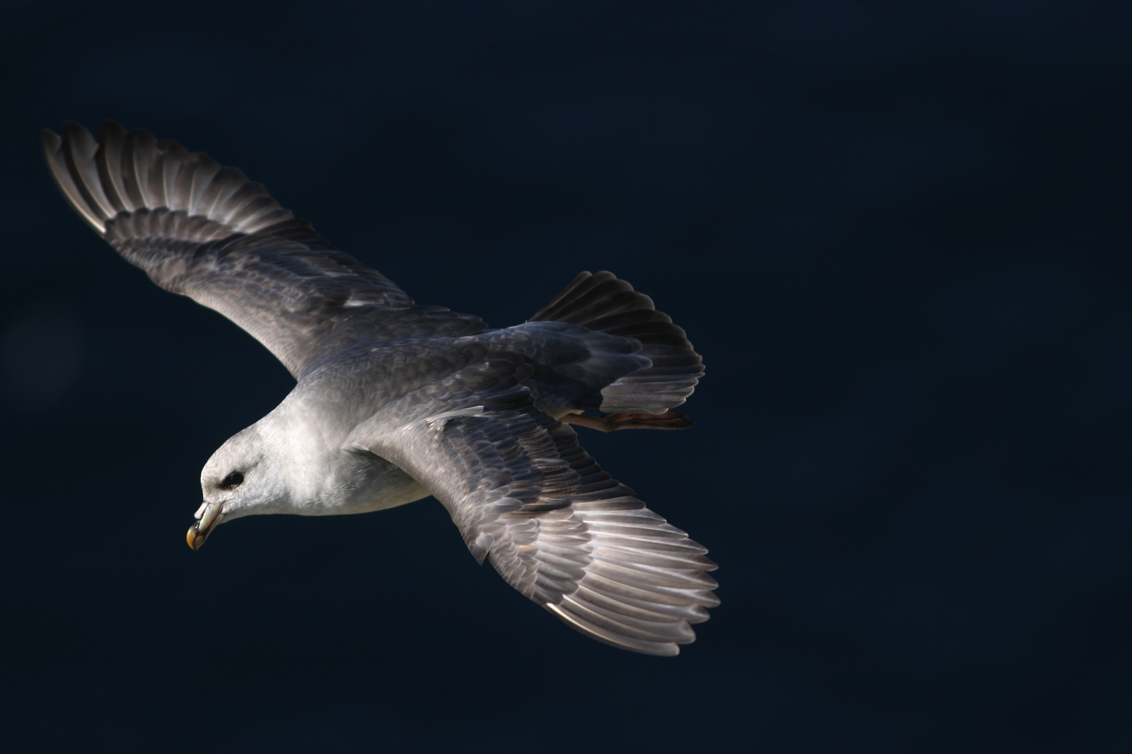
Northern fulmar
Gull-like relative of albatross and shearwater
Long-lived (average adult life-span of 32 years)
Lays one egg in nests on steep cliffs
Eats fish, squid, zooplankton, and offal from fishing vessels
© Ram Papish
Notes:
The Northern fulmar is a tubenose (nostrils enclosed in a tube)

Slide 8
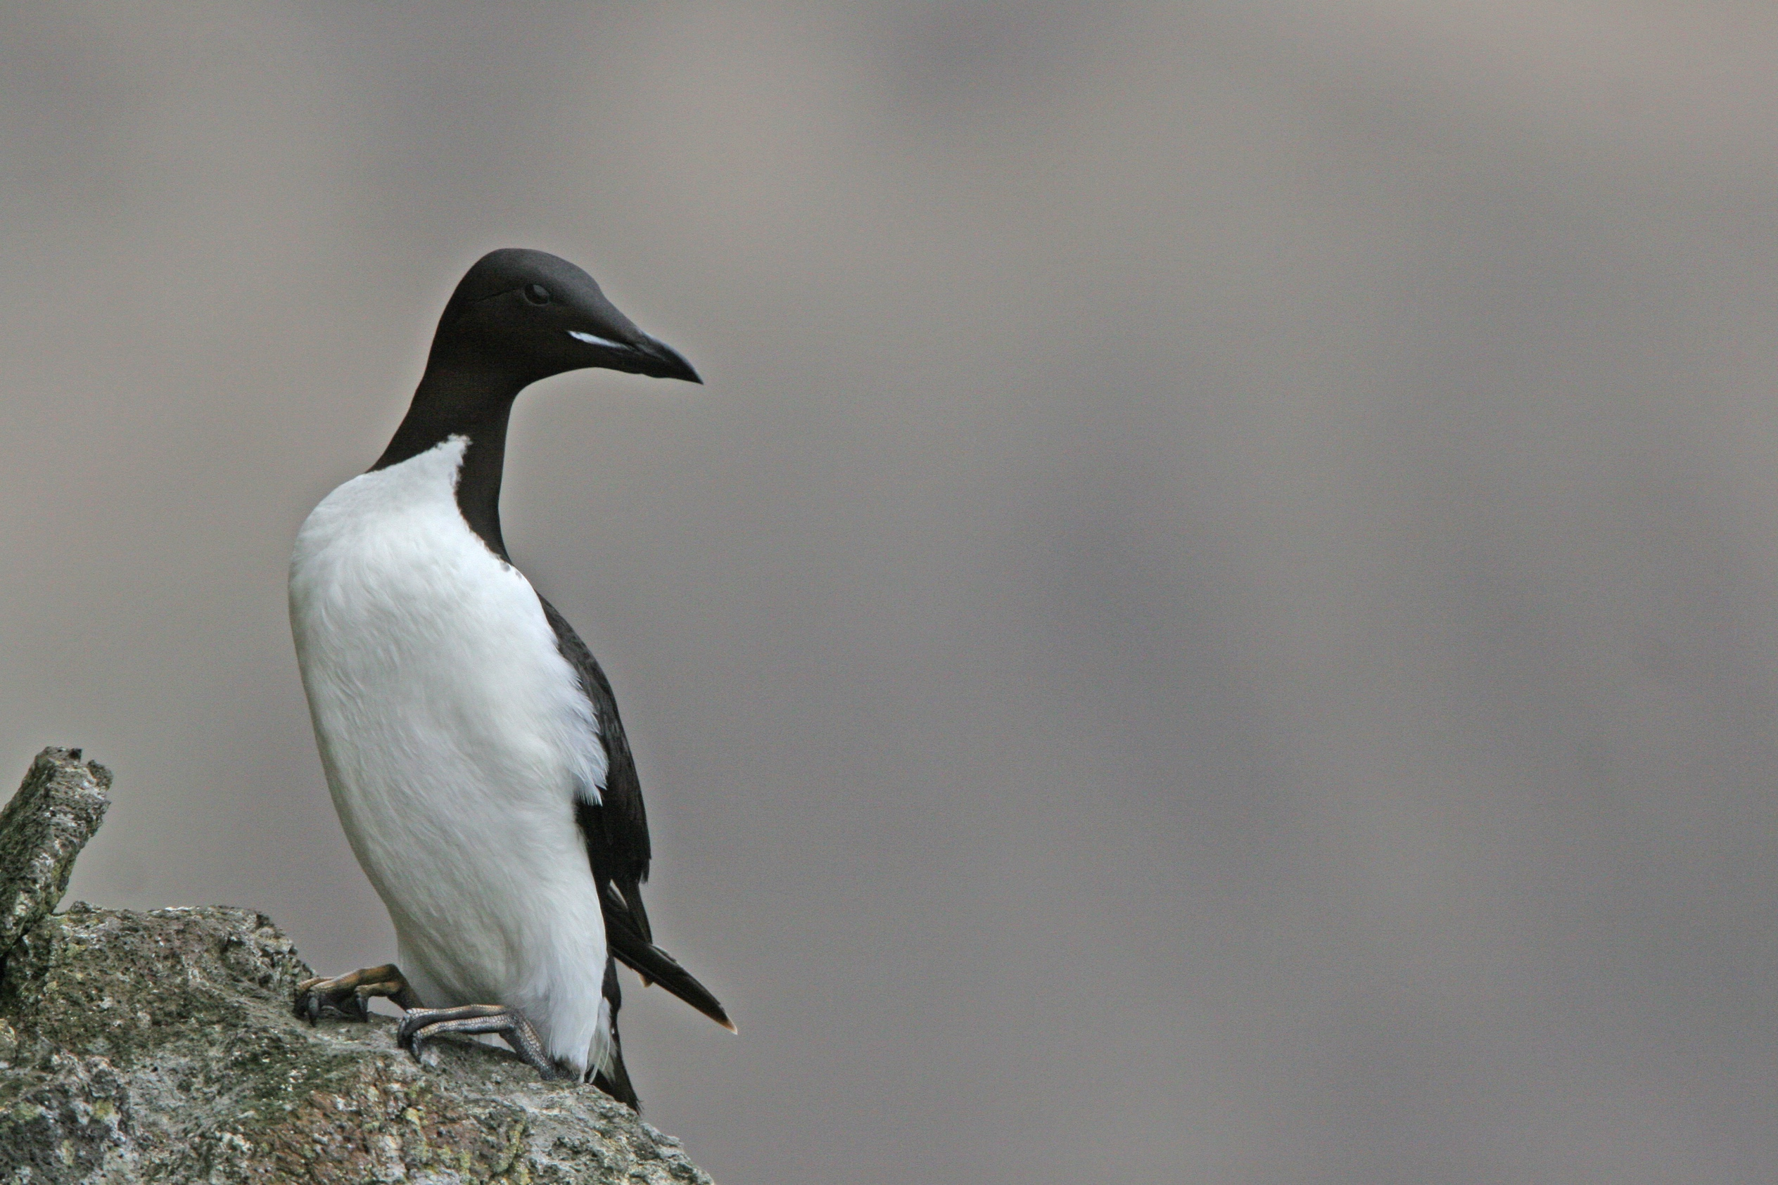
Thick-billed murre
Largest living species in the Auk family (the extinct Great Auk was larger)
Has a thicker, shorter bill than the common murre, has a white gape stripe.*
Lays a single egg on narrow ledges and steep cliffs
Can dive to depths of 150 meters (450 feet or 1.5 football fields)!
© Ram Papish
Notes:
* The base of a bird's bill where the mandible and maxilla join

Slide 9
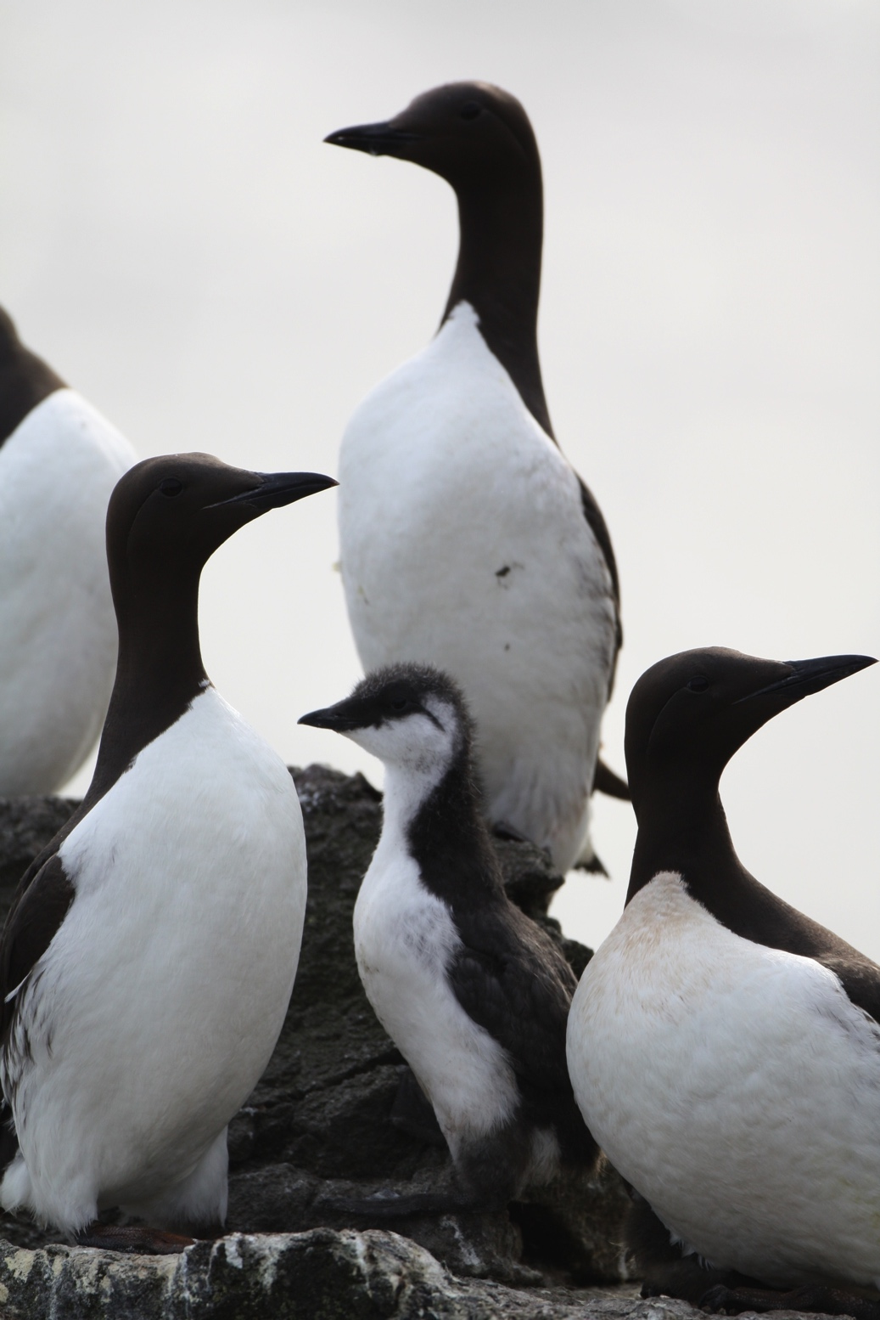
Common murre
Also known as the common guillemot
Breeds in dense colonies, on narrow cliff ledges
The single egg is laid on bare rock
Eats mostly small, schooling fish
Single fish are held in the bill and carried back to the chick at the colony
© Ram Papish

Slide 10
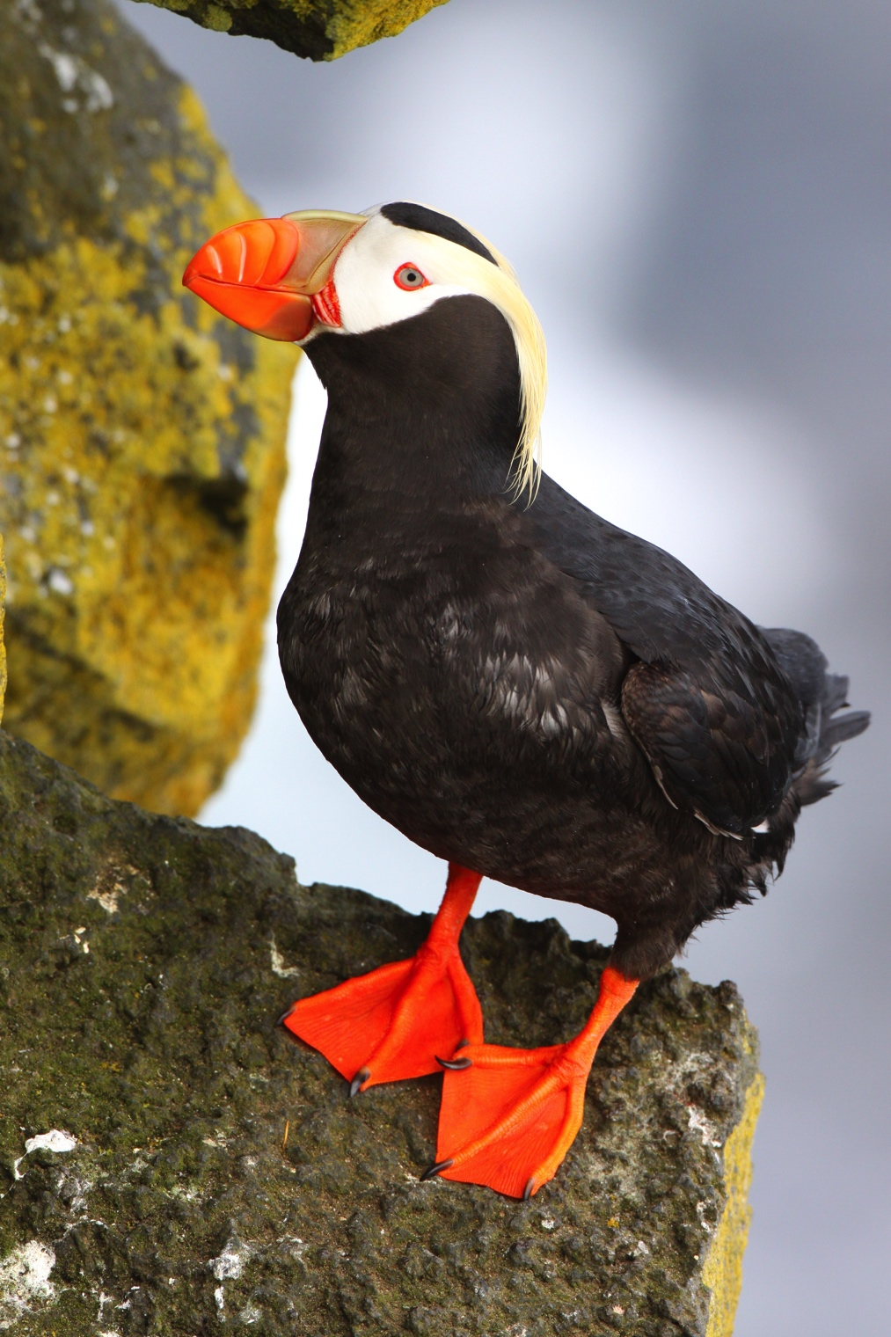
Tufted puffin
Lays a single egg in a burrow or rocky crevice
Egg is incubated for about 45 days, and the chick fledges (leaves the colony) between 40-55 days old
Adults carry many fish (and sometimes squid) crosswise in their bill to deliver to their chick at the colony
© Ram Papish

Slide 11
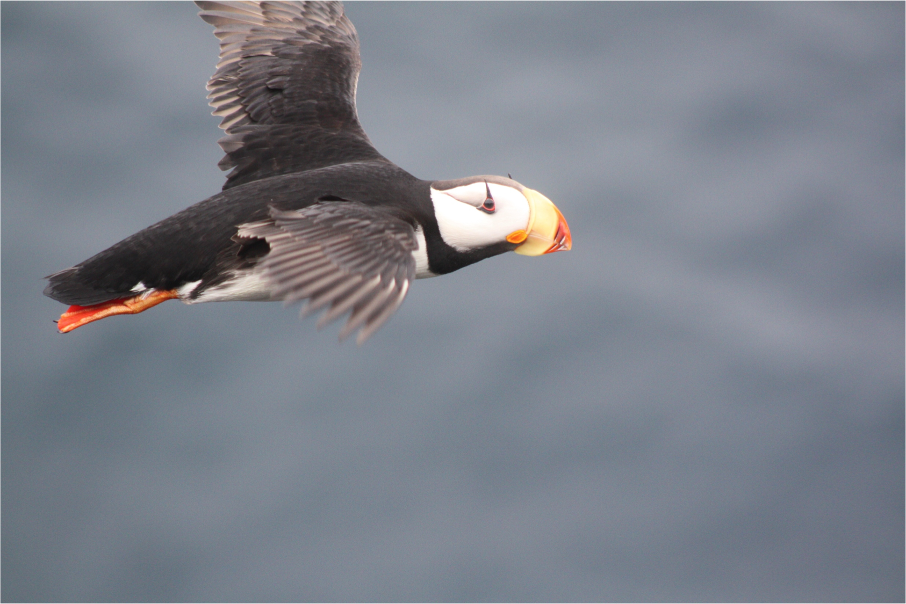
Horned puffin
First breed at 3-5 years old
Lays a single egg in rocky crevices
Small fleshy “horn” above the eyes
Bill adapted to carry a number of fish. Record of 62 fish carried by one bird
© Chris Barger
Notes:
Parent puffins carry whole fish back to their chick at the colony.

Slide 12
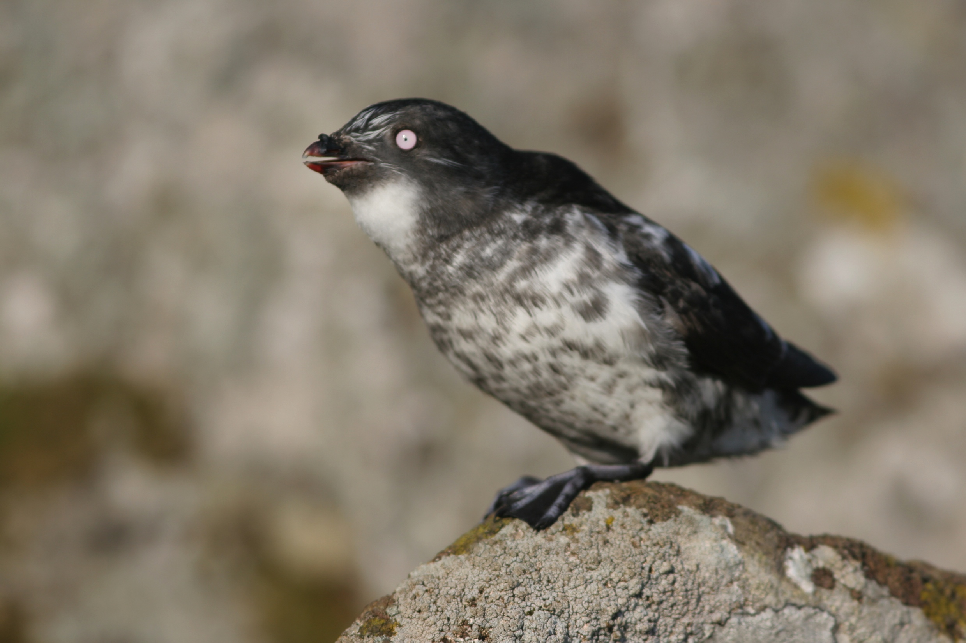
Least auklet
Smallest species
of Auk (or Alcid)
Eats zooplankton
Like other Auks, they use
their wings to “fly” under water to catch their prey
Nests in rocky crevices, in large colonies of up to a million birds
© Ram Papish

Slide 13
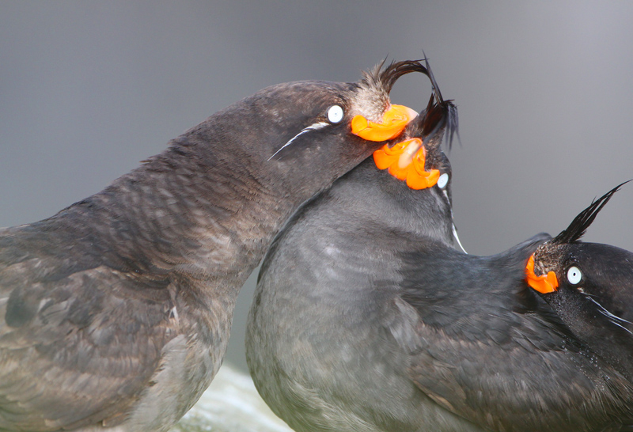
Crested auklet
Belongs to the Auk (or Alcid) family (same as the puffin)
Nests in dense colonies (up to 1 million individuals) in the Bering Sea and the Sea of Okhotsk
Often breeds in mixed colonies, with the least auklet
Has a striking citrus scent!
© Ram Papish

Slide 14
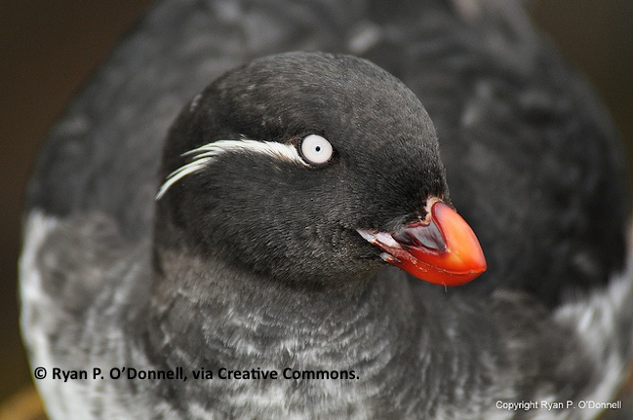
Parakeet auklet
Unusual bill structure probably an adaptation for handling slimy prey, like jellyfish
Walks mostly on the legs and not the toes
Nests in bare rock crevices or burrows
Lays one egg
Eats zooplankton and larval fish

Slide 15
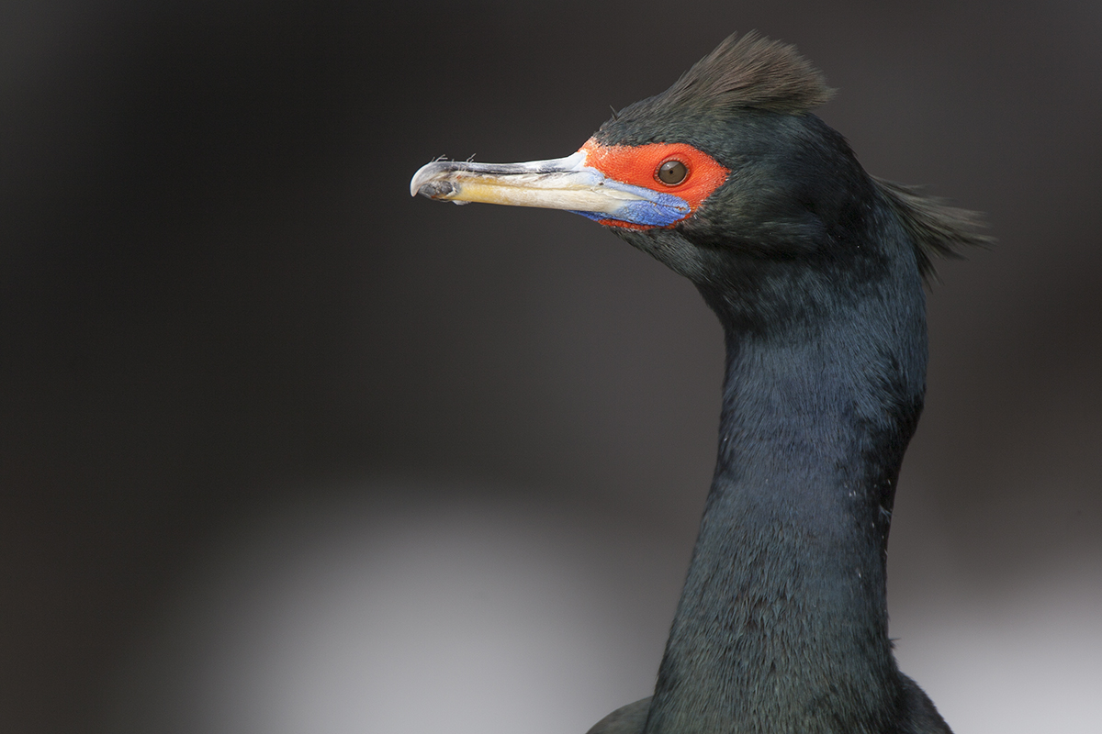
Red-faced cormorant
Use large web feet to swim underwater to find food
Feathers are not naturally waterproof, and they have to groom their feathers with oil from gland at base of tail
Their favorite food is fish that live close to the ocean floor
© Ram Papish

