Slide 1
Lesson 2: Seabird Feeding
(foraging)
SEABIRDS
Ann Harding¹
Ram Papish
Notes:
¹Ann Harding, Auk Ecological Consulting: a.m.a.harding@gmail.com

Slide 2
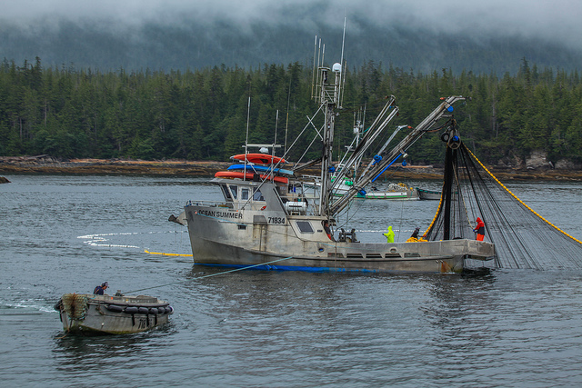
HOW DO SEABIRDS CATCH THEIR FOOD?
Four main strategies:
© Afletch4141 via creative commons

Slide 3
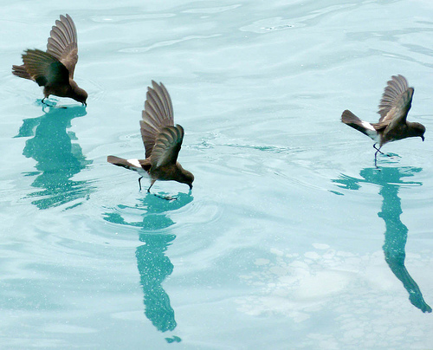
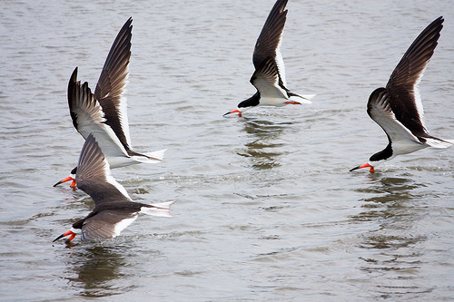
SURFACE FEEDING
While flying
© NKS Swampie via creative commons
storm petrels
© Murray H77 via creative commons
skimmers
Notes:
Many seabirds feed on the surface of the ocean, only dipping their head into the water to catch prey.
Ocean currents, or the vertical migration of some prey species (such as squid) concentrates prey near the surface of the water and makes them available to seabirds.

Slide 4
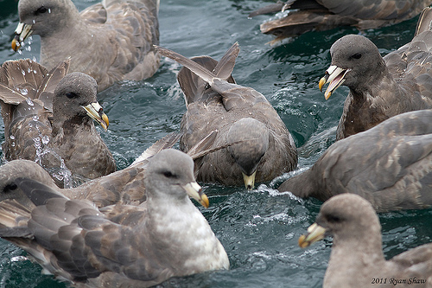
SURFACE FEEDING
(b) While swimming
creative commons © Murray H77
© Ryan Shaw via Creative Commons
northern fulmar
Notes:
The bills of these species are often adapted for catching prey. Albatross have a hooked bill to catch prey such as squid. Prions have filters (lamellae) that filter plankton from the mouthful of water.
Northern Fulmar:
Breeds in subarctic regions of N. Atlantic and N. Pacific.
Two color morphs: Light (almost white), and Dark (grey, as in photo).
3) A tubenose (family Procellariidae).
4) Produces stomach oil that can be used against predators (will matt the plumage of other birds), and is a rich meal for their chick.
5) Starts breeding between 8-12 yrs.

Slide 5
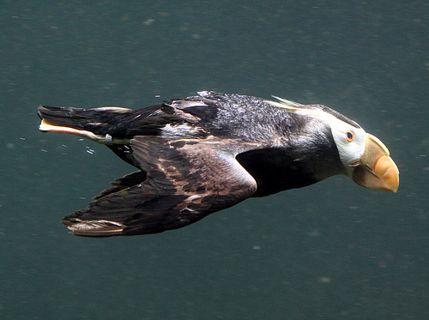
2. PURSUIT DIVING
Swim underwater:
(a) Foot propulsion (cormorants, grebes, loons)
(b) Wing propulsion (penguins, auks)
tufted puffin
© Jdurston via Creative Commons
Notes:
These species have the advantage of accessing a greater area to find food than the surface feeders or plunge divers.
Many also have specialized adaptations for conducting long, deep dives.
For example, the emperor penguin can dive to depths of more than 1500ft. Scientists have shown that they can lower the rate of their heartbeat when diving in order to conserve oxygen and allow longer dives. During one 18 minute dive, one penguin decreased its’ heart-rate to 3 beats per minute!
Feet and wings that are specially adapted for underwater travel are usually less efficient for other uses. For example, the legs of loons are located far back on their body (near the tail) for efficient swimming under water, and they have a hard time walking on land. And, puffins have short, narrow wings (like flippers) that are excellent for swimming underwater, but they have to work very hard when flying.
Tufted Puffin:
1) Breeds in North Pacific.
2) Nests in burrow (dug with feet and bill) or crevice between rocks.
3) Carries whole fish back to chick at the colony, held crosswise in the bill.
4) Bill adapted to hold fish; raspy tongue holds fish against spines on the palate (top of the bill).
5) May dive deeper than 80 feet to catch fish!

Slide 6
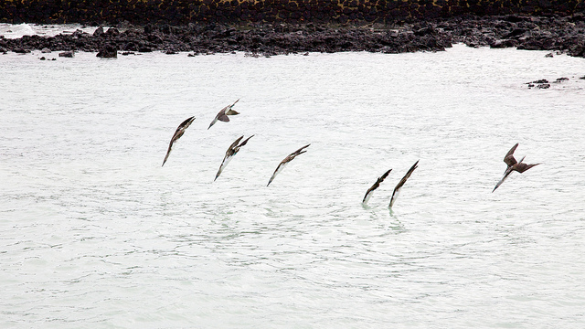
3. PLUNGE DIVING
Dive into water from flight (gannets, boobies, tropic birds, and some terns)
blue-footed boobies
© David Brossard via Creative Commons
Notes:
This is the most specialized form of feeding, and it can take years for individuals to learn efficient foraging. Some plunge-divers are dependent on marine mammals (such as dolphins) and predatory fish (e.g., tuna) to push prey to the surface.

Slide 7
4. KLEPTOPARASITISM, SCAVENGING, and LAND PREDATION
KLEPTOPARASITISM: Steal food from other seabirds (e.g., frigate birds and skuas).
SCAVENGING: Feed on carrion ( e.g. gulls, giant petrel), or scavenge from commercial fishing boats.
LAND PREDATION: Take eggs, chicks and even small adults from seabird colonies (e.g. gulls, skuas).

Slide 8
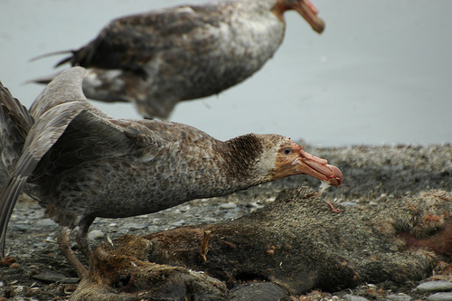
SCAVENGING
Giant Petrel feeds on a fur seal carcass
© JDurston via Creative Commons
Notes:
Southern Giant Petrel:
Breeds in Southern Hemisphere.
2) Aggressive predator and scavenger; whalers used to call them “gluttons”.
3) Feeds on carrion (especially seals and penguins). Capable of killing other birds. Also eats squid, krill, offal, and discarded fish from commercial fishing boats.

Slide 9
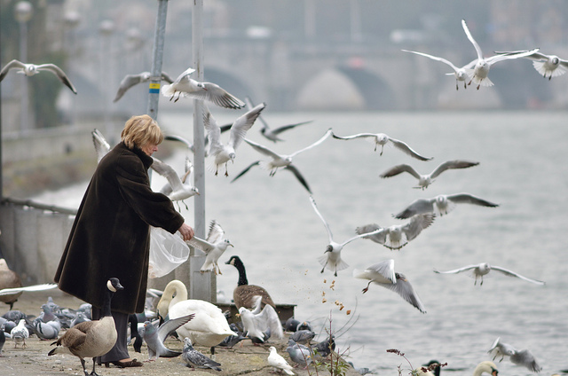
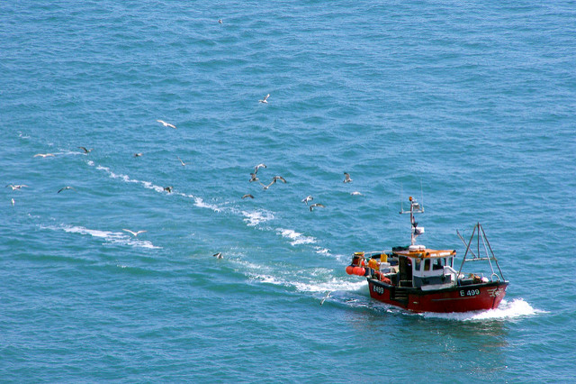
Scavenging gulls
© Gilles San Martin via Creative Commons
© Jim Champion via Creative Commons
Notes:
Some birds, such as gulls, feed on seabird and marine mammal carrion, and many species have learned to scavenge offal or bycatch from commercial fishing boats and processors.

Slide 10
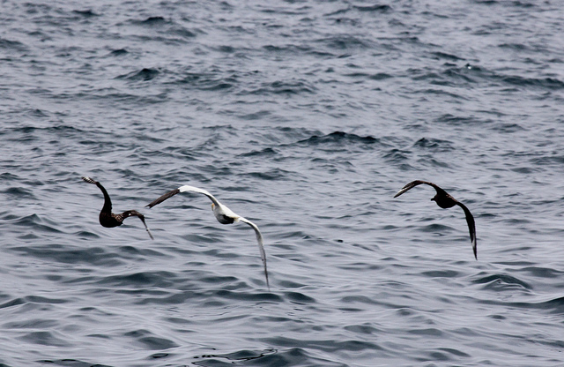
KLEPTOPARASITISM
Great skuas chasing a gannet for its food
© Mark Hodgson via Creative Commons
Notes:
Kleptoparasites steal food from other seabirds (frigate birds and skuas). This method of hunting usually supplements other methods of foraging.

Slide 11
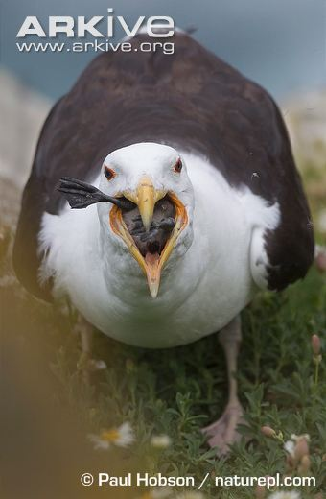
Land Predation
Greater black-backed Gull
The largest gull in the world
Will eat fish, but also hunts any prey on land smaller than itself
Will attack and kill chicks, and even some adult birds (such as the Atlantic puffin)
Most prey are swallowed whole
Greater black-backed gull eating a razorbill chick. © Paul Hobson/naturepl.com
Notes:
Gulls, skuas, and giant petrels will often take eggs, chicks and even small adults from seabird colonies. The great skua will often take adult puffins and gulls, and the giant petrel will even tackle an albatross! Yikes!

Slide 12
HOW DO SEABIRDS FEED THEIR CHICKS?
All seabird catch food out at sea, and then carry the food back to their chick at the nest-site.
Parents carry chick food using four main methods:

Slide 13
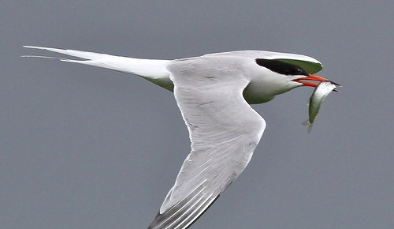
WHOLE PREY
© David Gibbon via Creative Commons
common tern with fish
Notes:
Many species carry whole prey in their bill. These species maximize the value of the meals by choosing large and nutritious prey species. Murres and many species of tern carry single prey items back to their chick, whereas puffins may carry over 30 items in their bill!
Common Tern:
Circumpolar distribution
Plunge-dive (from heights of about 3-10ft), and dive no deeper than 50cm underwater.
Has the longest migration of any bird. Travelling from the Arctic to spend winters in the Antarctic (11,000 miles of more!).
Many species carry whole prey in their bill. These species maximize the value of the meals by choosing large and nutritious prey species. Murres and many species of tern carry single prey items back to their chick, whereas puffins may carry over 30 items in their bill!

Slide 14
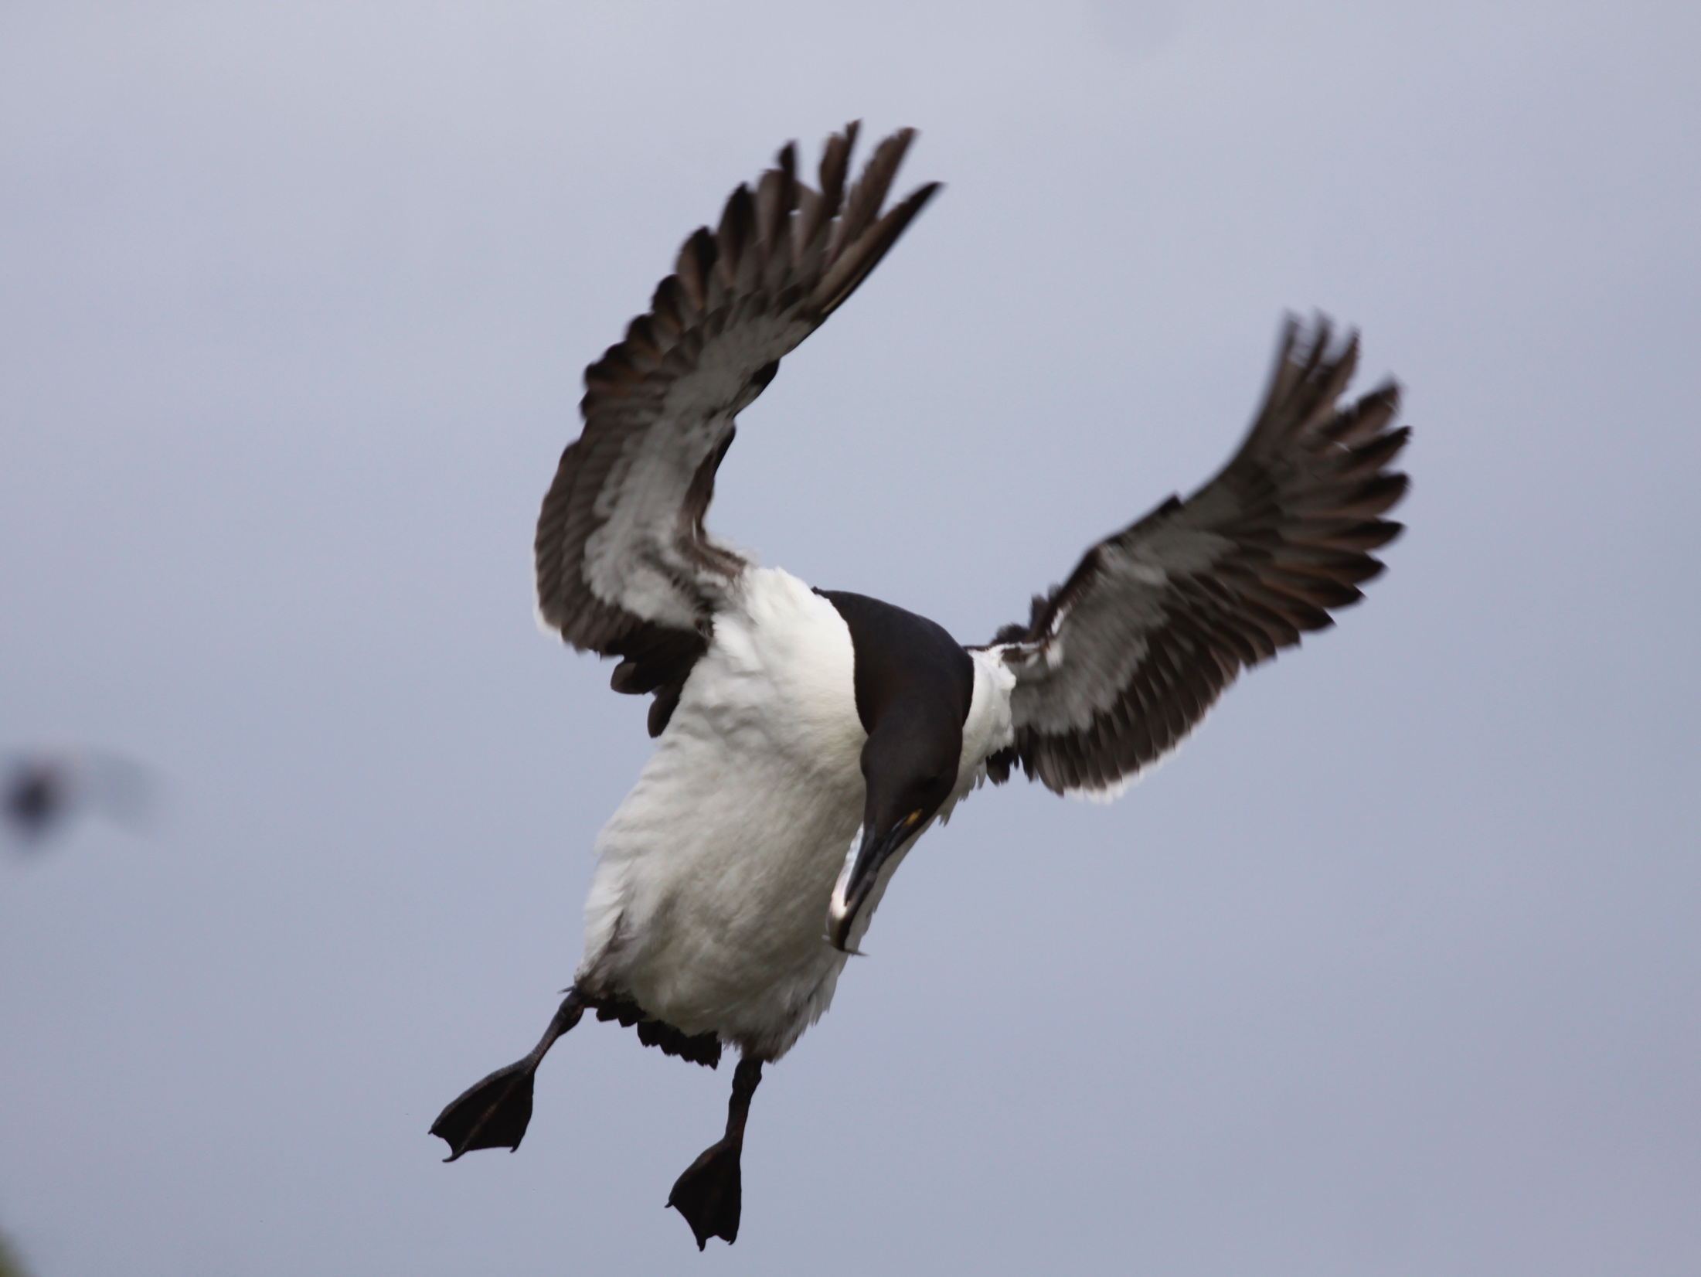
Thick-billed murre with a fish
© Ram Papish

Slide 15
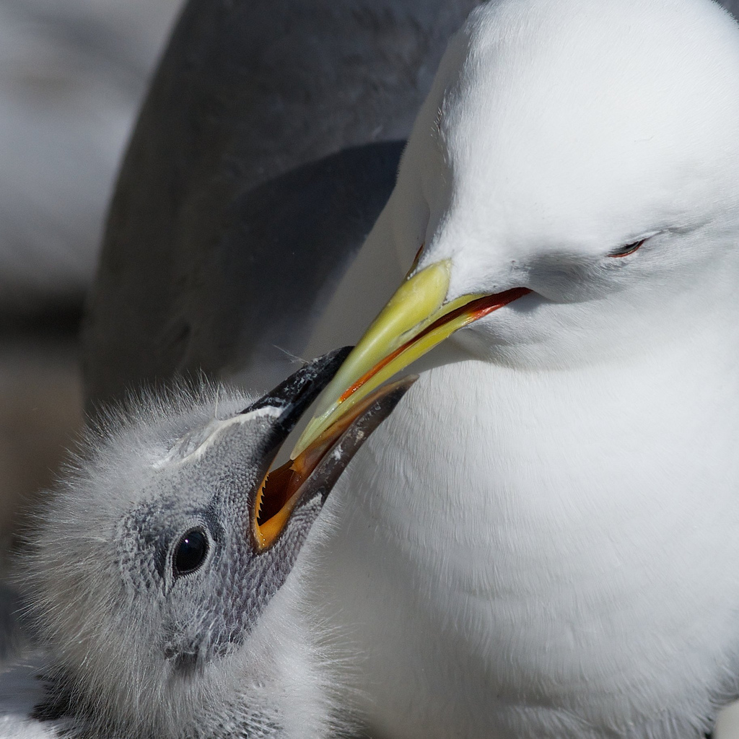
2. REGURGITATION
black-legged kittiwake
© Brandon Birder via Creative Commons
Notes:
Some species of seabird, such as kittiwakes, regurgitate the content of their stomach for their chick.
Black-legged Kittiwake:
1) Breeds in North Atlantic and North Pacific.
2) Breed in large colonies, on cliffs. Nest is made of mud, seabird and moss.
3) Lays 1-3 eggs
4) Often feeds in flocks. Catching food at the surface, or just below the surface of the water.

Slide 16
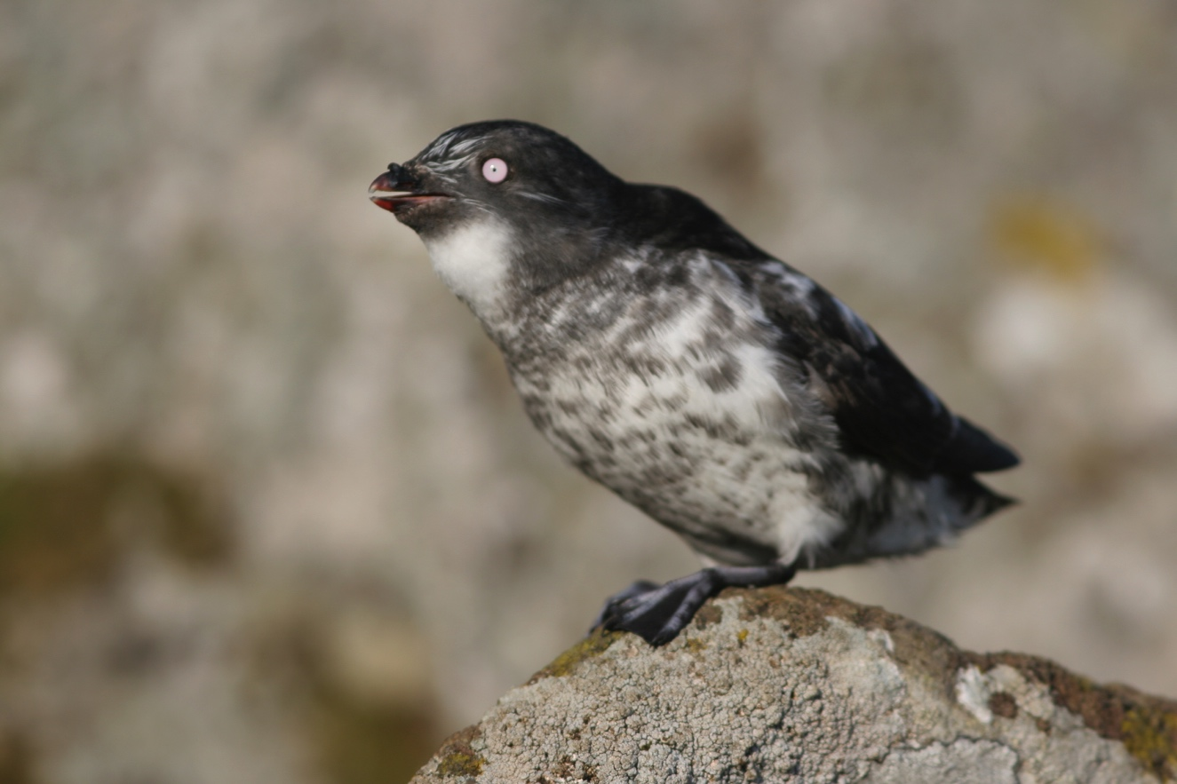
3. THROAT OR GULAR POUCH
least auklet
© Ram Papish
Least auklets can carry more than 700 zooplankton in their pouch
Notes:
Some species have a pouch (or sac) under their tongue or in their throat where they store whole prey for their chick.

Slide 17
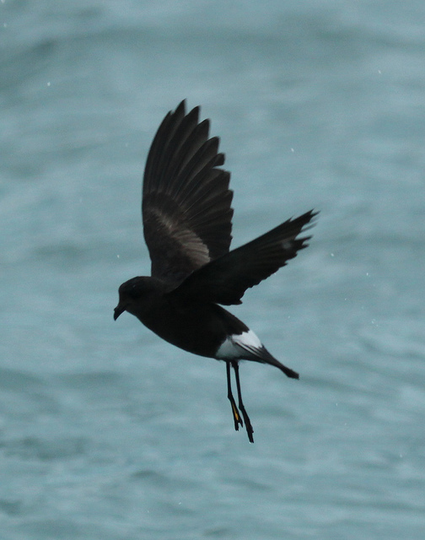
4. STOMACH OIL
Wilson storm petrel
© Liam Quinn via Creative Commons
Notes:
Some species feed their chick stomach oil. This oil is created from partly digested prey. It is very energy rich, about 9,600 calories per gram. In comparison, most cheeses only have 3 to 4.5 calories per gram! These incredibly high-energy meals are important to small birds, such as the storm petrel, that only feed their chick once every 24 hours (at nighttime).

Slide 18
Seabird Feeding (foraging)
Review
Four strategies to catch food:
1) Surface feeding
a) while flying
b) while swimming
2) Pursuit Diving
3) Plunge Diving
4) Kleptoparasitism,
Scavenging,
Land Predation
How seabirds feed chicks:
1) Whole Fish
2) Regurgitation
3) Throat/gular pouch
4) Stomach oil

