Slide 1
Lesson 6: Seabird Capture
SEABIRDS
Ann Harding¹, Ram Papish²
and Rachael Orben³
Ram Papish
Notes:
¹Auk Ecological Consulting: a.m.a.harding@gmail.com
²Ram Papish : rampapish@yahoo.com
³ Oregon State University

Slide 2
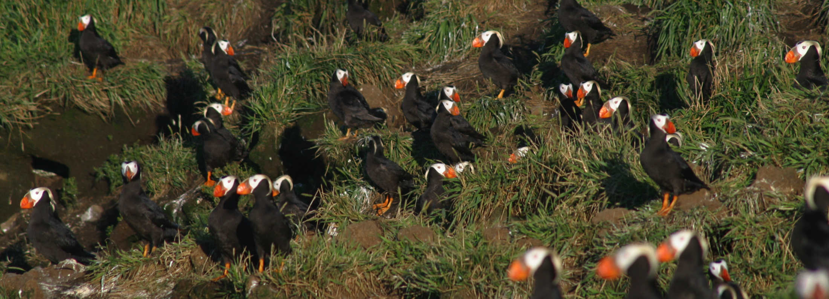
Why capture Seabirds?
© Cory Williams
Can you tell these birds apart?
IDENTIFICATION: It’s hard for humans to
tell one seabird from another!
Thought question:
How do you think birds tell each other apart?
Notes:
Scientists will capture birds in order to put leg bands or color on their feathers in order to tell them apart. Each bird is usually banded with a metal band from USFWS that has a unique identifying number. Because the number on these bands are hard to read at a distance, often the scientists will use other brightly colored plastic bands too in order to “resight” and identify the bird more easily.
Answer to Thought Question: Many birds recognize each other by their voices or calls

Slide 3
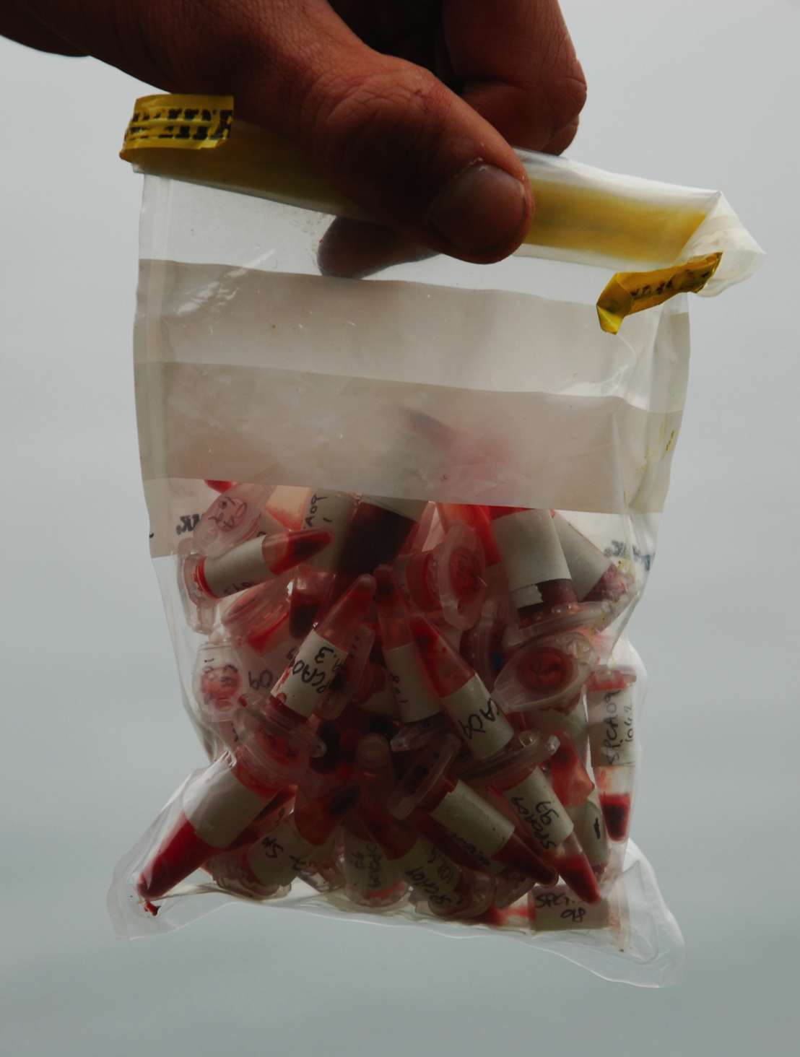
Why capture Seabirds?
(2) PHYSIOLOGICAL SAMPLES!
This includes taking blood and feather samples, swabbing for viruses, collecting guano, and even weighing and measuring birds.
© Ram Papish
Kind of like when the doctor takes a sample of your blood!
© Ram Papish
Notes:
Birds are typically captured because the scientist needs samples. Physiology is the branch of science/biology that deals with the normal functions of living organisms and their parts.

Slide 4
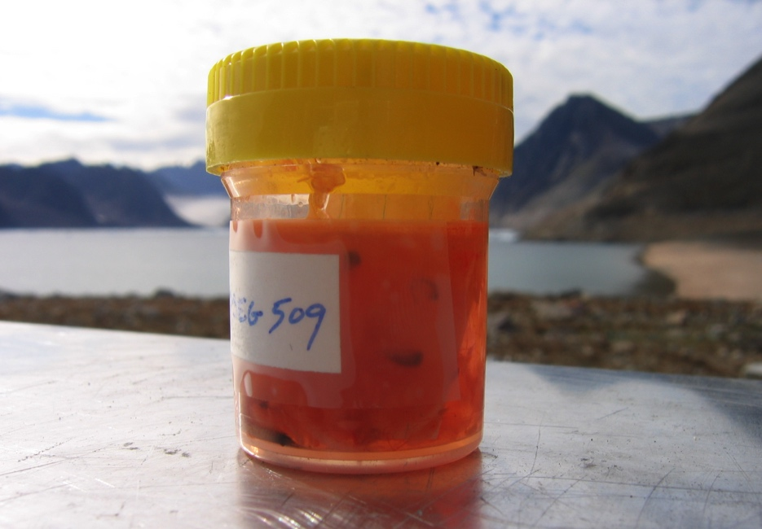
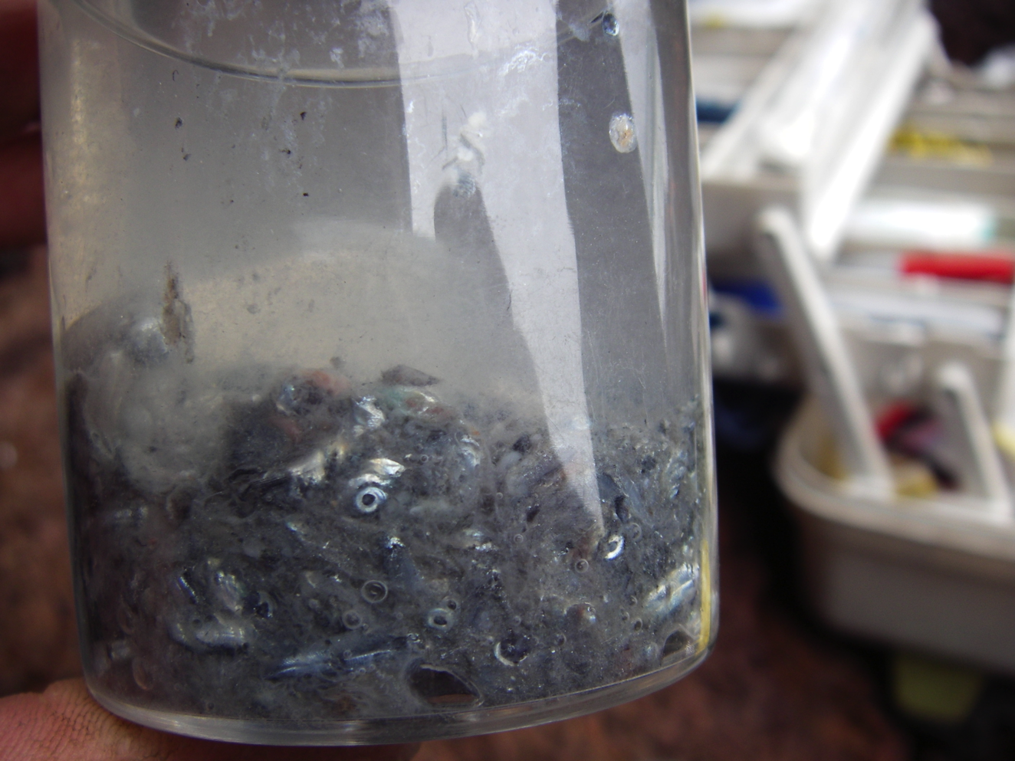
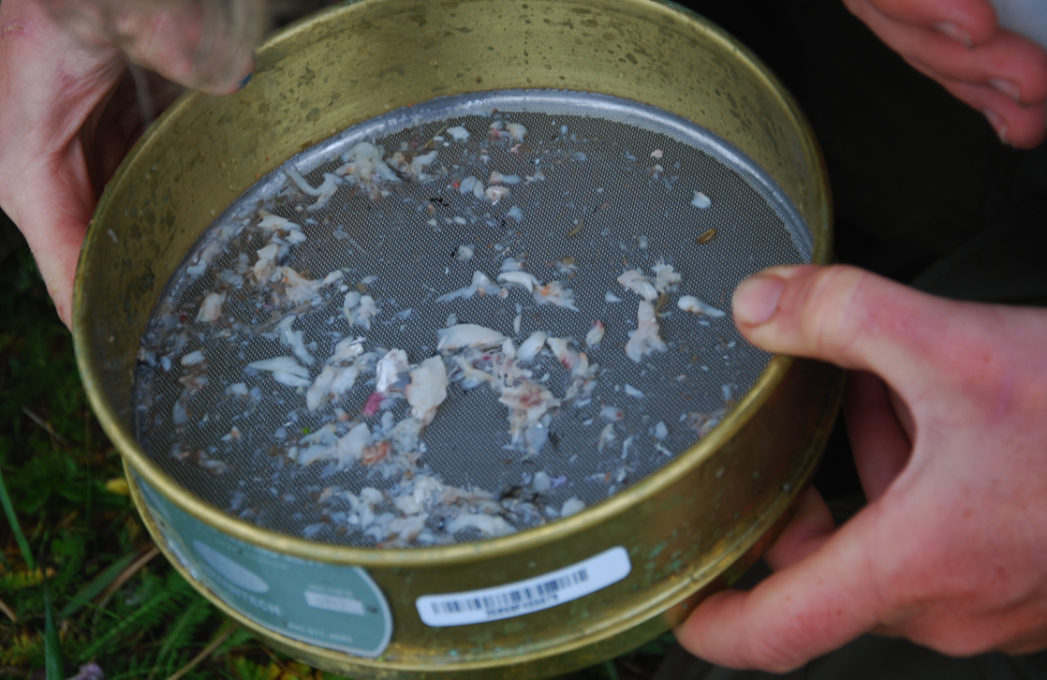
Why capture Seabirds?
(3) DIET SAMPLING to find out what birds are eating.
Vomit sample from a black-legged kittiwake.
Can you see the fish eyes?
Zooplankton for a dovekie chick!
Samples from a murre stomach!
Notes:
Seabirds eat fish, zooplankton and squid. There are several different strategies that seabirds use to feed: Skimming the surface of the water, diving just below the surface and even swimming quite far below the surface, plunging into the water from high heights, and scavenging. By studying seabird diet, scientists can learn about individual behavior, as well as learning about the marine environment that seabirds rely on for food. Seabirds are often called “indicators” of the marine environment, and studies of diet, feeding rates, and chick growth can tell us about prey availability (density, abundance, depth etc.).

Slide 5
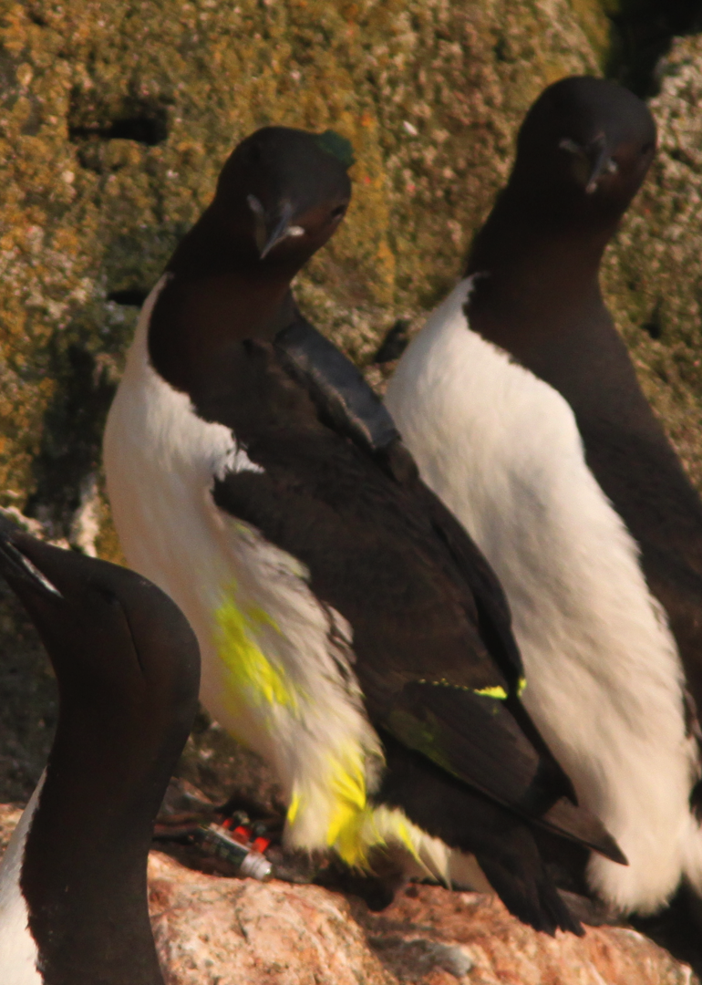
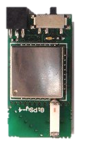
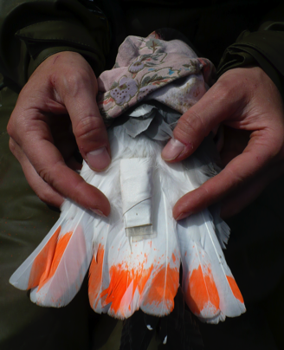
Why capture Seabirds?
(4) BIOLOGGING to use electronic data-loggers to track movements, behavior, and even physiology of individual birds!
GPS
© Kerrith McKay
The GPS logger is taped to murre’s back feathers.
Can you find the other logger on the same murre?
© Rachael Orben
GPS loggers record the position of a bird so that biologists can learn where birds are going at sea to find food. How would you do this without data-loggers?
Notes:
Applying loggers to the birds does not harm the bird nor do they significantly affect the bird’s ability to swim or fly. There would be no point recording data that is not “normal”.
There are various types of loggers: some that record data and store them in the logger (these have to be retrieved for the data to be downloaded), and some that can transmit the collected information by satellite. Most loggers run on an internal battery. Biologgers can cost anywhere from $50 to $7000. Usually the scientists will recapture the bird and retrieve the logger from the bird in order to download the data and/ or to replace the battery and apply it to another bird. Re-catching individual birds to retrieve the data-logger can be very challenging
Can you find the other logger on the same murre?
Answer: The other logger is on the same bird’s leg.
How would you do this without data-loggers?
Boat surveys can record the species, density and location of birds feeding at sea. This can give important broad information, but doesn’t tell us which birds these colonies come from, or even if they are breeding individuals.

Slide 6
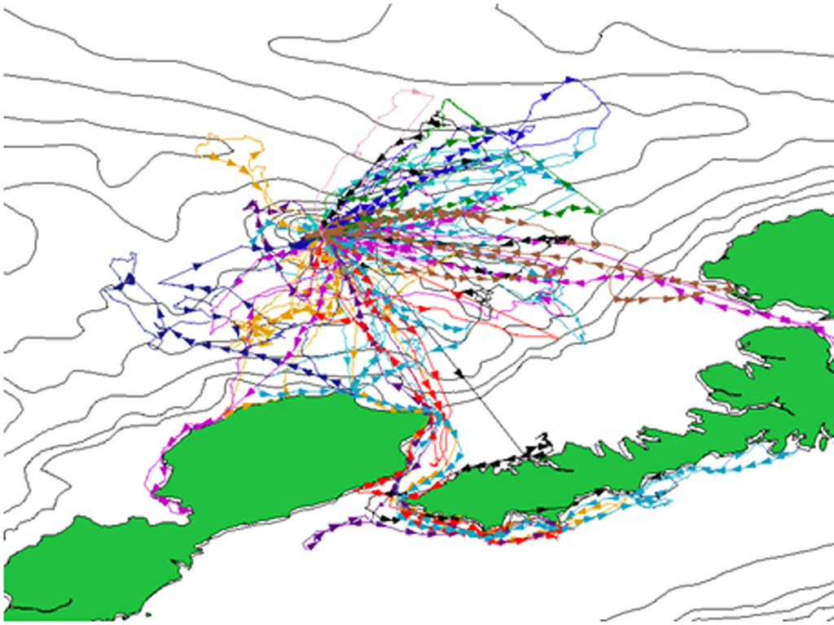
GPS tracks of thick-billed murres foraging from their breeding colony. Each color track is a different bird.
Notes:
This slide shows a different colored dotted line for each bird that received a tracker/logger. You can see that the birds travelled to different areas to feed and return to their nest sites to feed their chicks. You can see that some birds travelled nearby the colony on some trips, yet others traveled quite far to feed on other trips. The colony is Bogoslof Island, and the green land masses are islands in the Aleutian Chain.

Slide 7

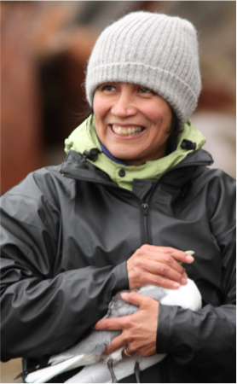
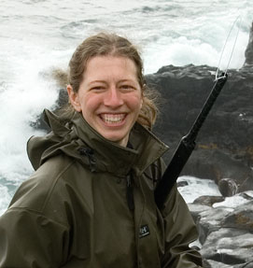
Question: Who captures Seabirds?
Answer:
Researchers and biologists
© Nathan Bamfield
Dr. Rosana Parades
© Dan Cushing
Dr. Rachael Orben
Question: Can anyone capture seabirds?
Answer: NO! You need training, official permits, and an animal welfare committee has to approve your study.
Notes:
It is important to have the proper training to capture seabirds and to take samples. Scientists want to be certain that the least amount of harm or disturbance is done to the birds as possible. Additionally, several species of seabirds are protected under the Migratory Bird Act.

Slide 8
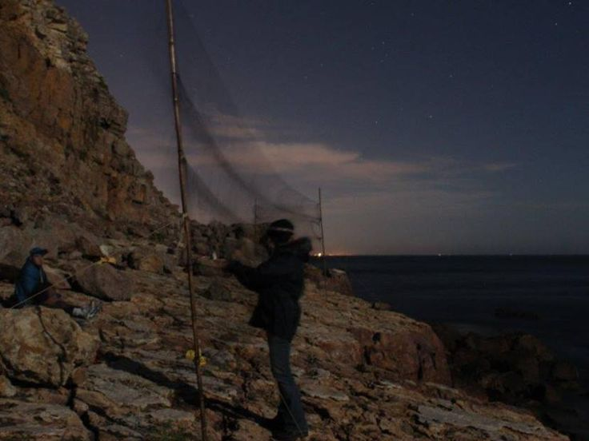
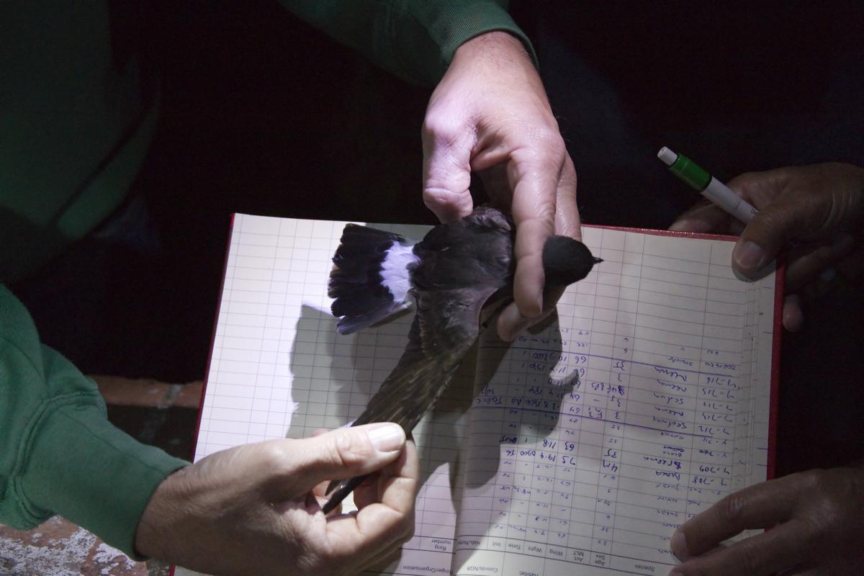
How do we capture Seabirds?
(Very carefully!)
Seabirds are usually captured on land during the breeding season
(1) MIST-NET
Often used to capture smaller seabirds in flight at the colony.
A Rocha International
Storm petrels are captured at night in Portugal. Sound recordings of their songs are used to lure the birds into the nets.
This storm petrel was captured in Scotland, 370 days and 361km from where it was first captured in Wales.
Notes:
Mist nets look like very fine volleyball nets stretched across the bird’s colony area. Scientists will hide near the net, and when a bird is caught the scientist will quickly get the bird free of the net, take the permitted samples, and then release the bird. Data (such as mass, wing-length) are collected as quickly as possible, and the birds are released without harm.

Slide 9
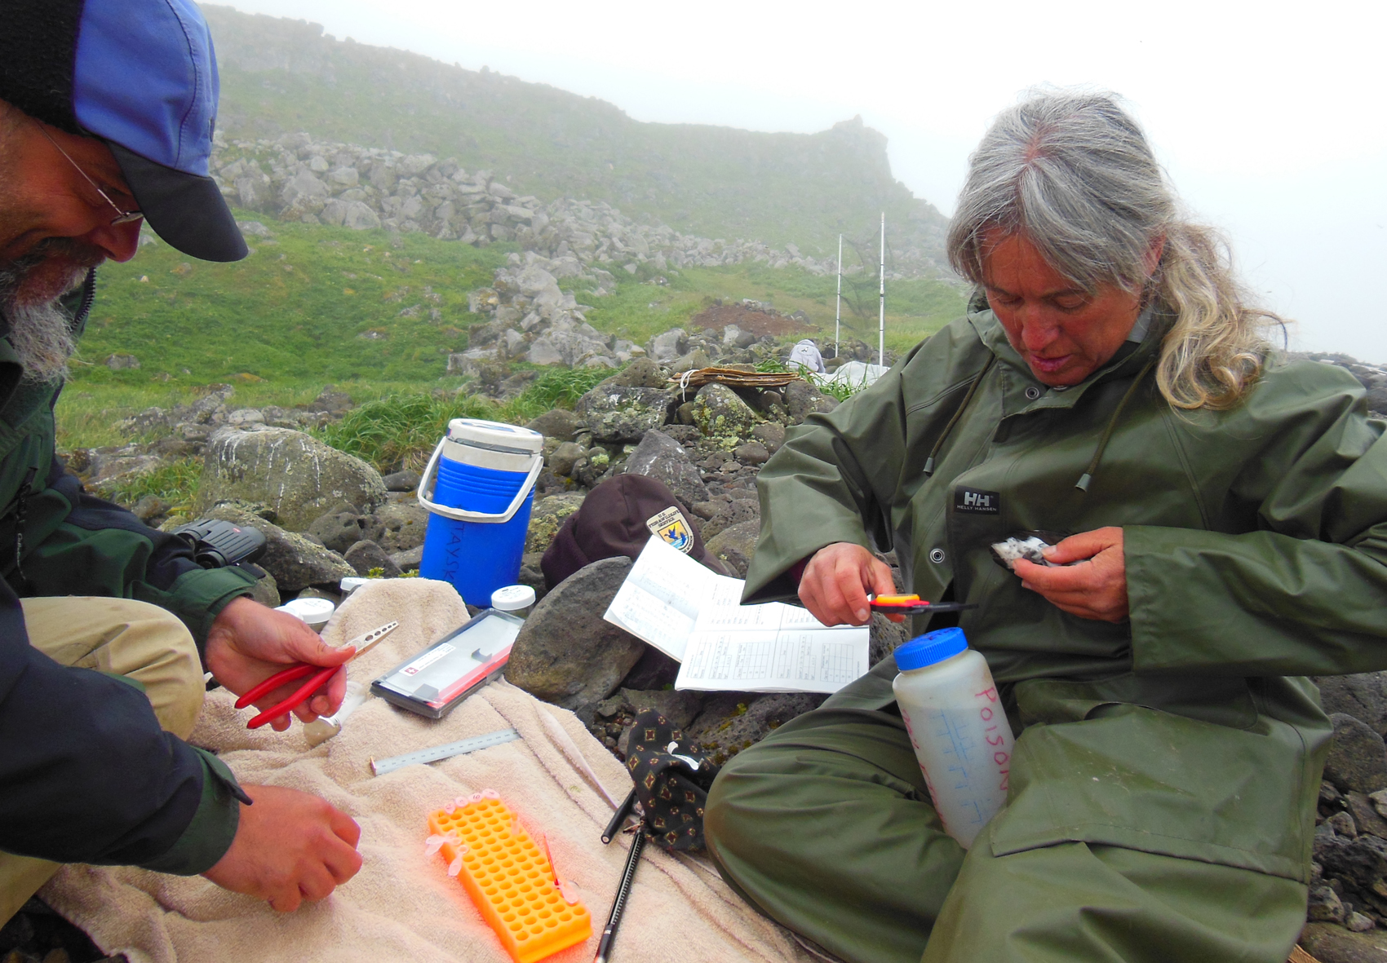
© Ram Papish
Notes:
This is a photo taken at the Zapadni least auklet colony on St. Paul Island Alaska. Here the scientists are measuring and collecting blood and diet samples from the least auklets collected in the mist net seen in the background. Typically if more than one bird is caught at a time, the scientist will lower the mist net so that other birds are not caught while they are working on the current bird(s).

Slide 10
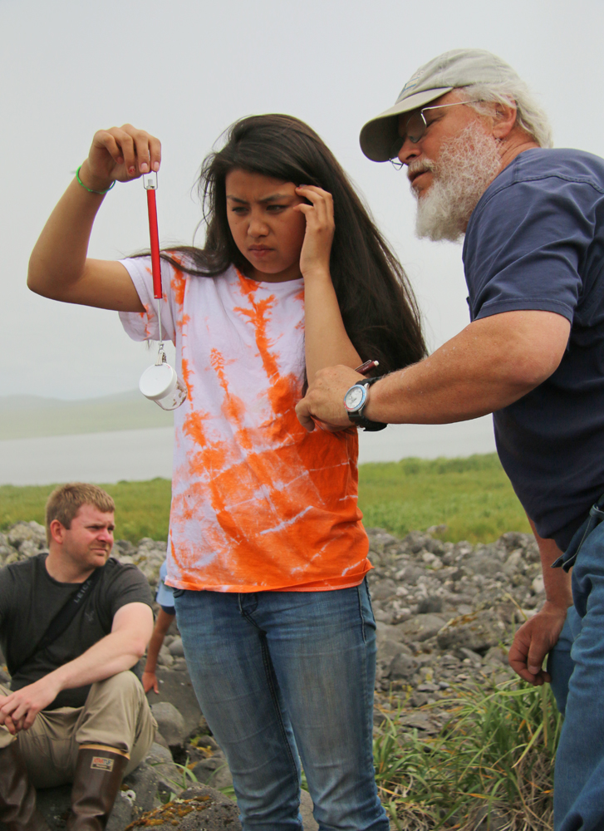
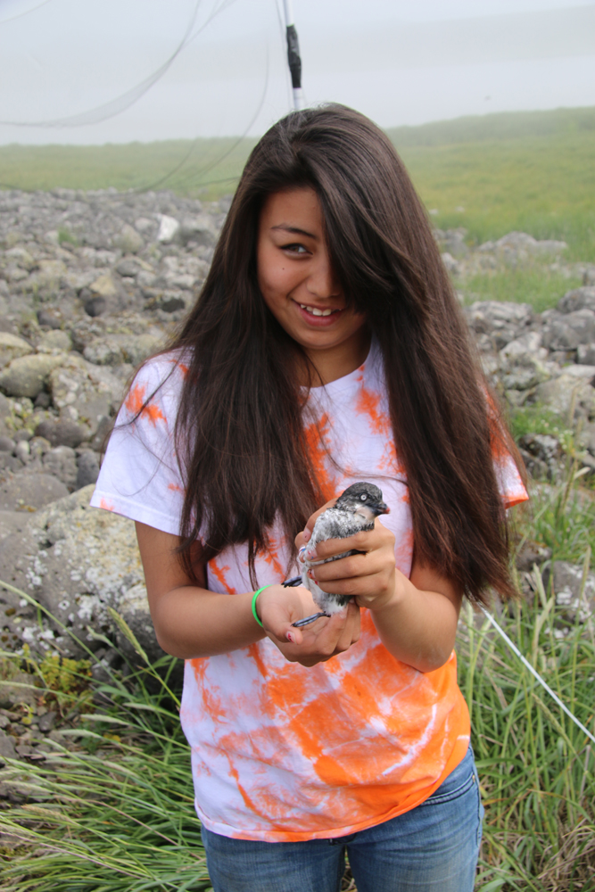
© Ram Papish
© Ram Papish
Notes:
Many Seabird Biologists are interested in teaching the next generation the skills they will need to become seabird biologists. Here, student intern, Diamond is working with the USFWS biologist to measure the mass of a captured least auklet. The bird will then be be released back to the colony. Note that the bird has been placed in a bag to keep it calm and a pesola scale is being used to measure the mass.

Slide 11
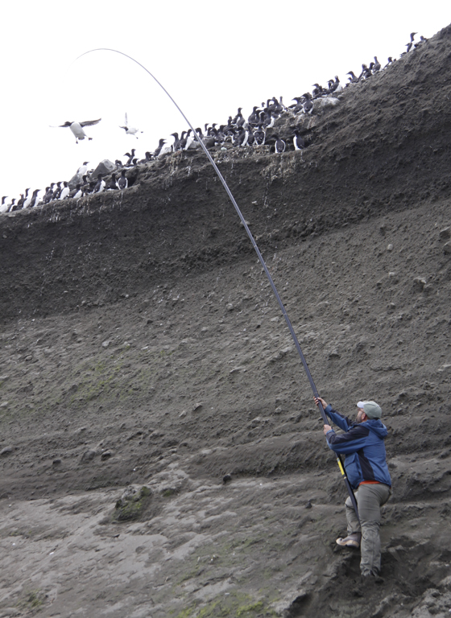
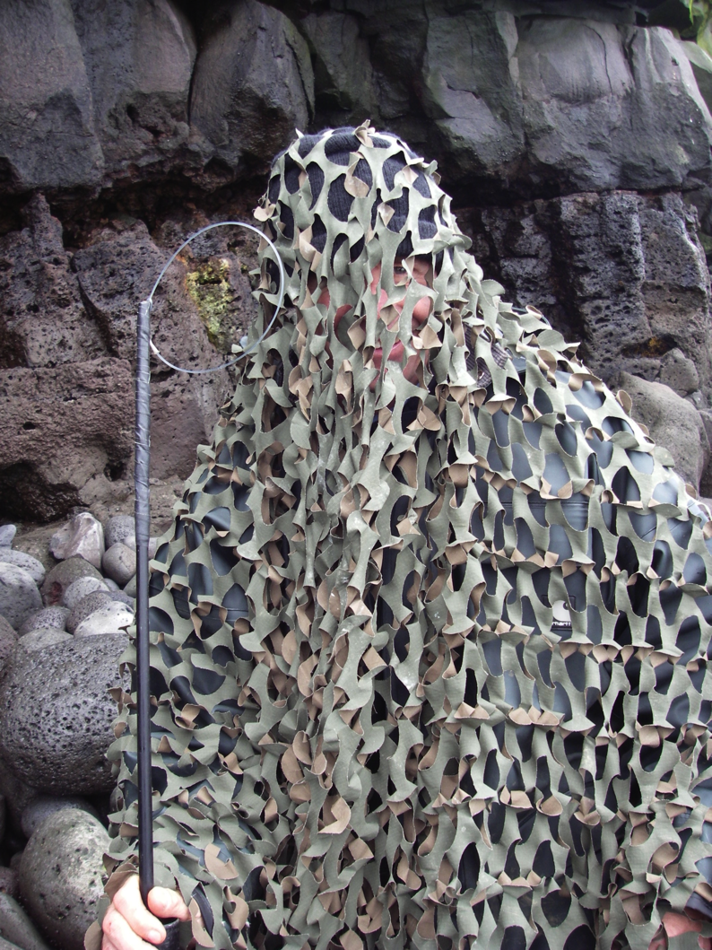
How do we capture Seabirds?... continued
(2) NOOSE-POLE
Often used for species that nest on cliffs e.g., kittiwakes and murres
© Chris Barger
© Tom Hartin
Notes:
Some birds are too large or nest too high for a mist net to be effective, or maybe you need to re-catch a specific individual to retrieve a data-logger. In this case a Noose Pole may be used. This device is modeled after the hangman’s noose and has a telescoping pvc pole that can help reach up to the birds. The process begins with sneaking up on the colony, slowly raising the noose pole to the targeted bird and slipping the noose slowly over their head and back down to the neck. After the noose is on the neck the bird will tighten it as he tries to fly away. A carefully placed knot prevents the noose from over-tightening. The scientist on the pole will guide the bird to another waiting scientist who will capture and calm the bird prior to beginning the sampling process.

Slide 12
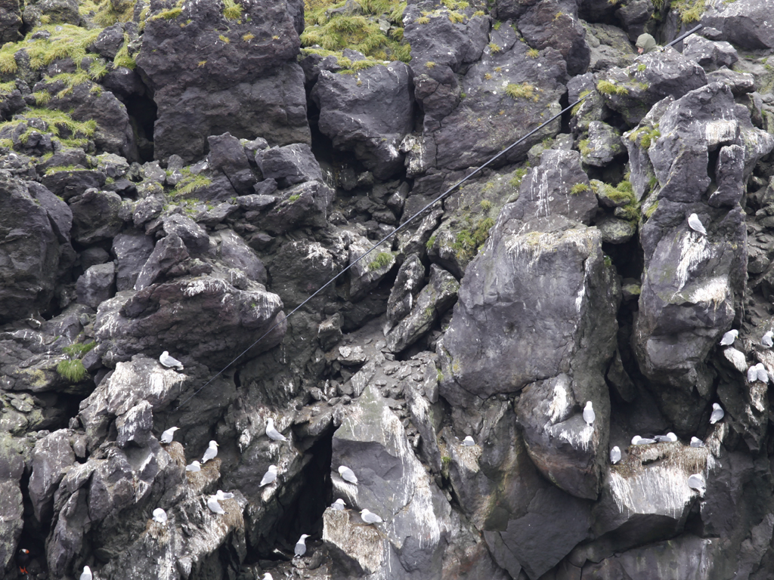
© Ram Papish
Notes:
Sometimes the scientist must capture the bird from above the nest, and gently bring the bird back up the cliff to a waiting partner. Can you see the hidden biologist holding the noose-pole?

Slide 13
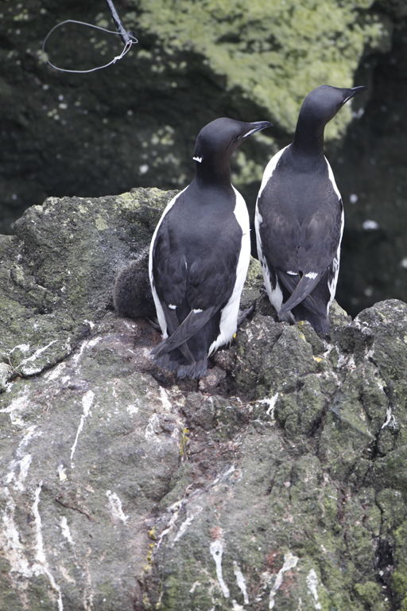
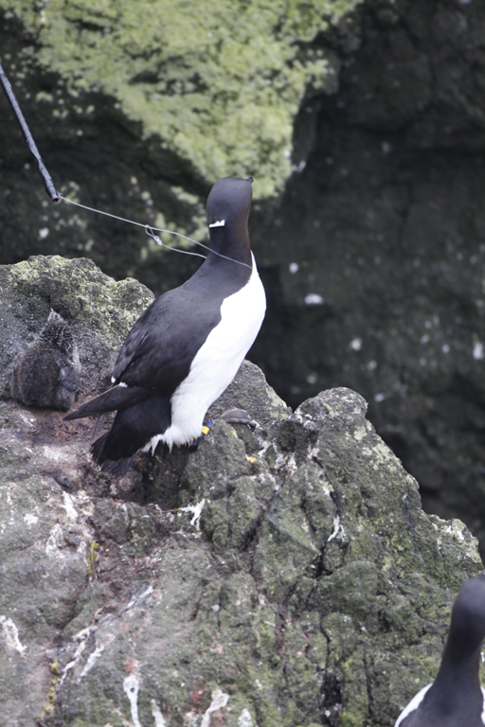
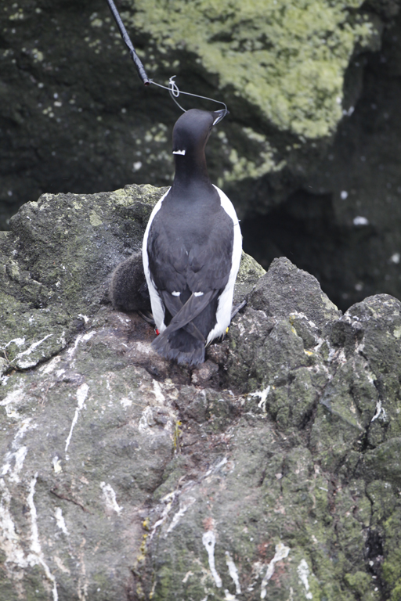
© Ram Papish
© Ram Papish
© Ram Papish
Notes:
Slowly slowly the noose is slipped over the bird’s neck. The noose is made out of a clear thick monofilament line so that the bird does not see it coming.
You can see a glimpse of a yellow band on the bird in the right hand photo.
You can also see a white speck on the back of the bird’s neck. This is white tape that was carefully placed by the biologist to be easily able to identify this individual bird from above. The scientists needed to capture this individual to be able to retrieve a data-logger. The tape will fall off within 48 hrs.

Slide 14
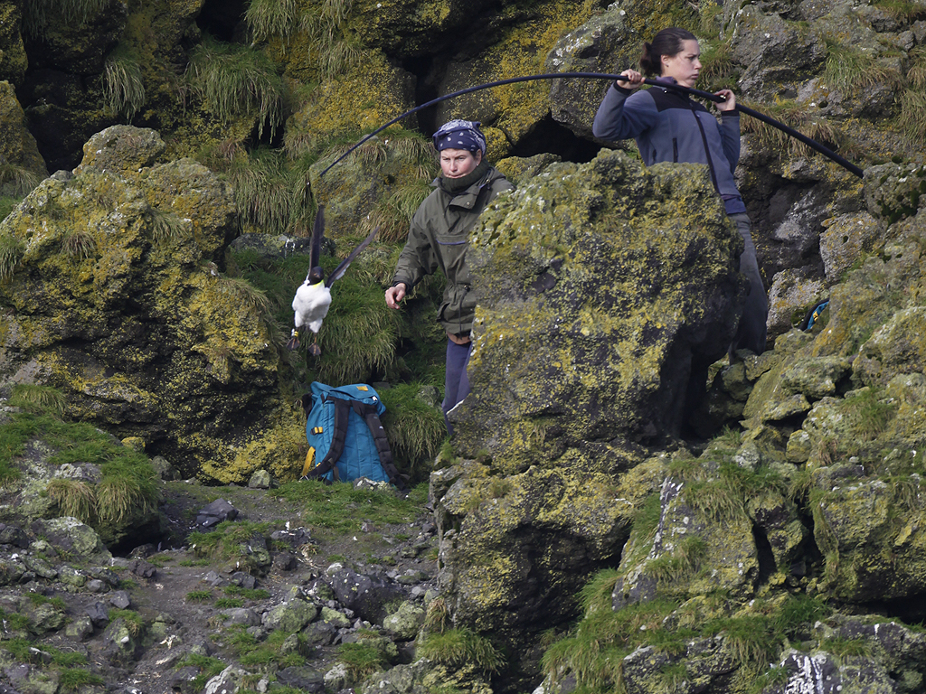
© Ram Papish
Notes:
Notice how heavy the bird (thick-billed murre) is by the bend in the noose pole. After being weighed, measured, and ??? the bird was released unharmed.

Slide 15
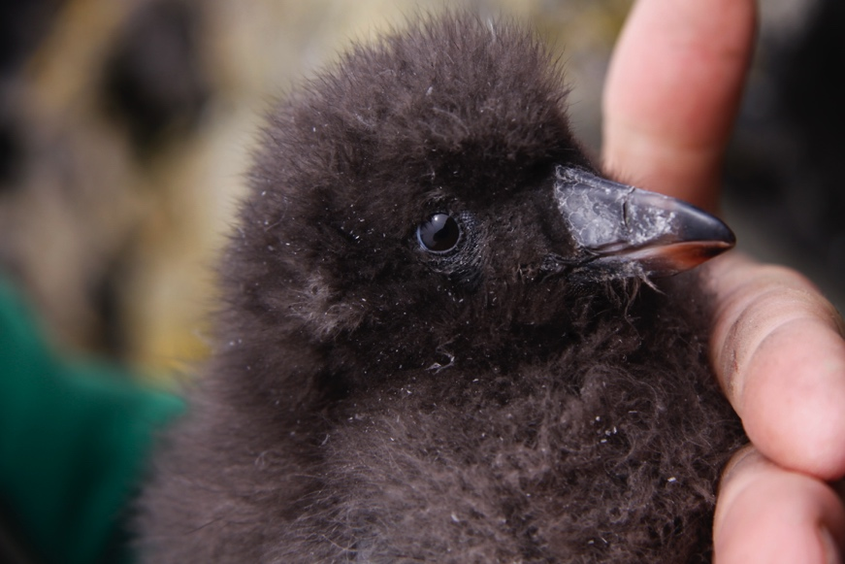
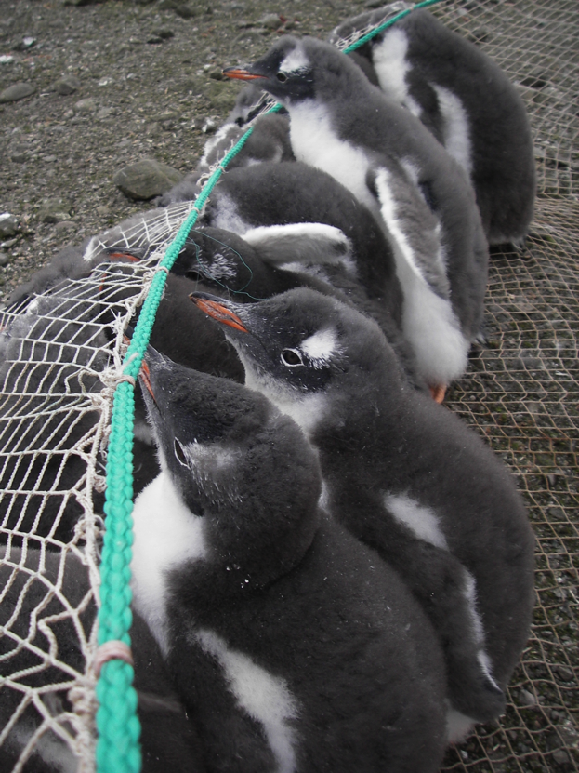
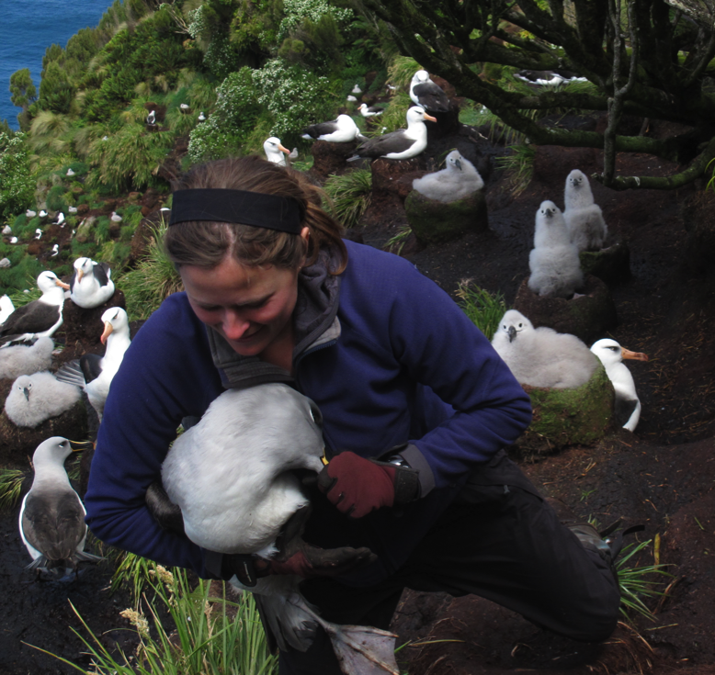
How do we capture Seabirds?... continued
(3) BY-HAND!
Chicks, adults that breed in burrows, and some of the larger species like albatross and penguins are often just caught by hand.
© Ram Papish
tufted puffin Chick
© Rachael Orben
© Rachael Orben
Notes:
A third way to capture birds is by hand. Some birds make their nests in crevices or on open land. This easy access allows for the scientist to carefully sneak up to the nesting site and reach right in to the crevice or open nest to capture the chick or even an adult.

Slide 16
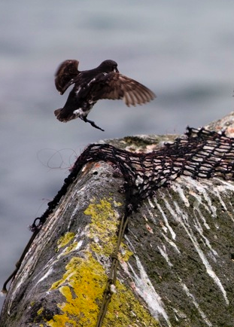
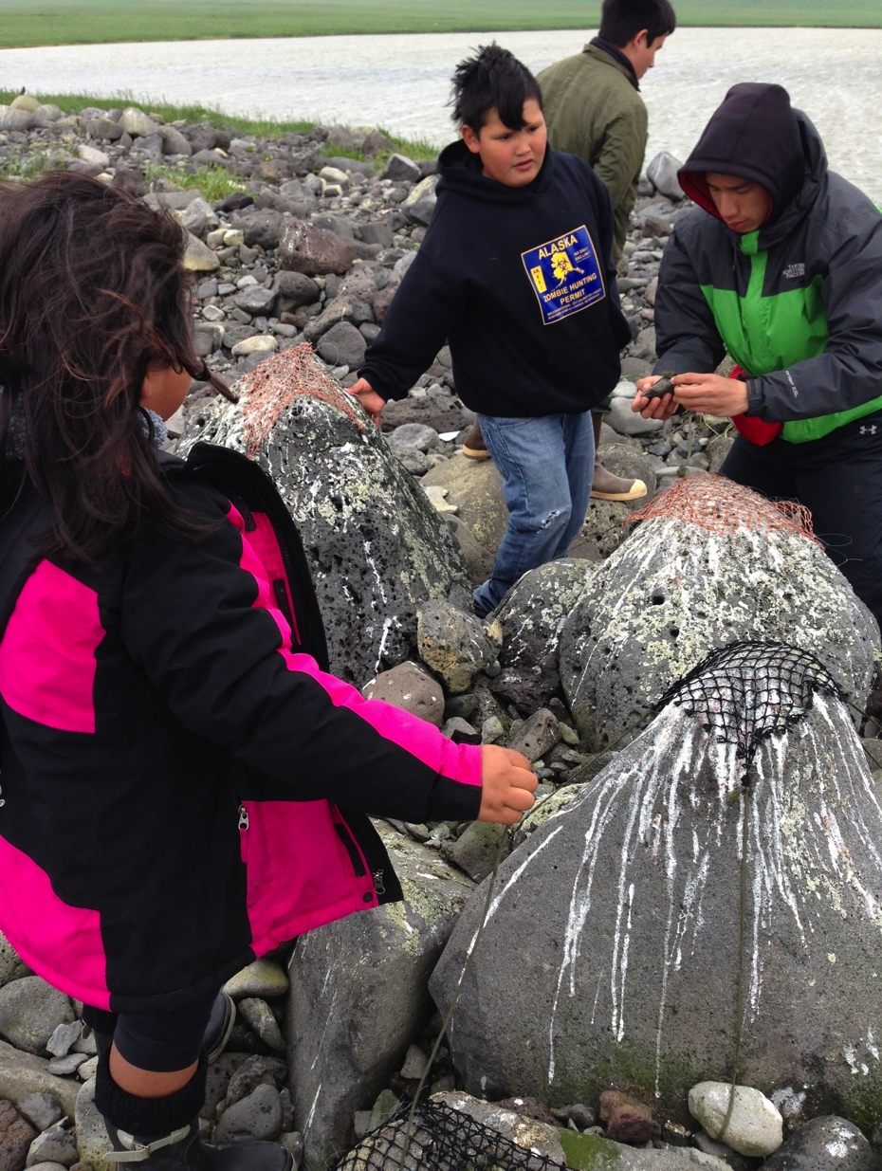
© Ram Papish
(4) NOOSE CARPET
Great for species that spend
social time on rocks, such as
Least auklets. The birds walk
over the rocks and with a little
luck their legs get caught in a noose.
© Ram Papish
Notes:
A fourth way to capture birds is to use a noose carpet. This method us much like the noose pole, but the nooses of fishing line are tied to a piece of fishing net that is firmly attached to land. This noose carpet is then placed on the rocks in a nesting colony area and when the bird lands on a roosting rock, its foot will get caught in the noose and then the scientists can gather it up, take samples, and then release the bird.

Slide 17
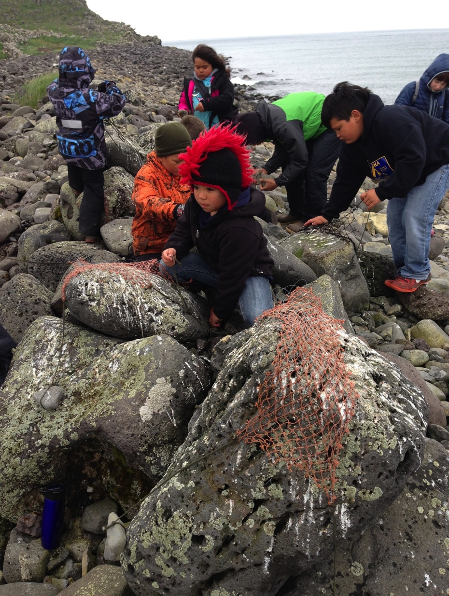
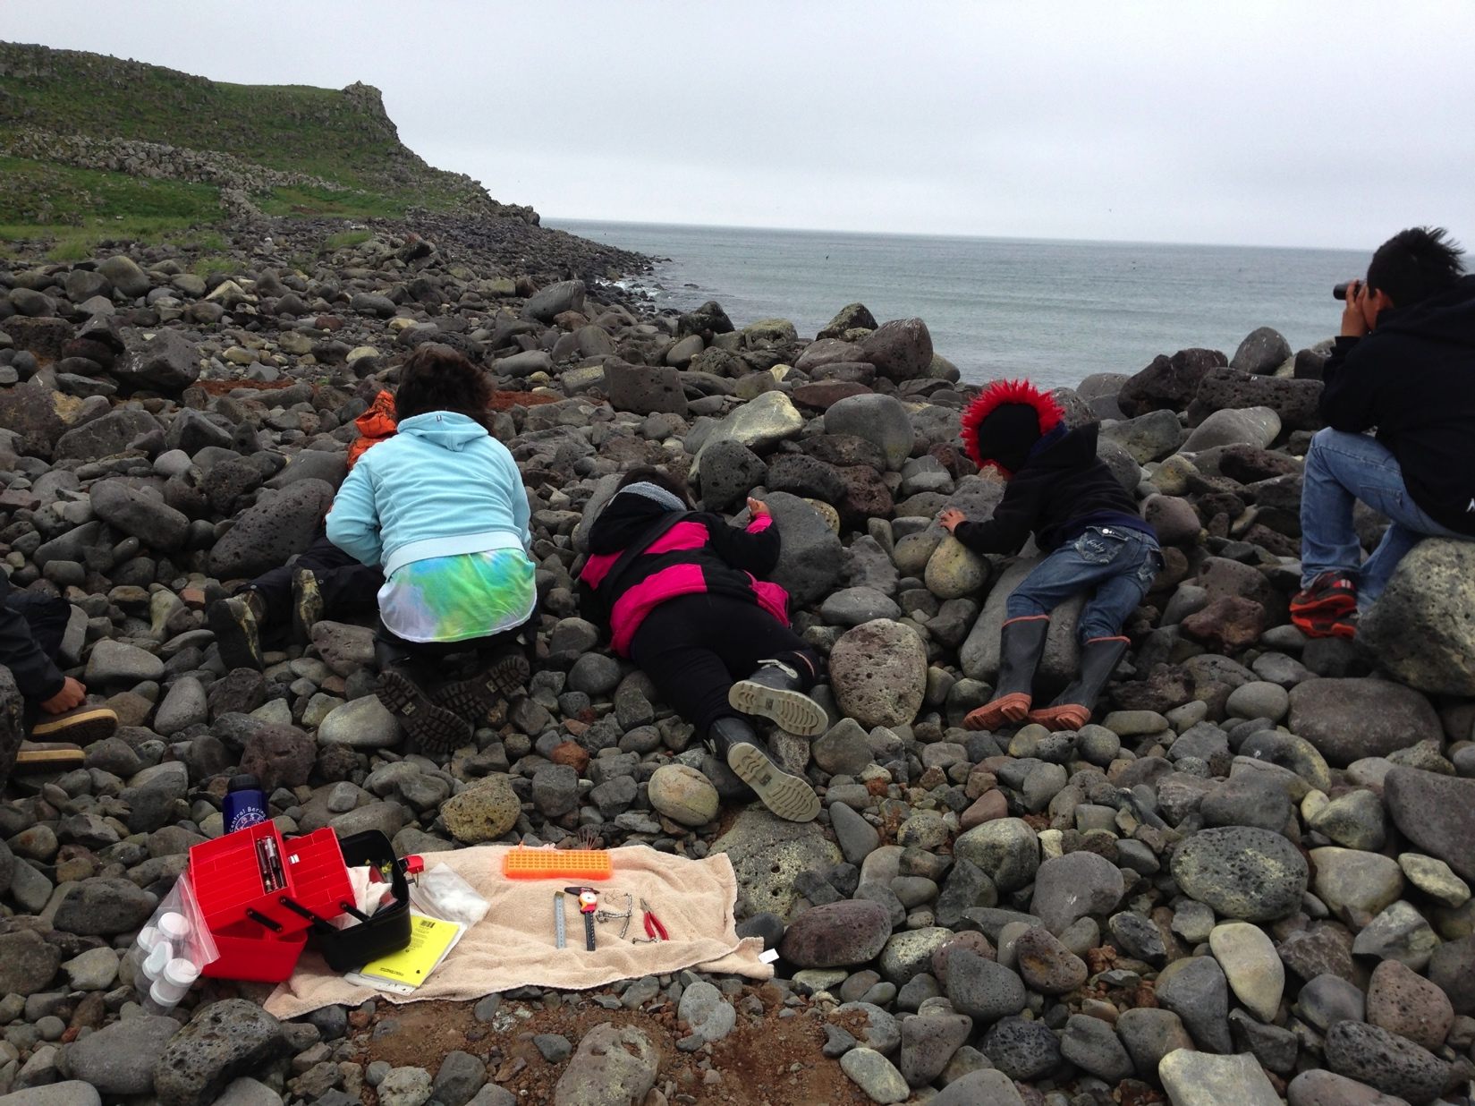
© Ram Papish
© Ram Papish
Notes:
Nets are placed on the rocks with the most guano because that is a sign of a good roosting rock. Notice that the scientist and students are sitting back aways from the nets until a bird is captured. They already have their sampling station set up and ready for a bird.

Slide 18
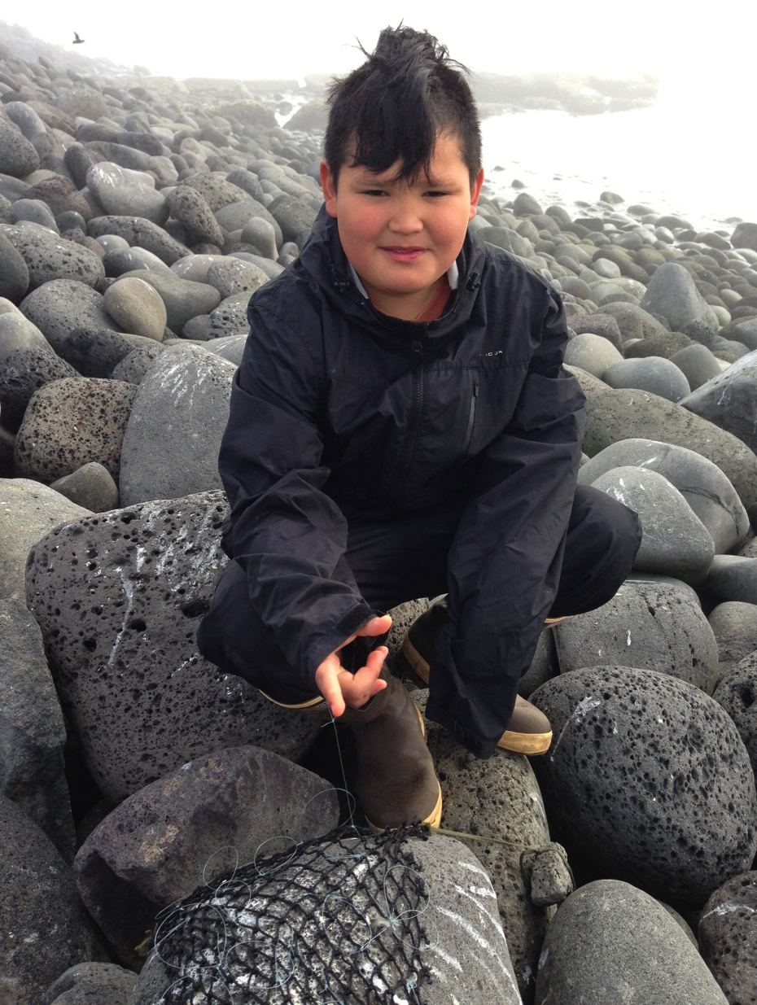
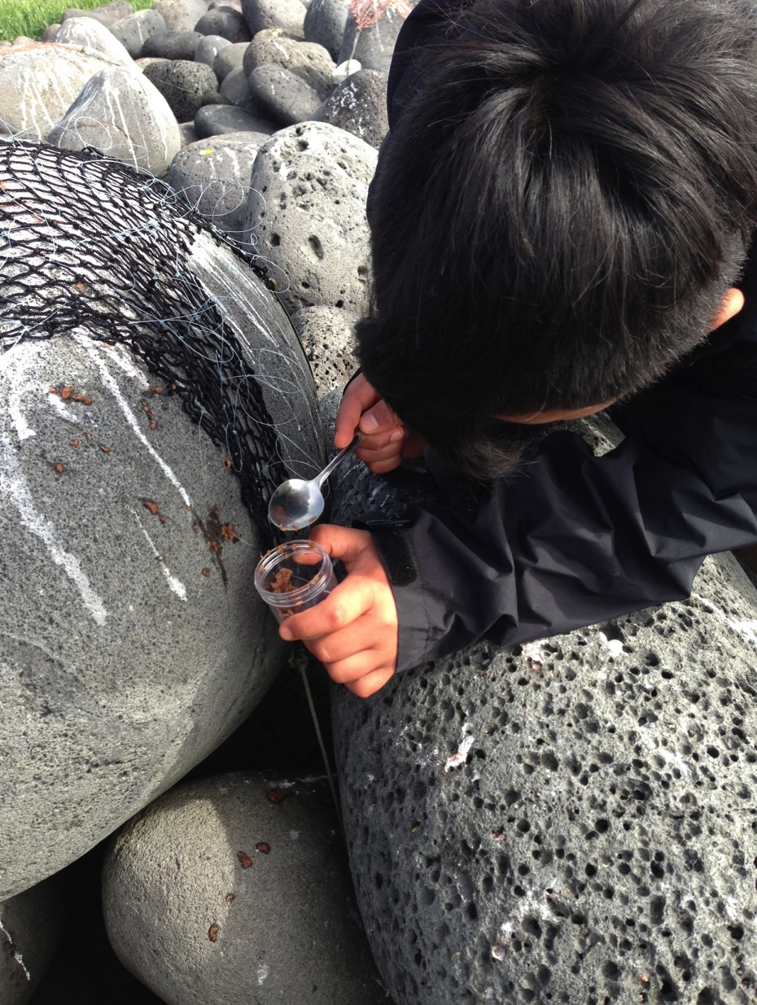
© Ram Papish
© Ram Papish
Notes:
Here a student collects a regurgitation sample from a least auklet that was caught. All zooplankton are carefully collected to be counted and the species identified.

Slide 19
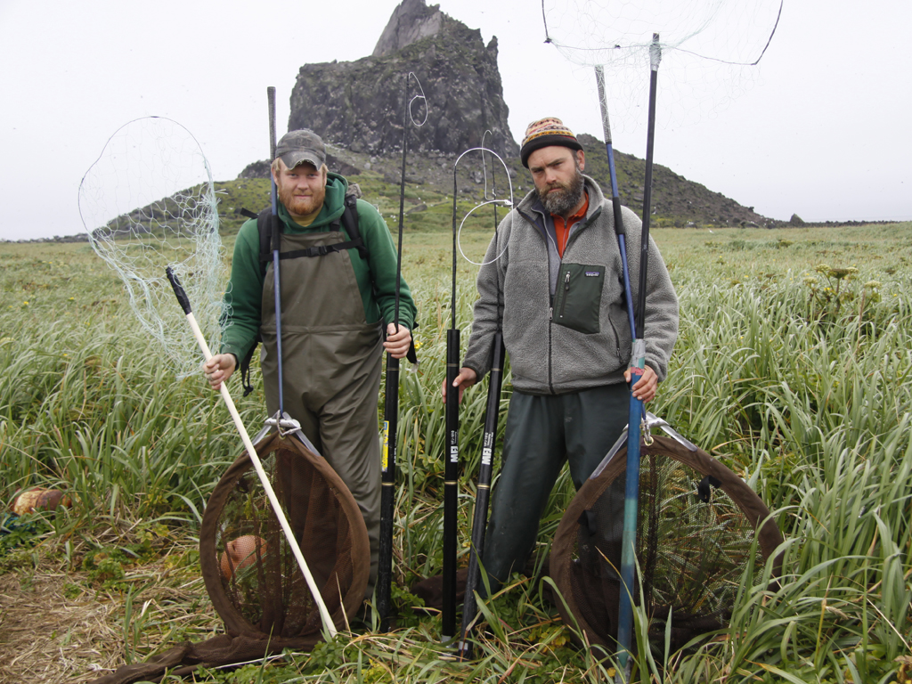
© Alexis Will
Notes:
Scientists must bring all gear they think they may need as it is often a lengthy hike to get to the bird rookeries (where the birds nest).

Slide 20
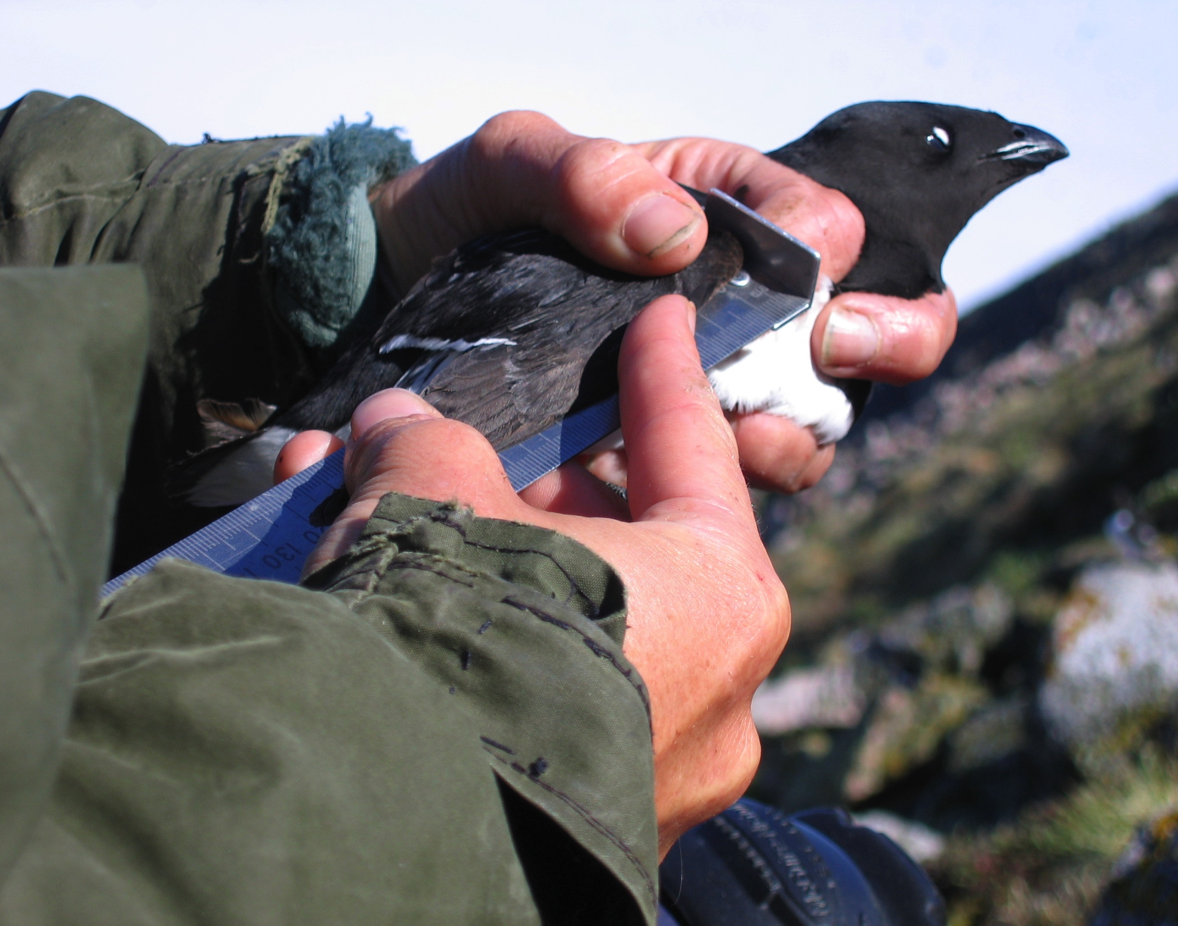
Birds are usually weighed and measured after capture
Notes:
Here a scientist is taking a wing cord measurement. Note the special ruler that the wing is placed against, it has a stopper at one end to help keep the wing stable while measuring.

Slide 21
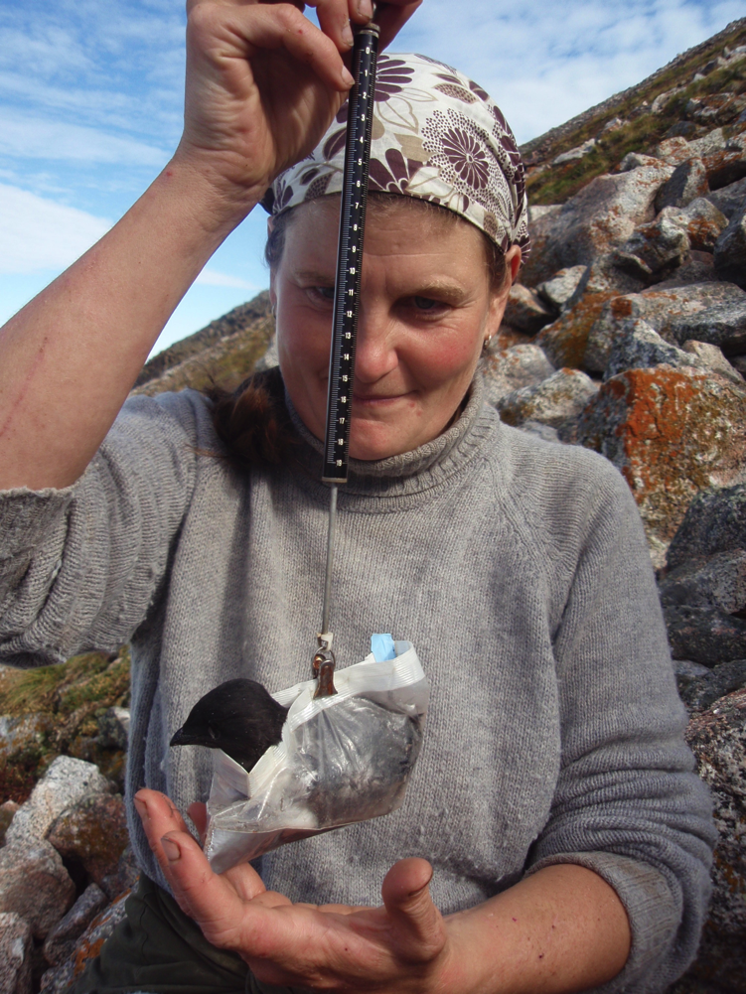
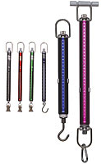
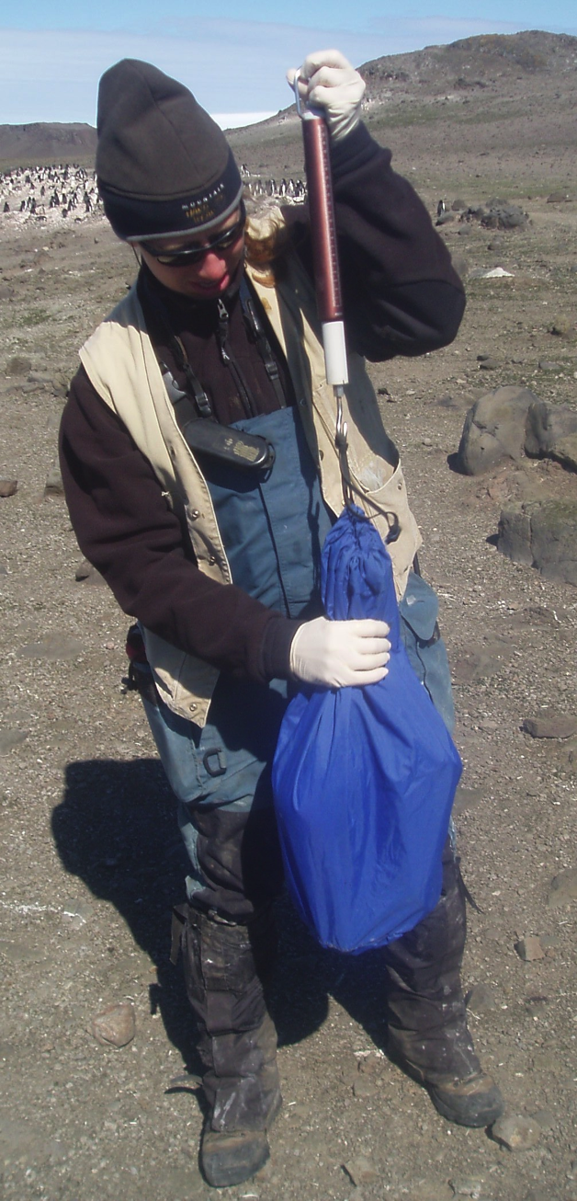
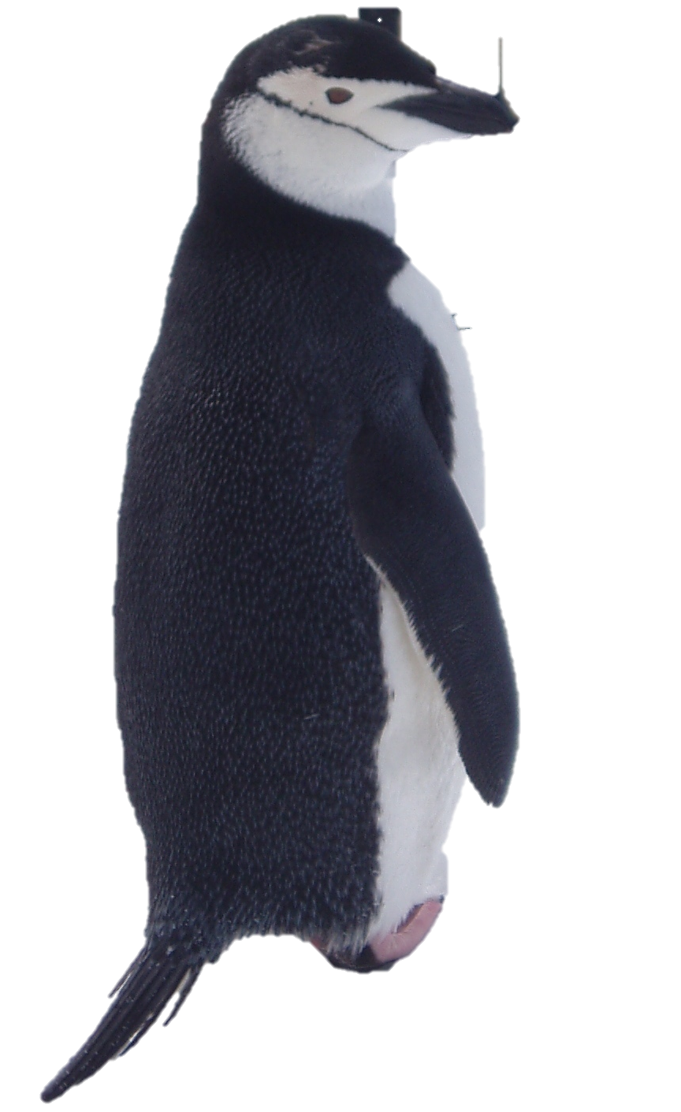
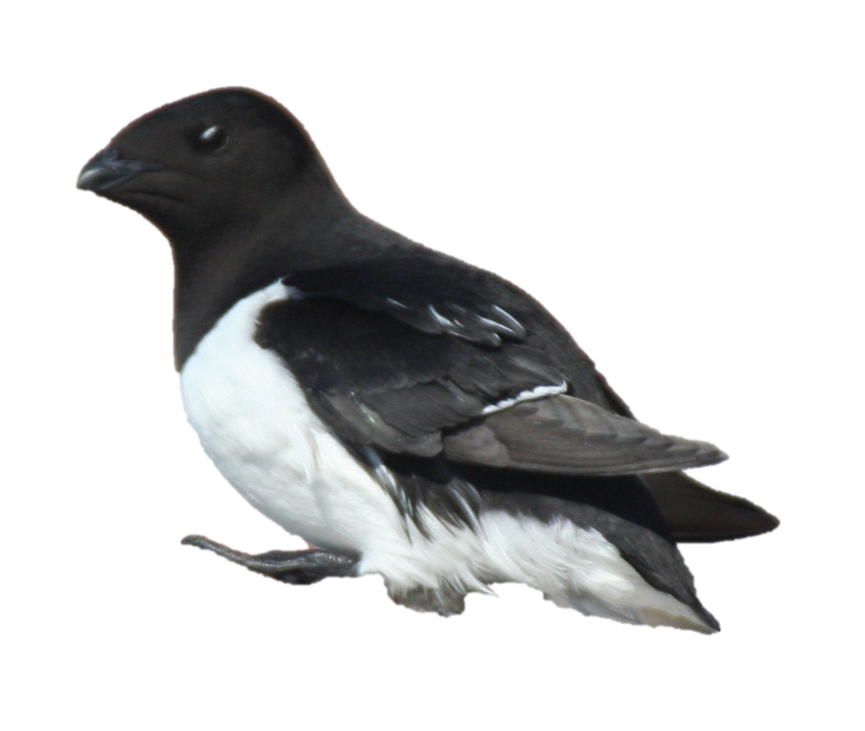
How do you weigh a bird?
Some birds need big bags and large scales
© Rachael Orben
And some much smaller scales!
Pesola spring scales
dovekie:145 g
chinstrap penguin: 2.1 kg
© Elaine Leung
Notes:
Scientists will put the bird into a calming bag, weigh the whole bird and then subtract the weight of the bag to get a true weight (mass). These Pesola scales weigh a bird using the metric system (grams/kilograms), the scale a scientist uses depends on the size of the bird.

Slide 22
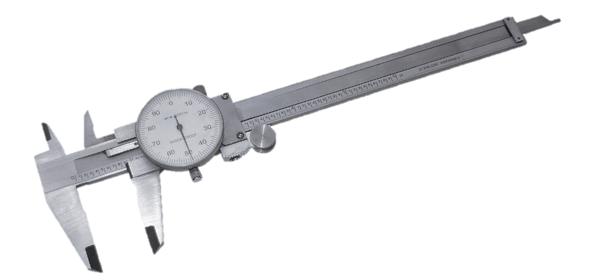
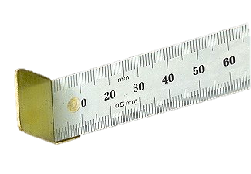
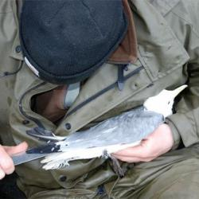
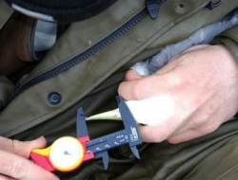
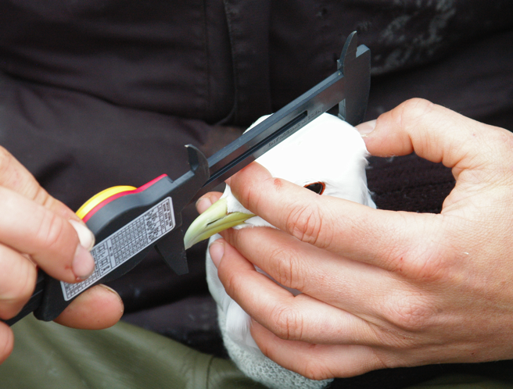
How do you measure a bird?
Calipers are used to measure the leg (tarsus bone), bill, and head
Ruler is used to measure the wing
Notes:
Calipers are a tool used to get an exact measurement of a relatively small item.

Slide 23
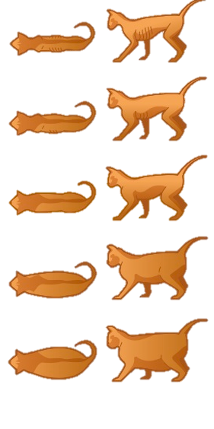
Why do we measure birds?
(1) BODY CONDITION: Measurements can give us idea of how much food the bird is eating or how hard they are having to work to find food
Very Thin
What is body condition?
What two things would you need to know/measure?
Obese
Notes:
Knowing the general body condition of a group of birds can help tell the scientist whether the birds at that colony are doing well or maybe there has not been enough food that season.
Answers:
Body condition is the condition of an animal based on how thin or fat the animal is. You would need to know the weight (mass) of the individual, and some measure of structural size (such as winglength, tarsus (leg-length) or head size). It is important to measure both mass and structural size. Just like humans, birds vary in size: you may have small and thin, small and fat, large and thin, and large and fat individuals.

Slide 24
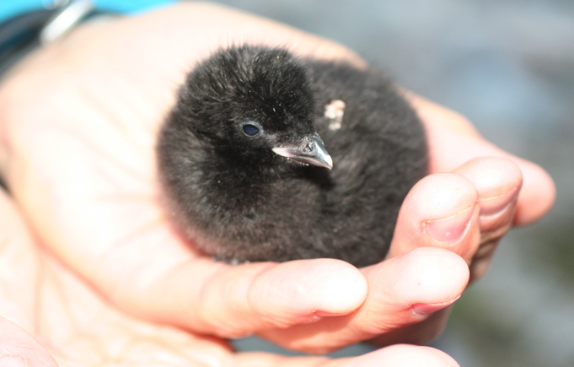
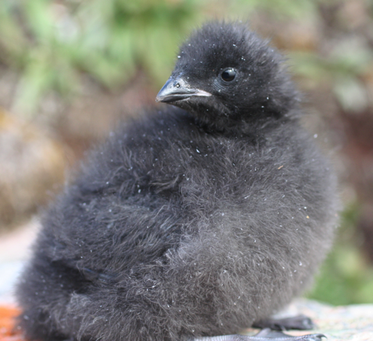
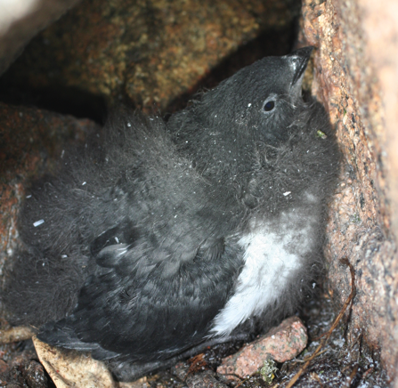
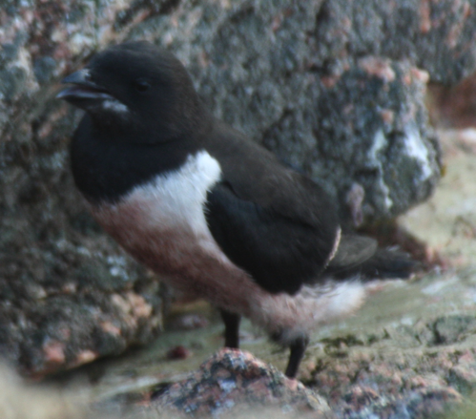
(2) CHICK GROWTH can help tell us how much food the chick is being fed.
Weight gain in grams of dovekie chicks
Notes:
Recording a chick’s weight throughout the breeding season can help tell a biologist whether the parent is finding enough food to raise a healthy chick.

Slide 25
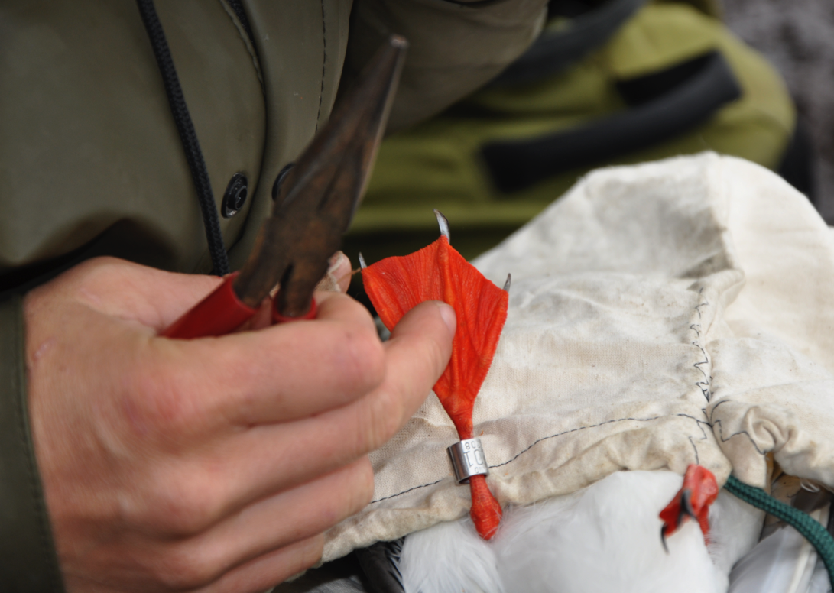


BANDING
After measuring, birds are often banded (or ringed)
Question: What is a band?
Answer: A leg ring that is used to identify the bird. Band are made of metal or plastic.
METAL BANDS
Usually for life-time use.
Different sizes for different species.
Each metal band has a unique number for bird identification, and an address for the band to be sent if found.
© Rachael Orben
Pliers specially designed for closing bands
Notes:
USFWS is the agency (in the USA) in charge of permitting bird banding projects.

Slide 26



COLOR BANDS
Great for identifying a bird at a distance
Each individual gets its own combination
The combinations are read left to right: red over metal, blue over green.
© Rachael Orben
© Thibaut Vergoz
Notes:
Because the metal bands are so hard to see and read the numbers once they are applied, scientists may use a combination of color bands too so that the bird can be resighted from afar. The bands are always “read” in the same sequence therefore the bird’s identity can be established. Example: the band combination Metal over orange (left leg), grey over red (right leg) will always be linked to a unique individual.

Slide 27


WHY DO WE BAND?
Individual Identification!
OBSERVATIONS:
Biologists often watch birds at the colony to record behavior. For example, to find out how often parents feed their chick.
What other behaviors might you be able to observe?
© Alexis Will
© Andrew Trites
Can you find the birds being watched?
Notes:
After color-banding a bird, the scientist will watch the colony over the breeding season to record what the banded birds are doing. By observing known individuals, researchers can record foraging trip lengths, and chick-feeding rates.

Slide 28


Why do we band? Continued…
(2) ANNUAL SURVIVAL: One way to measure how long birds live for is to use color bands and look for these banded birds each year.
(3) AGE: Unlike humans seabirds look the same as they age. So if a bird was banded the year that it fledged when we read the band and look up the record we can calculate age! Seabirds live a long time.
Wisdom: laysan albatross fledged and banded in 1952
How old is she now?
Can you see her band?
© USFWS
© N. Banfield
Notes:
Scientists can also tell annual survival rates and even approximate age if banded as an adult (or exact age if banded as a chick) since most of these banded birds will return to the same colony year after year and can be resighted over a long period of time.
Answer: subtract 1952 from current year to get age.
Her band is the pinkinsh colored part on her right leg.

Slide 29




Many thanks to all the photographers who provided such wonderful images for this presentation.
And, to our funders: The National Park Service, U.S. Fish and Wildlife Service, and the North Pacific Research Board

